Slide 1
第4章 网络层：数据平面
我们了解到网络层涉及到网络中的每一台主机和路由器，因此，网络层协议是协议栈中最具挑战性的协议之一。

Slide 2
application process
application process
AP4
AP₂
AP3
AP₁
application data (presentation formatting and compression)
message = specific headers + manipulated data
5
4
3
2
1
port/socket/endpoint
port
5
4
3
2
1
message segment or user datagram
运输层为相互通信的应用进程提供了逻辑通信
IP 层
Host A
Host B
Router 1
Router 2
AP₁
AP₃
LAN₁
WAN
LAN₂
AP₂
AP₄
Notes:
传输层协议为运行在不同Host上的进程提供了一种逻辑通信机制，之所以叫做逻辑通信，是因为两个进程之间的通信就像所在的两个Host存在直接链接一样。
其实，两个Host可能相距很远，两者的物理连接可能经过了多个交换机/路由器，传输路径可能由不同类型的物理链路组成。
利用这种逻辑通信机制，两个进程可以不用考虑两者之间的物理连接方式而实现发送/接收报文。
传输层协议在Host中实现，交换机/路由器中没有传输层。
发送方：将应用递交的报文分成一个或多个的Segment，并向下传给网络层。
接收方：将接收到的segment组装成报文，并向上交给应用层。

Slide 3
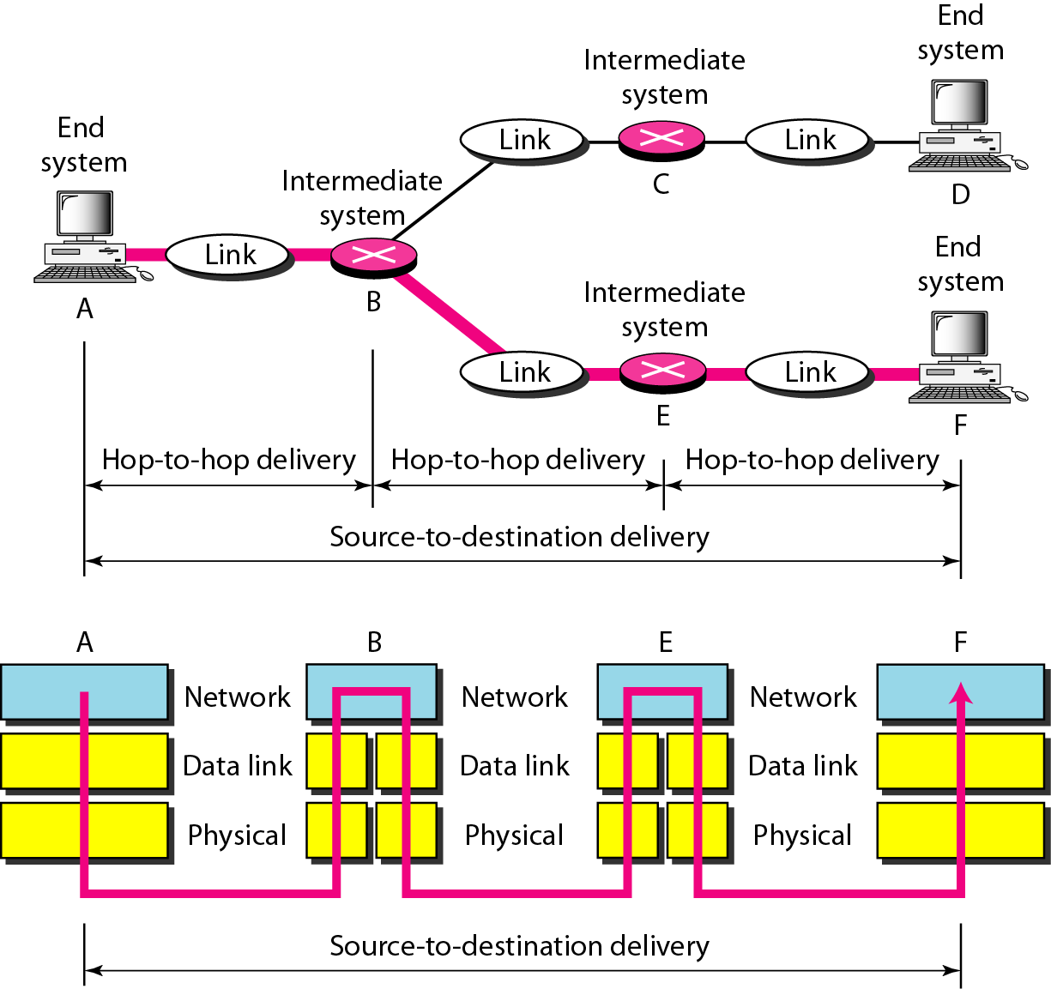
How to achieve source-to-destination delivery

Slide 4
How to implement internetworking
Application
Application
Transport
Transport
Network
Network
Network
Network
Data Link
Data Link
Data Link
Data Link
Physical
Physical
Physical
Physical
Radio
Medium

Slide 5
本章目的
understand principles behind network layer services, focusing on data plane:
network layer service models
forwarding versus routing
how a router works
generalized forwarding
instantiation, implementation in the Internet
Notes:
We learned in the previous chapter that the transport layer provides various forms of process-to-process communication by relying on the network layer’s host-to-host communication service.
We also learned that the transport layer does so without any knowledge about how the network layer actually implements this service.
So perhaps you’re now wondering, what’s under the hood of the host-to-host communication service, what makes it tick?
In this chapter, we’ll learn exactly how the network layer implements the host-to-host communication service.
We’ll see that unlike the transport and application layers, there is a piece of the network layer in each and every host and router in the network.
Because of this, network-layer protocols are among the most challenging (and therefore among the most interesting!) in the protocol stack.
Since the network layer is arguably the most complex layer in the protocol stack, we’ll have a lot of
ground to cover here.
Indeed, there is so much to cover that we cover the network layer in two chapters.
We’ll see that the network layer can be decomposed into two interacting parts, the data plane and the control plane.
In Chapter 4, we’ll first cover the data plane functions of the network layer — the per-router functions in the network layer that determine how a datagram (that is, a network-layer packet)
arriving on one of a router’s input links is forwarded to one of that router’s output links.
We’ll cover both traditional IP forwarding (where forwarding is based on a datagram’s destination address) and generalized forwarding (where forwarding and other functions may be performed using values in several different fields in the datagram’s header).
We’ll study the IPv4 and IPv6 protocols and addressing in detail.
In Chapter 5, we’ll cover the control plane functions of the network layer — the network-wide logic
that controls how a datagram is routed among routers along an end-to-end path from the source host to the destination host.
We’ll cover routing algorithms, as well as routing protocols, such as OSPF and BGP, that are in widespread use in today’s Internet.
Traditionally, these control-plane routing protocols and data-plane forwarding functions have been implemented together, monolithically, within a router.
Software-defined networking (SDN) explicitly separates the data plane and control plane by implementing these control plane functions as a separate service, typically in a remote “controller.”
We’ll also cover SDN controllers in Chapter 5.
This distinction between data-plane and control-plane functions in the network layer is an important concept to keep in mind as you learn about the network layer — it will help structure your thinking about the network layer and reflects a modern view of the network layer’s role in computer networking.

Slide 6
第4章 网络层: 数据平面
4.1 网络层概述
转发和路由选择: 数据平面和控制平面
网络服务模型
4.2 路由器工作原理
输入端口处理和基于目的地转发
交换
输出端口处理
何处出现排队
分组调度
4.4 网际协议: IPv4、寻址、IPv6及其它
IPv4 数据报格式
IPv4 数据报分片
IPv4 编址
网络地址转换
IPv6
4.5 通用转发和SDN
匹配
动作
匹配加动作操作中的OpenFlow例子
4.8 小结

Slide 7
















网络层
transport datagram from sending to receiving host
on sending side encapsulates segments into datagrams
on receiving side, delivers segments to transport layer
network layer protocols in every host, router
router examines header fields in all IP datagrams passing through it
application
transport
network
data link
physical
network
data link
physical
network
data link
physical
network
data link
physical
network
data link
physical
network
data link
physical
network
data link
physical
network
data link
physical
network
data link
physical
network
data link
physical
application
transport
network
data link
physical
network
data link
physical
network
data link
physical
Notes:
Figure 4.1 shows a simple network with two hosts, H1 and H2, and several routers on the path between H1 and H2.
Suppose that H1 is sending information to H2, and consider the role of the network layer in these hosts and in the intervening routers.
The network layer in H1 takes segments from the transport layer in H1, encapsulates each segment into a datagram (that is, a network-layer packet), and then sends the datagrams to its nearby router, R1.
At the receiving host, H2, the network layer receives the datagrams from its nearby router R2, extracts the transport-layer segments, and delivers the segments up to the transport layer at H2.
The primary role of the routers is to forward datagrams from input links to output links.
Note that the routers in Figure 4.1 are shown with a truncated protocol stack, that is, with no upper layers above the network layer, because (except for control purposes) routers do not run application- and transport-layer protocols such as those we examined in Chapters 2 and 3.

Slide 8
第4章 网络层: 数据平面
4.1 网络层概述
转发和路由选择: 数据平面和控制平面
网络服务模型
4.2 路由器工作原理
输入端口处理和基于目的地转发
交换
输出端口处理
何处出现排队
分组调度
4.4 网际协议: IPv4、寻址、IPv6及其它
IPv4 数据报格式
IPv4 数据报分片
IPv4 编址
网络地址转换
IPv6
4.5 通用转发和SDN
匹配
动作
匹配加动作操作中的OpenFlow例子
4.8 小结

Slide 9
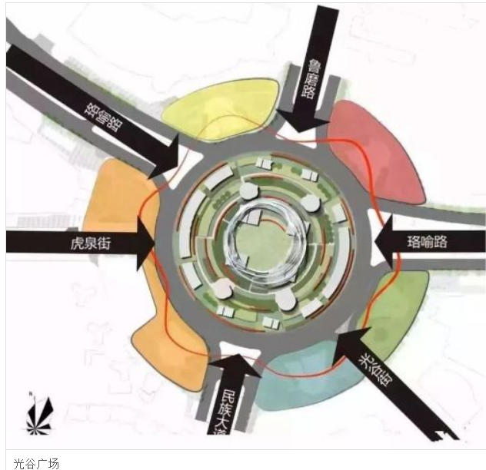
两种重要的网络层功能
网络层功能:
转发: 当一个分组到达某路由器的输入链路时，该路由器必须将该分组移动到适当的输出链路。
路由: 当分组发送方流向接收方时，网络层必须确定这些分组时所采取的路由或路径。
路由算法
类比: taking a trip
forwarding: process of getting through single interchange
routing: process of planning trip from source to destination
Notes:
The role of the network layer is thus deceptively simple — to move packets from a sending host to a receiving host.
To do so, two important network-layer functions can be identified:
• Forwarding. When a packet arrives at a router’s input link, the router must move the packet to the appropriate output link.
For example, a packet arriving from Host H1 to Router R1 must be forwarded to the next router on a path to H2.
In Section 4.3, we’ll look inside a router and examine how a packet is actually forwarded from an input link to an output link within a router.
• Routing. The network layer must determine the route or path taken by packets as they flow from a sender to a receiver.
The algorithms that calculate these paths are referred to as routing algorithms.
A routing algorithm would determine, for example, the path along which packets flow from H1 to H2.
The terms forwarding and routing are often used interchangeably by authors discussing the network layer.
We’ll use these terms much more precisely in this book.
Forwarding refers to the router-local action of transferring a packet from an input link interface to the appropriate output link interface.
Routing refers to the network-wide process that determines the end-to-end paths that packets take from source to destination.
Using a driving analogy, consider the trip from Pennsylvania to Florida undertaken by our traveler back in Section 1.3.1.
During this trip, our driver passes through many interchanges en route to Florida.
We can think of forwarding as the process of getting through a single interchange: A car enters the interchange from one road and determines which road it should take to leave the interchange.
We can think of routing as the process of planning the trip from Pennsylvania to Florida:
Before embarking on the trip, the driver has consulted a map and chosen one of many paths possible, with each path consisting of a series of road segments connected at interchanges.

Slide 10
路由和转发之间的相互作用
选路算法
本地转发表
首部值
输出链路
0100
0101
0111
1001
3
2
2
1
到达分组的首部值
0111
1
3
2
Notes:
A key element in every network router is its forwarding table.
A router forwards a packet by examining the value of one or more fields in the arriving packet’s header, and then using these header values to index into its forwarding table.
The value stored in the forwarding table entry for those values indicates the outgoing link interface at that router to which that packet is to be forwarded.
For example, in Figure 4.2, a packet with header field value of 0110 arrives to a router.
The router indexes into its forwarding table and determines that the output link interface for this packet is interface 2.
The router then internally forwards the packet to interface 2.
In Section 4.2, we’ll look inside a router and examine the forwarding function in much greater detail.
Forwarding is the key function performed by the data-plane functionality of the network layer.

Slide 11
网络层: 数据平面和控制平面
数据平面
local, per-router function
determines how datagram arriving on router input port is forwarded to router output port
forwarding function
控制平面
network-wide logic
determines how datagram is routed among routers along end-end path from source host to destination host
2种控制平面的方法:
传统的路由算法: 在路由器实现
软件定义网络(SDN): 在(远程)一个或多个服务器中实现
values in arriving
packet header
0111
1
3
2
Notes:
A key element in every network router is its forwarding table.
A router forwards a packet by examining the value of one or more fields in the arriving packet’s header, and then using these header values to index into its forwarding table.
The value stored in the forwarding table entry for those values indicates the outgoing link interface at that router to which that packet is to be forwarded.
For example, in Figure 4.2, a packet with header field value of 0110 arrives to a router.
The router indexes into its forwarding table and determines that the output link interface for this packet is interface 2.
The router then internally forwards the packet to interface 2.
In Section 4.2, we’ll look inside a router and examine the forwarding function in much greater detail.
Forwarding is the key function performed by the data-plane functionality of the network layer.

Slide 12

每路由器的控制平面
每个路由器具备独立的路由功能和数据转发功能，路由算法组件分布在不同路由器上，彼此交互，计算生成转发表，构成分布式的控制平面。
Routing
Algorithm
控制平面
数据平面
values in arriving
packet header
0111
1
3
2
Notes:
Control Plane: The Traditional Approach
But now you are undoubtedly wondering how a router’s forwarding tables are configured in the first place.
This is a crucial issue, one that exposes the important interplay between forwarding (in data plane) and routing (in control plane).
As shown in Figure 4.2, the routing algorithm determines the contents of the routers’ forwarding tables.
In this example, a routing algorithm runs in each and every router and both forwarding and routing functions are contained within a router.
As we’ll see in Sections 5.3 and 5.4, the routing algorithm function in one router communicates with the routing algorithm function in other routers to compute the values for its forwarding table.
How is this communication performed?
By exchanging routing messages containing routing information according to a routing protocol!
We’ll cover routing algorithms and protocols in Sections 5.2 through 5.4.
The distinct and different purposes of the forwarding and routing functions can be further illustrated by considering the hypothetical (and unrealistic, but technically feasible) case of a network in which all forwarding tables are configured directly by human network operators physically present at the routers.
In this case, no routing protocols would be required!
Of course, the human operators would need to interact with each other to ensure that the forwarding tables were configured in such a way that packets reached their intended destinations.
It’s also likely that human configuration would be more error-prone and much slower to respond to changes in the network topology than a routing protocol.
We’re thus fortunate that all networks have both a forwarding and a routing function!

Slide 13
逻辑集中控制平面
路由控制功能从本地路由器分离，汇聚到远程控制器，与路由器中的本地控制代理(CAs)进行交互，以计算并分发转发表。
远程控制器
控制平面
控制平面
CA
CA
CA
CA
CA
values in arriving
packet header
0111
1
3
2
Notes:
Control Plane: The SDN Approach
The approach to implementing routing functionality shown in Figure 4.2 — with each router having a routing component that communicates with the routing component of other routers — has been the traditional approach adopted by routing vendors in their products, at least until recently.
Our observation that humans could manually configure forwarding tables does suggest, however, that there may be other ways for control-plane functionality to determine the contents of the data-plane forwarding tables.
Figure 4.3 shows an alternate approach in which a physically separate (from the routers), remote controller computes and distributes the forwarding tables to be used by each and every router.
Note that the data plane components of Figures 4.2 and 4.3 are identical.
In Figure 4.3, however, control-plane routing functionality is separated from the physical router — the routing device performs forwarding only, while the remote controller computes and distributes forwarding tables.
The remote controller might be implemented in a remote data center with high reliability and redundancy, and might be managed by the ISP or some third party.
How might the routers and the remote controller communicate?
By exchanging messages containing forwarding tables and other pieces of routing information.
The control-plane approach shown in Figure 4.3 is at the heart of software-defined networking (SDN), where the network is “software-defined” because the controller that computes forwarding tables and interacts with routers is implemented in software.
Increasingly, these software implementations are also open, i.e., similar to Linux OS code, the code is publically available, allowing ISPs (and networking researchers and students!) to innovate and propose changes to the software that controls network-layer functionality.
We will cover the SDN control plane in Section 5.5.

Slide 14
第4章 网络层: 数据平面
4.1 网络层概述
转发和路由选择: 数据平面和控制平面
网络服务模型
4.2 路由器工作原理
输入端口处理和基于目的地转发
交换
输出端口处理
何处出现排队
分组调度
4.4 网际协议: IPv4、寻址、IPv6及其它
IPv4 数据报格式
IPv4 数据报分片
IPv4 编址
网络地址转换
IPv6
4.5 通用转发和SDN
匹配
动作
匹配加动作操作中的OpenFlow例子
4.8 小结

Slide 15
网络服务模型
Q: 将数据报从发送方传输到接收方的“信道”提供什么服务模型?
A：这些服务可能包括：
单个数据报服务的例子:
确保交付
具有时延上界(小于40 msec延迟)的确保交付
一个数据报流服务的例子:
有序分组交付
确保最小带宽
确保最大时延抖动
Notes:
Before delving into the network layer, let’s take the broader view and consider the different types of service that might be offered by the network layer.
When the transport layer at a sending host transmits a packet into the network (that is, passes it down to the network layer at the sending host), can the transport layer rely on the network layer to deliver the packet to the destination?
When multiple packets are sent, will they be delivered to the transport layer in the receiving host in the order in which they were sent?
Will the amount of time between the sending of two sequential packet transmissions be the same as the amount of time between their reception?
Will the network provide any feedback about congestion in the network?
What is the abstract view (properties) of the channel connecting the transport layer in the sending and receiving hosts?
The answers to these questions and others are determined by the service model provided by the network layer.
The network service model defines the characteristics of end-to-end transport of packets between sending and receiving end systems.
Let’s now consider some possible services that the network layer could provide.
In the sending host, when the transport layer passes a packet to the network layer, specific services that could be provided by the network layer include:
• Guaranteed delivery.
This service guarantees that the packet will eventually arrive at its destination.
• Guaranteed delivery with bounded delay.
This service not only guarantees delivery of the packet, but delivery within a specified host-to-host delay bound (for example, within 100 msec).
Furthermore, the following services could be provided to a flow of packets between a given source and destination:
• In-order packet delivery.
This service guarantees that packets arrive at the destination in the order that they were sent.
• Guaranteed minimal bandwidth.
This network-layer service emulates the behavior of a transmission link of a specified bit rate (for example, 1 Mbps) between sending and receiving hosts.
As long as the sending host transmits bits (as part of packets) at a rate below the specified bit rate, then all packets are eventually delivered to the destination host.
• Guaranteed maximum jitter.
This service guarantees that the amount of time between the transmission of two successive packets at the sender is equal to the amount of time between their receipt at the destination (or that this spacing changes by no more than some specified value).
• Security services.
The network layer could encrypt all datagrams at the source and decrypt them at the destination, thereby providing confidentiality to all transport-layer segments..
This is only a partial list of services that a network layer could provide — there are countless variations possible.

Slide 16
网络服务模型
几种实际使用的网络层服务模型
网络体系结构 服务模型 带宽保证 无丢失保证 排序 定时 拥塞指示
互联网 尽力而为 无 无 无 不维持 无
ATM CBR 保证恒定速率 是 有序 维持 无拥塞
ATM ABR 保证最小速率 无 有序 维持 提供指示
Notes:
The Internet’s network layer provides a single service, known as best-effort service.
From Table 4.1, it might appear that best-effort service is a euphemism for no service at all.
With best-effort service, timing between packets is not guaranteed to be preserved, packets are not guaranteed to be received in the order in which they were sent, nor is the eventual delivery of transmitted packets guaranteed.
Given this definition, a network that delivered no packets to the destination would satisfy the definition of best-effort delivery service.
As we’ll discuss shortly, however, there are sound reasons for such a minimalist network-layer service model.
Other network architectures have defined and implemented service models that go beyond the Internet’s best-effort service.
For example, the ATM network architecture [MFAForum 2012, Black 1995] provides for multiple service models, meaning that different connections can be provided with different classes of service within the same network.
A discussion of how an ATM network provides such services is well beyond the scope of this book; our aim here is only to note that alternatives do exist to the Internet’s best-effort model.
Two of the more important ATM service models are constant bit rate and available bit rate service:
• Constant bit rate (CBR) ATM network service. This was the first ATM service model to be standardized, reflecting early interest by the telephone companies in ATM and the suitability of CBR service for carrying real-time, constant bit rate audio and video traffic.
The goal of CBR service is conceptually simple — to provide a flow of packets (known as cells in ATM terminology) with a virtual pipe whose properties are the same as if a dedicated fixed-bandwidth transmission link existed between sending and receiving hosts.
With CBR service, a flow of ATM cells is carried across the network in such a way that a cell’s end-to-end delay, the variability in a cell’s end-to-end delay (that is, the jitter), and the fraction of cells that are lost or delivered late are all guaranteed to be less than specified values.
These values are agreed upon by the sending host and the ATM network when the CBR connection is first established.
• Available bit rate (ABR) ATM network service. With the Internet offering so-called best-effort service, ATM’s ABR might best be characterized as being a slightly-better-than-best-effort service.
As with the Internet service model, cells may be lost under ABR service.
Unlike in the Internet, however, cells cannot be reordered (although they may be lost), and a minimum cell transmission rate (MCR) is guaranteed to a connection using ABR service.
If the network has enough free resources at a given time, a sender may also be able to send cells successfully at a higher rate than the MCR.
Additionally, as we saw in Section 3.6, ATM ABR service can provide feedback to the sender (in terms of a congestion notification bit, or an explicit rate at which to send) that controls how the sender adjusts its rate between the MCR and an allowable peak cell rate.

Slide 17
网络服务模型
Service
Model
best effort
CBR
VBR
ABR
UBR
Guarantees ?
Network
Architecture
Internet
ATM
ATM
ATM
ATM
Congestion
feedback
no (inferred
via loss)
no
congestion
no
congestion
yes
no
Bandwidth
none
constant
rate
guaranteed
rate
guaranteed
minimum
none
No Loss
no
yes
yes
no
no
Order
no
yes
yes
yes
yes
Timing
no
yes
yes
no
no

Slide 18
网络层概述
分组交换机的分类
根据链路层首部信息进行转发的 —— 链路层节点交换机
根据网络层首部信息进行转发的 —— 路由器
Notes:
An Overview of Chapter 4
Having now provided an overview of the network layer, we’ll cover the data-plane component of the network layer in the following sections in this chapter.
In Section 4.2, we’ll dive down into the internal hardware operations of a router, including input and output packet processing, the router’s internal switching mechanism, and packet queuing and scheduling.
In Section 4.3, we’ll take a look at traditional IP forwarding, in which packets are forwarded to output ports based on their destination IP addresses.
We’ll encounter IP addressing, the celebrated IPv4 and IPv6 protocols and more.
In Section 4.4, we’ll cover more generalized forwarding, where packets may be forwarded to output ports based on a large number of header values (i.e., not only based on destination IP address).
Packets may be blocked or duplicated at the router, or may have certain header field values rewritten — all under software control.
This more generalized form of packet forwarding is a key component of a modern network data plane, including the data plane in software-defined networks (SDN).
We mention here in passing that the terms forwarding and switching are often used interchangeably by computer-networking researchers and practitioners; we’ll use both terms interchangeably in this textbook as well.
While we’re on the topic of terminology, it’s also worth mentioning two other terms that are often used interchangeably, but that we will use more carefully.
We’ll reserve the term packet switch to mean a general packet-switching device that transfers a packet from input link interface to output link interface, according to values in a packet’s header fields.
Some packet switches, called link-layer switches (examined in Chapter 6), base their forwarding decision on values in the fields of the link layer frame; switches are thus referred to as link-layer (layer 2) devices.
Other packet switches, called routers, base their forwarding decision on header field values in the network-layer datagram.
Routers are thus network-layer (layer 3) devices.
(To fully appreciate this important distinction, you might want to review Section 1.5.2, where we discuss network-layer datagrams and link-layer frames and their relationship.)
Since our focus in this chapter is on the network layer, we’ll mostly use the term router in place of packet switch.

Slide 19
虚电路和数据报网络
网络层提供的服务
面向连接的服务 —— 虚电路，需事先握手
面向无连接的服务 —— 数据报，无需握手
网络层与运输层相应服务的区别
网络层是向运输层提供主机到主机的服务，而运输层是向应用层提供进程到进程的服务。
网络层仅提供上述两种服务中的一种，不同时提供两种，而运输层则同时提供两种。
运输层的服务在网络边缘的端系统中实现，而网络层的服务则在整个网络中实现，含路由器。

Slide 20
虚电路和数据报网络
虚电路
目标
使收发双方之间的路径表现得如同电话线路一般
工作机制
数据开始流动之前，呼叫建立；流动结束后要断开
每一个分组携带虚电路的标识(而不是目的主机的地址)
路径上的每一个路由器必须为进行中的连接维持连接状态信息
传输层的连接仅涉及到两个端系统(end system)
链路和路由器资源 (带宽、缓冲区) 可以分配给虚电路
目的：为了达到类似线路交换的性能

Slide 21
虚电路和数据报网络
虚电路的组成
从源到目的主机的路径
VC 号，沿着该路径的每段链路的一个号码
沿着该路径的每台路由器中的转发表

Slide 22

虚电路和数据报网络
12
22
32
1
3
2
VC 号
路由器R1的转发表:
接口号
入接口 入 VC # 出接口 出 VC #
1 12 2 22
2 63 1 18
3 7 2 17
1 97 3 87
… … … …
路由器维持连接状态信息!

Slide 23
虚电路和数据报网络
信令协议
用于建立、维护以及断开虚电路
用于 ATM, 帧中继, X.25网络
今天的互联网已经不再使用该协议
应用层
传输层
网络层
数据链路层
物理层
5. 数据流开始
6. 接收数据
应用层
传输层
网络层
数据链路层
物理层
4. 呼叫连接
3. 接受呼叫
1. 启动呼叫
2. 入呼叫

Slide 24
虚电路和数据报网络
数据报网络
在网络层没有连接建立过程
路由器：在端到端的连接中不维护连接状态信息
在网络层不存在“连接”的概念
传输报文时使用目的主机地址信息
同一对主机间的报文可能会走不同的路径
应用层
传输层
网络层
数据链路层
物理层
应用层
传输层
网络层
数据链路层
物理层
1. 发送数据
2. 接收数据

Slide 25
第4章 网络层: 数据平面
4.1 网络层概述
转发和路由选择: 数据平面和控制平面
网络服务模型
4.2 路由器工作原理
输入端口处理和基于目的地转发
交换
输出端口处理
何处出现排队
分组调度
4.4 网际协议: IPv4、寻址、IPv6及其它
IPv4 数据报格式
IPv4 数据报分片
IPv4 编址
网络地址转换
IPv6
4.5 通用转发和SDN
匹配
动作
匹配加动作操作中的OpenFlow例子
4.8 小结

Slide 26
路由器体系结构视图
通用路由器体系结构的总体视图
routing, management
control plane (software)
operates in millisecond
time frame
routing
processor
forwarding data plane (hardware) operates in nanosecond timeframe
high-seed
switching
fabric
router input ports
router output ports
Notes:
Now that we’ve overviewed the data and control planes within the network layer, the important distinction between forwarding and routing, and the services and functions of the network layer, let’s turn our attention to its forwarding function — the actual transfer of packets from a router’s incoming links to the appropriate outgoing links at that router.
A high-level view of a generic router architecture is shown in Figure 4.4.
Four router components can be identified:
Input ports.
An input port performs several key functions.
It performs the physical layer function of terminating an incoming physical link at a router; this is shown in the leftmost box of an input port and the rightmost box of an output port in Figure 4.4.
An input port also performs link-layer functions needed to interoperate with the link layer at the other side of the incoming link; this is represented by the middle boxes in the input and output ports.
Perhaps most crucially, a lookup function is also performed at the input port; this will occur in the rightmost box of the input port.
It is here that the forwarding table is consulted to determine the router output port to which an arriving packet will be forwarded via the switching fabric. Control packets (for example, packets carrying routing protocol information) are forwarded from an input port to the routing processor.
Note that the term “port” here — referring to the physical input and output router interfaces — is distinctly different from the software ports associated with network applications and sockets discussed in Chapters 2 and 3.
In practice, the number of ports supported by a router can range from a relatively small number in enterprise routers, to hundreds of 10 Gbps ports in a router at an ISP’s edge, where the number of incoming lines tends to be the greatest.
The Juniper MX2020, edge router, for example, supports up to 960 10 Gbps Ethernet ports, with an overall router system capacity of 80 Tbps [Juniper MX 2020 2016].
Switching fabric.
The switching fabric connects the router’s input ports to its output ports.
This switching fabric is completely contained within the router — a network inside of a network router!
Output ports.
An output port stores packets received from the switching fabric and transmits these packets on the outgoing link by performing the necessary link-layer and physical-layer functions.
When a link is bidirectional (that is, carries traffic in both directions), an output port will typically be paired with the input port for that link on the same line card.
Routing processor.
The routing processor performs control-plane functions.
In traditional routers, it executes the routing protocols (which we’ll study in Sections 5.3 and 5.4), maintains routing tables and attached link state information, and computes the forwarding table for the router.
In SDN routers, the routing processor is responsible for communicating with the remote controller in order to (among other activities) receive forwarding table entries computed by the remote controller, and install these entries in the router’s input ports.
The routing processor also performs the network management functions that we’ll study in Section 5.7.
A router’s input ports, output ports, and switching fabric are almost always implemented in hardware, as shown in Figure 4.4.
To appreciate why a hardware implementation is needed, consider that with a 10 Gbps input link and a 64-byte IP datagram, the input port has only 51.2 ns to process the datagram before another datagram may arrive.
If N ports are combined on a line card (as is often done in practice), the datagram-processing pipeline must operate N times faster — far too fast for software implementation.
Forwarding hardware can be implemented either using a router vendor’s own hardware designs, or constructed using purchased merchant-silicon chips (e.g., as sold by companies such as Intel and Broadcom).
While the data plane operates at the nanosecond time scale, a router’s control functions — executing the routing protocols, responding to attached links that go up or down, communicating with the remote controller (in the SDN case) and performing management functions — operate at the millisecond or second timescale.
These control plane functions are thus usually implemented in software and execute on the routing processor (typically a traditional CPU).

Slide 27
输入端口功能
查表,
转发
排队
线路端接
链路层协议
(接收)
交换结构
物理层:
位特级的接收
分散式交换:
按照给出的目的地址，使用输入端口的内存中存储的转发表，查找输出端口。
目标: 以“线路速度”完成输入端口的处理。
排队：如果数据报到达的速度超过了输入端口将数据报转交给交换结构的速度，则后到的分组会暂时阻塞。
data link layer:
e.g., Ethernet
see chapter 5

Slide 28
输入端口功能
查表,
转发
排队
线路端接
链路层协议
(接收)
交换结构
物理层:
位特级的接收
分散式交换:
按照给出的目的地址，使用输入端口的内存中存储的转发表，查找输出端口。(match plus action)
基于目的地转发: forward based only on destination IP address (traditional).
通用转发: forward based on any set of header field values.
data link layer:
e.g., Ethernet
see chapter 5
Notes:
Before delving into the details of router internals, let’s return to our analogy from the beginning of this chapter, where packet forwarding was compared to cars entering and leaving an interchange.
Let’s suppose that the interchange is a roundabout, and that as a car enters the roundabout, a bit of processing is required.
Let’s consider what information is required for this processing:
Destination-based forwarding.
Suppose the car stops at an entry station and indicates its final destination (not at the local roundabout, but the ultimate destination of its journey).
An attendant at the entry station looks up the final destination, determines the roundabout exit that leads to that final destination, and tells the driver which roundabout exit to take.
Generalized forwarding.
The attendant could also determine the car’s exit ramp on the basis of many other factors besides the destination.
For example, the selected exit ramp might depend on the car’s origin, for example the state that issued the car’s license plate.
Cars from a certain set of states might be directed to use one exit ramp (that leads to the destination via a slow road), while cars from other states might be directed to use a different exit ramp (that leads to the destination via superhighway).
The same decision might be made based on the model, make and year of the car.
Or a car not deemed roadworthy might be blocked and not be allowed to pass through the roundabout.
In the case of generalized forwarding, any number of factors may contribute to the attendant’s choice of the exit ramp for a given car.
We can easily recognize the principal router components in Figure 4.4 in this analogy — the entry road and entry station correspond to the input port (with a lookup function to determine to local outgoing port); the roundabout corresponds to the switch fabric; and the roundabout exit road corresponds to the output port.
With this analogy, it’s instructive to consider where bottlenecks might occur.
What happens if cars arrive blazingly fast (for example, the roundabout is in Germany or Italy!) but the station attendant is slow?
How fast must the attendant work to ensure there’s no backup on an entry road?
Even with a blazingly fast attendant, what happens if cars traverse the roundabout slowly — can backups still occur?
And what happens if most of the cars entering at all of the roundabout’s entrance ramps all want to leave the roundabout at the same exit ramp — can backups occur at the exit ramp or elsewhere?
How should the roundabout operate if we want to assign priorities to different cars, or block certain cars from entering the roundabout in the first place?
These are all analogous to critical questions faced by router and switch designers.
In the following subsections, we’ll look at router functions in more detail.
[Iyer 2008, Chao 2001; Chuang 2005; Turner 1988; McKeown 1997a; Partridge 1998; Sopranos 2011] provide a discussion of specific router architectures.
For concreteness and simplicity, we’ll initially assume in this section that forwarding decisions are based only on the packet’s destination address, rather than on a generalized set of packet header fields.
We will cover the case of more generalized packet forwarding in Section 4.4.

Slide 29
第4章 网络层: 数据平面
4.1 网络层概述
转发和路由选择: 数据平面和控制平面
网络服务模型
4.2 路由器工作原理
输入端口处理和基于目的地转发
交换
输出端口处理
何处出现排队
分组调度
4.4 网际协议: IPv4、寻址、IPv6及其它
IPv4 数据报格式
IPv4 数据报分片
IPv4 编址
网络地址转换
IPv6
4.5 通用转发和SDN
匹配
动作
匹配加动作操作中的OpenFlow例子
4.8 小结

Slide 30
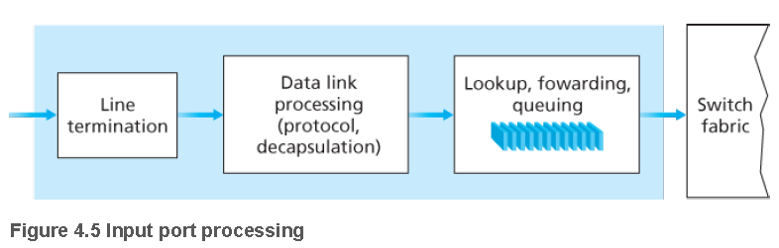
输入端口处理和基于目的地转发
Notes:
A more detailed view of input processing is shown in Figure 4.5.
As just discussed, the input port’s line termination function and link-layer processing implement the physical and link layers for that individual input link.
The lookup performed in the input port is central to the router’s operation — it is here that the router uses the forwarding table to look up the output port to which an arriving packet will be forwarded via the switching fabric.
The forwarding table is either computed and updated by the routing processor (using a routing protocol to interact with the routing processors in other network routers) or is received from a remote SDN controller.
The forwarding table is copied from the routing processor to the line cards over a separate bus (e.g., a PCI bus) indicated by the dashed line from the routing processor to the input line cards in Figure 4.4.
With such a shadow copy at each line card, forwarding decisions can be made locally, at each input port, without invoking the centralized routing processor on a per-packet basis and thus avoiding a centralized processing bottleneck.
Let’s now consider the “simplest” case that the output port to which an incoming packet is to be switched is based on the packet’s destination address.
In the case of 32-bit IP addresses, a brute-force implementation of the forwarding table would have one entry for every possible destination address.
Since there are more than 4 billion possible addresses, this option is totally out of the question.

Slide 31
基于目的地转发
forwarding table
目的地址范围
11001000 00010111 00010000 00000000
through
11001000 00010111 00010111 11111111
11001000 00010111 00011000 00000000
through
11001000 00010111 00011000 11111111
11001000 00010111 00011001 00000000
through
11001000 00010111 00011111 11111111
otherwise
链路接口
0
1
2
3
Q: but what happens if ranges don’t divide up so nicely?
Notes:
As an example of how this issue of scale can be handled, let’s suppose that our router has four links, numbered 0 through 3, and that packets are to be forwarded to the link interfaces as follows:
Destination Address Range Link Interface
11001000 00010111 00010000 00000000
through 0
11001000 00010111 00010111 11111111
11001000 00010111 00011000 00000000
through 1
11001000 00010111 00011000 11111111
11001000 00010111 00011001 00000000
through 2
11001000 00010111 00011111 11111111
otherwise 3

Slide 32
最长前缀匹配
最长前缀匹配
当寻找给定目的地址的转发表条目时，使用与目标地址匹配的最长地址前缀。
目的地址范围
11001000 00010111 00010*** *********
11001000 00010111 00011000 *********
11001000 00010111 00011*** *********
otherwise
链路接口
0
1
2
3
例子:
DA: 11001000 00010111 00010110 10100001
which interface?
DA: 11001000 00010111 00011000 10101010
which interface?
Notes:
Clearly, for this example, it is not necessary to have 4 billion entries in the router’s forwarding table.
We could, for example, have the following forwarding table with just four entries:
Prefix Match Link Interface
11001000 00010111 00010 0
11001000 00010111 00011000 1
11001000 00010111 00011 2
otherwise 3
With this style of forwarding table, the router matches a prefix of the packet’s destination address with the entries in the table; if there’s a match, the router forwards the packet to a link associated with the match.
For example, suppose the packet’s destination address is 11001000 00010111 00010110 10100001; because the 21-bit prefix of this address matches the first entry in the table, the router forwards the packet to link interface 0.
If a prefix doesn’t match any of the first three entries, then the router forwards the packet to interface 3.
Although this sounds simple enough, there’s an important subtlety here.
You may have noticed that it is possible for a destination address to match more than one entry.
For example, the first 24 bits of the address 11001000 00010111 00011000 10101010 match the second entry in the table, and the first 21 bits of the address match the third entry in the table.
When there are multiple matches, the router uses the longest prefix matching rule; that is, it finds the longest matching entry in the table and forwards the packet to the link interface associated with the longest prefix match.
We’ll see exactly why this longest prefix-matching rule is used when we study Internet addressing in more detail in Section 4.3.

Slide 33
最长前缀匹配
当学习寻址时，我们将很快看到为什么使用最长前缀匹配。
最长前缀匹配: 通常使用三元内容可寻址存储器(TCAMs)来执行
内容可寻址: 当给TCAM提交地址时，无论表的大小，在一个时钟周期内检索地址
Cisco Catalyst: 能在TCAM有1 ~1M路由表项
Notes:
Given the existence of a forwarding table, lookup is conceptually simple — hardware logic just searches through the forwarding table looking for the longest prefix match.
But at Gigabit transmission rates, this lookup must be performed in nanoseconds (recall our earlier example of a 10 Gbps link and a 64-byte IP datagram).
Thus, not only must lookup be performed in hardware, but techniques beyond a simple linear search through a large table are needed; surveys of fast lookup algorithms can be found in [Gupta 2001, Ruiz-Sanchez 2001].
Special attention must also be paid to memory access times, resulting in designs with embedded on-chip DRAM and faster SRAM (used as a DRAM cache) memories.
In practice, Ternary Content Addressable Memories (TCAMs) are also often used for lookup [Yu 2004].
With a TCAM, a 32-bit IP address is presented to the memory, which returns the content of the forwarding table entry for that address in essentially constant time.
The Cisco Catalyst 6500 and 7600 Series routers and switches can hold upwards of a million TCAM forwarding table entries [Cisco TCAM 2014].
Once a packet’s output port has been determined via the lookup, the packet can be sent into the switching fabric.
In some designs, a packet may be temporarily blocked from entering the switching fabric if packets from other input ports are currently using the fabric.
A blocked packet will be queued at the input port and then scheduled to cross the fabric at a later point in time.
We’ll take a closer look at the blocking, queuing, and scheduling of packets (at both input ports and output ports) shortly.
Although “lookup” is arguably the most important action in input port processing, many other actions must be taken: (1) physical- and link-layer processing must occur, as discussed previously; (2) the packet’s version number, checksum and time-to-live field — all of which we’ll study in Section 4.3 — must be checked and the latter two fields rewritten; and (3) counters used for network management (such as the number of IP datagrams received) must be updated.
Let’s close our discussion of input port processing by noting that the input port steps of looking up a destination IP address (“match”) and then sending the packet into the switching fabric to the specified output port (“action”) is a specific case of a more general “match plus action” abstraction that is performed in many networked devices, not just routers.
In link-layer switches (covered in Chapter 6), link-layer destination addresses are looked up and several actions may be taken [error recovery] in addition to sending the frame into the switching fabric towards the output port.
In firewalls (covered in Chapter 8) — devices that filter out selected incoming packets — an incoming packet whose header matches a given criteria (e.g., a combination of source/destination IP addresses and transport-layer port numbers) may be dropped (action).
In a network address translator (NAT, covered in Section 4.3), an incoming packet whose transport-layer port number matches a given value will have its port number rewritten before forwarding (action).
Indeed, the “match plus action” abstraction is both powerful and prevalent in network devices today, and is central to the notion of generalized forwarding that we’ll study in Section 4.4.

Slide 34
第4章 网络层: 数据平面
4.1 网络层概述
转发和路由选择: 数据平面和控制平面
网络服务模型
4.2 路由器工作原理
输入端口处理和基于目的地转发
交换
输出端口处理
何处出现排队
分组调度
4.4 网际协议: IPv4、寻址、IPv6及其它
IPv4 数据报格式
IPv4 数据报分片
IPv4 编址
网络地址转换
IPv6
4.5 通用转发和SDN
匹配
动作
匹配加动作操作中的OpenFlow例子
4.8 小结

Slide 35
交换结构
将分组从输入缓冲区传输到适当的输出缓冲区
交换速率：数据包从输入传输到输出的速率
通常以输入/输出线速率的倍数来测量
N inputs：交换速率N倍于理想的线路速率
三种交换技术
memory
内存
总线
纵横式
Notes:
The switching fabric is at the very heart of a router, as it is through this fabric that the packets are actually switched (that is, forwarded) from an input port to an output port.
Switching can be accomplished in a number of ways, as shown in Figure 4.6:

Slide 36
交换
"4"
Link 1, ingress
Choose
Egress
Link 1, egress
Link 2
Link 2, ingress
Choose
Egress
Link 2, egress
R1
"4"
Link 1
Link 3
Link 3, ingress
Choose
Egress
Link 3, egress
Link 4
Link 4, ingress
Choose
Egress
Link 4, egress

Slide 37
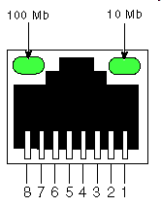
经内存交换
经内存交换：
在输入端口和输出端口之间的交换是在CPU (路由处理器)的直接控制下完成的
分组被拷贝到系统内存中，然后在CPU的控制下输送到输出端口
转发速度受限于内存的带宽(每个分组走两次总线)
input
port
(e.g.,
Ethernet)
output
port
(e.g.,
Ethernet)
memory
系统总线
Notes:
• Switching via memory.
The simplest, earliest routers were traditional computers, with switching between input and output ports being done under direct control of the CPU (routing processor).
Input and output ports functioned as traditional I/O devices in a traditional operating system.
An input port with an arriving packet first signaled the routing processor via an interrupt.
The packet was then copied from the input port into processor memory.
The routing processor then extracted the destination address from the header, looked up the appropriate output port in the forwarding table, and copied the packet to the output port’s buffers.
In this scenario, if the memory bandwidth is such that B packets per second can be written into, or read from, memory, then the overall forwarding throughput (the total rate at which packets are transferred from input ports to output ports) must be less than B/2.
Note also that two packets cannot be forwarded at the same time, even if they have different destination ports, since only one memory read/write over the shared system bus can be done at a time.
Many modern routers switch via memory.
A major difference from early routers, however, is that the lookup of the destination address and the storing of the packet into the appropriate memory location are performed by processing on the input line cards.
In some ways, routers that switch via memory look very much like shared-memory multiprocessors, with the processing on a line card switching (writing) packets into the memory of the appropriate output port.
Cisco’s Catalyst 8500 series switches [Cisco 8500 2012] forward packets via a shared memory.

Slide 38
经总线交换
经总线交换
输入端口经一根共享总线将分组直接传送到输出端口
总线交换的问题: 交换速度受限于总线的带宽
32Gbps总线, Cisco 5600: 对于运行在接入网或企业网的路由器，通过总线交换的转发速度是足够的。
总线
Notes:
• Switching via a bus.
In this approach, an input port transfers a packet directly to the output port over a shared bus, without intervention by the routing processor.
This is typically done by having the input port prepend a switch-internal label (header) to the packet indicating the local output port to which this packet is being transferred and transmitting the packet onto the bus.
The packet is received by all output ports, but only the port that matches the label will keep the packet.
The label is then removed at the output port, as this label is only used within the switch to cross the bus.
If multiple packets arrive to the router at the same time, each at a different input port, all but one must wait since only one packet can cross the bus at a time.
Because every packet must cross the single bus, the switching speed of the router is limited to the bus speed; in our roundabout analogy, this is as if the roundabout could only contain one car at a time.
Nonetheless, switching via a bus is often sufficient for routers that operate in small local area and enterprise networks.
The Cisco 5600 [Cisco Switches 2012] switches packets over a 32 Gbps backplane bus.

Slide 39
经内联网络交换
经内联网络
克服总线带宽限制
Banyan网络：过去在多处理机计算机体系结构中用来互连多个处理器的网络
设计先进：将长度变化的IP分组分片成固定尺寸的信元，通过交换结构对信元进行转发
Cisco 12000: 通过内联网络交换速度为60Gb/s
A
B
纵横式
X
Y
Notes:
• Switching via an interconnection network.
One way to overcome the bandwidth limitation of a single, shared bus is to use a more sophisticated interconnection network, such as those that have been used in the past to interconnect processors in a multiprocessor computer architecture.
A crossbar switch is an interconnection network consisting of 2N buses that connect N input ports to N output ports, as shown in Figure 4.6.
Each vertical bus intersects each horizontal bus at a crosspoint, which can be opened or closed at any time by the switch fabric controller (whose logic is part of the switching fabric itself).
When a packet arrives from port A and needs to be forwarded to
port Y, the switch controller closes the crosspoint at the intersection of busses A and Y, and port A then sends the packet onto its bus, which is picked up (only) by bus Y.
Note that a packet from port B can be forwarded to port X at the same time, since the A-to-Y and B-to-X packets use different input and output busses.
Thus, unlike the previous two switching approaches, crossbar switches are capable of forwarding multiple packets in parallel.
A crossbar switch is non-blocking — a packet being forwarded to an output port will not be blocked from reaching that output port as long as no other packet is currently being forwarded to that output port.
However, if two packets from two different input ports are destined to that same output port, then one will have to wait at the input, since only one packet can be sent over any given bus at a time.
Cisco 12000 series switches [Cisco 12000 2016] use a crossbar switching network; the Cisco 7600 series can be configured to use either a bus or crossbar switch [Cisco 7600 2016].
More sophisticated interconnection networks use multiple stages of switching elements to allow packets from different input ports to proceed towards the same output port at the same time through the multi-stage switching fabric.
See [Tobagi 1990] for a survey of switch architectures.
The Cisco CRS employs a three-stage non-blocking switching strategy.
A router’s switching capacity can also be scaled by running multiple switching fabrics in parallel.
In this approach, input ports and output ports are connected to N switching fabrics that operate in parallel.
An input port breaks a packet into K smaller chunks, and sends (“sprays”) the chunks through K of these N switching fabrics to the selected output port, which reassembles the K chunks back into the original packet.

Slide 40
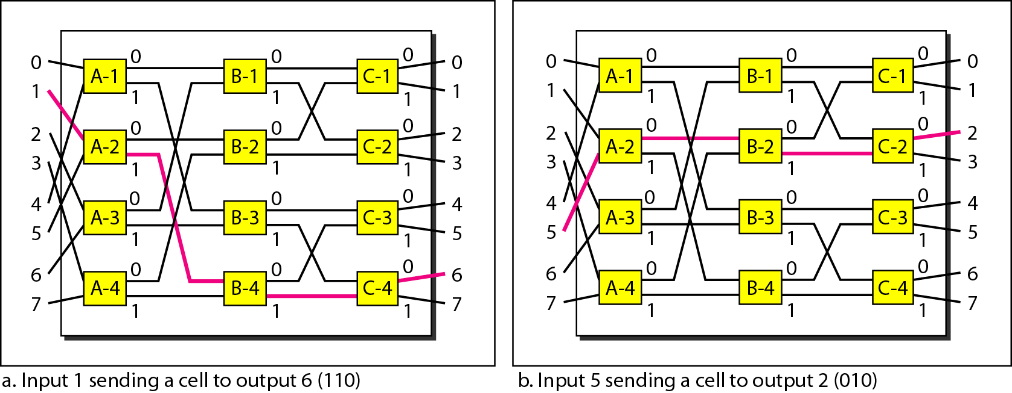
routing in a banyan switch

Slide 41
经内联网络交换
Batcher-Banyan switch
High speed router
routing software
/router OS
Line card
(转发
buffering)
选路
CPU
Buffer
memory
Line card
(转发
buffering)
Line card
(转发
buffering)
Line card
(转发
buffering)

Slide 42
第4章 网络层: 数据平面
4.1 网络层概述
转发和路由选择: 数据平面和控制平面
网络服务模型
4.2 路由器工作原理
输入端口处理和基于目的地转发
交换
输出端口处理
何处出现排队
分组调度
4.4 网际协议: IPv4、寻址、IPv6及其它
IPv4 数据报格式
IPv4 数据报分片
IPv4 编址
网络地址转换
IPv6
4.5 通用转发和SDN
匹配
动作
匹配加动作操作中的OpenFlow例子
4.8 小结

Slide 43
输出端口
This slide in HUGELY important!
datagram
buffer
queueing
交换
结构
link
layer
protocol
(send)
line
termination
缓存管理：当交换结构将分组交付给输出端口的速率超过输出链路速率时
调度原则：在数据报队列中选择数据报进行传输
Datagram (packets) can be lost due to congestion, lack of buffers
Priority scheduling – who gets best performance, network neutrality
Notes:
Output port processing, shown in Figure 4.9, takes packets that have been stored in the output port’s memory and transmits them over the output link.
This includes selecting and de-queueing packets for transmission, and performing the needed link-layer and physical-layer transmission functions.

Slide 44
第4章 网络层: 数据平面
4.1 网络层概述
转发和路由选择: 数据平面和控制平面
网络服务模型
4.2 路由器工作原理
输入端口处理和基于目的地转发
交换
输出端口处理
何处出现排队
分组调度
4.4 网际协议: IPv4、寻址、IPv6及其它
IPv4 数据报格式
IPv4 数据报分片
IPv4 编址
网络地址转换
IPv6
4.5 通用转发和SDN
匹配
动作
匹配加动作操作中的OpenFlow例子
4.8 小结

Slide 45
输入端口排队
fabric slower than input ports combined ->在输入队列可能发生排队
由输入缓冲区溢出导致排队时延和丢失 !
线头(HOL)阻塞： 队列前端的排队数据报阻止队列中的其他数据包向前移动
switch
fabric
switch
fabric
output port contention:
only one red datagram can be transferred. lower red packet is blocked
one packet time later: green packet experiences HOL blocking
Notes:
Where Does Queuing Occur ?
If we consider input and output port functionality and the configurations shown in Figure 4.6, it’s clear that packet queues may form at both the input ports and the output ports, just as we identified cases where cars may wait at the inputs and outputs of the traffic intersection in our roundabout analogy.
The location and extent of queuing (either at the input port queues or the output port queues) will depend on the traffic load, the relative speed of the switching fabric, and the line speed.
Let’s now consider these queues in a bit more detail, since as these queues grow large, the router’s memory can eventually be exhausted and packet loss will occur when no memory is available to store arriving packets.
Recall that in our earlier discussions, we said that packets were “lost within the network” or “dropped at a router.”
It is here, at these queues within a router, where such packets are actually dropped and lost.
Suppose that the input and output line speeds (transmission rates) all have an identical transmission rate of R_{line} packets per second, and that there are N input ports and N output ports.
To further simplify the discussion, let’s assume that all packets have the same fixed length, and the packets arrive to input ports in a synchronous manner.
That is, the time to send a packet on any link is equal to the time to receive a packet on any link, and during such an interval of time, either zero or one packet can arrive on an input link.
Define the switching fabric transfer rate R_{switch} as the rate at which packets can be moved from input port to output port.
If R_{switch} is N times faster than R_{line}, then only negligible queuing will occur at the input ports.
This is because even in the worst case, where all N input lines are receiving packets, and all packets are to be forwarded to the same output port, each batch of N packets (one packet per input port) can be cleared through the switch fabric before the next batch arrives.
Input Queueing
But what happens if the switch fabric is not fast enough (relative to the input line speeds) to transfer all arriving packets through the fabric without delay?
In this case, packet queuing can also occur at the input ports, as packets must join input port queues to wait their turn to be transferred through the switching fabric to the output port.
To illustrate an important consequence of this queuing, consider a crossbar switching fabric and suppose that (1) all link speeds are identical, (2) that one packet can be transferred from any one input port to a given output port in the same amount of time it takes for a packet to be received on an input link [不影响接收], and (3) packets are moved from a given input queue to their desired output queue in an FCFS manner.
Multiple packets can be transferred in parallel, as long as their output ports are different.
However, if two packets at the front of two input queues are destined for the same output queue, then one of the packets will be blocked and must wait at the input queue — the switching fabric can transfer only one packet to a given output port at a time.
Figure 4.8 shows an example in which two packets (darkly shaded) at the front of their input queues are destined for the same upper-right output port.
Suppose that the switch fabric chooses to transfer the packet from the front of the upper-left queue.
In this case, the darkly shaded packet in the lower-left queue must wait.
But not only must this darkly shaded packet wait, so too must the lightly shaded packet that is queued behind that packet in the lower-left queue, even though there is no contention for the middle-right output port (the destination for the lightly shaded packet).
This phenomenon is known as head-of-the-line (HOL) blocking in an input-queued switch — a queued packet in an input queue must wait for transfer through the fabric (even though its output port is free) because it is blocked by another packet at the head of the line.
[Karol 1987] shows that due to HOL blocking, the input queue will grow to unbounded length (informally, this is equivalent to saying that significant packet loss will occur) under certain assumptions as soon as the packet arrival rate on the input links reaches only 58 percent of their capacity.
A number of solutions to HOL blocking are discussed in [McKeown 1997].

Slide 46
输出端口排队
输出端口排队
当通过交换结构到达的分组速率超过了输出链路的速率时，需要对分组进行缓存
输出端口缓冲区溢出会导致分组的排队和丢失!
交换结构
交换结构
在t时刻，分组试图从输入端口去往输出端口
1个分组交换时间之后
Notes:
Output Queueing
Let’s next consider whether queueing can occur at a switch’s output ports.
Suppose that R_{switch} is again N times faster than R_{line} and that packets arriving at each of the N input ports are destined to the same output port.
In this case, in the time it takes to send a single packet onto the outgoing link, N new packets will arrive at this output port (one from each of the N input ports).
Since the output port can transmit only a single packet in a unit of time (the packet transmission time), the N arriving packets will have to queue (wait) for transmission over the outgoing link.
Then N more packets can possibly arrive in the time it takes to transmit just one of the N packets that had just previously been queued.
And so on.
Thus, packet queues can form at the output ports even when the switching fabric is N times faster than the port line speeds.
Eventually, the number of queued packets can grow large enough to exhaust available memory at the output port.
When there is not enough memory to buffer an incoming packet, a decision must be made to either drop the arriving packet (a policy known as drop-tail) or remove one or more already-queued packets to make room for the newly arrived packet.
In some cases, it may be advantageous to drop (or mark the header of) a packet before the buffer is full in order to provide a congestion signal to the sender.
A number of proactive packet-dropping and -marking policies (which collectively have become known as active queue management (AQM) algorithms) have been proposed and analyzed [Labrador 1999, Hollot 2002].
One of the most widely studied and implemented AQM algorithms is the Random Early Detection (RED) algorithm [Christiansen 2001; Floyd 2016].
Output port queuing is illustrated in Figure 4.9.
At time t, a packet has arrived at each of the incoming input ports, each destined for the uppermost outgoing port.
Assuming identical line speeds and a switch operating at three times the line speed, one time unit later (that is, in the time needed to receive or send a packet), all three original packets have been transferred to the outgoing port and are queued awaiting transmission.
In the next time unit, one of these three packets will have been transmitted over the outgoing link.
In our example, two new packets have arrived at the incoming side of the switch; one of these packets is destined for this uppermost output port.
A consequence of such queuing is that a packet scheduler at the output port must choose one packet, among those queued, for transmission — a topic we’ll cover in the following section.

Slide 47
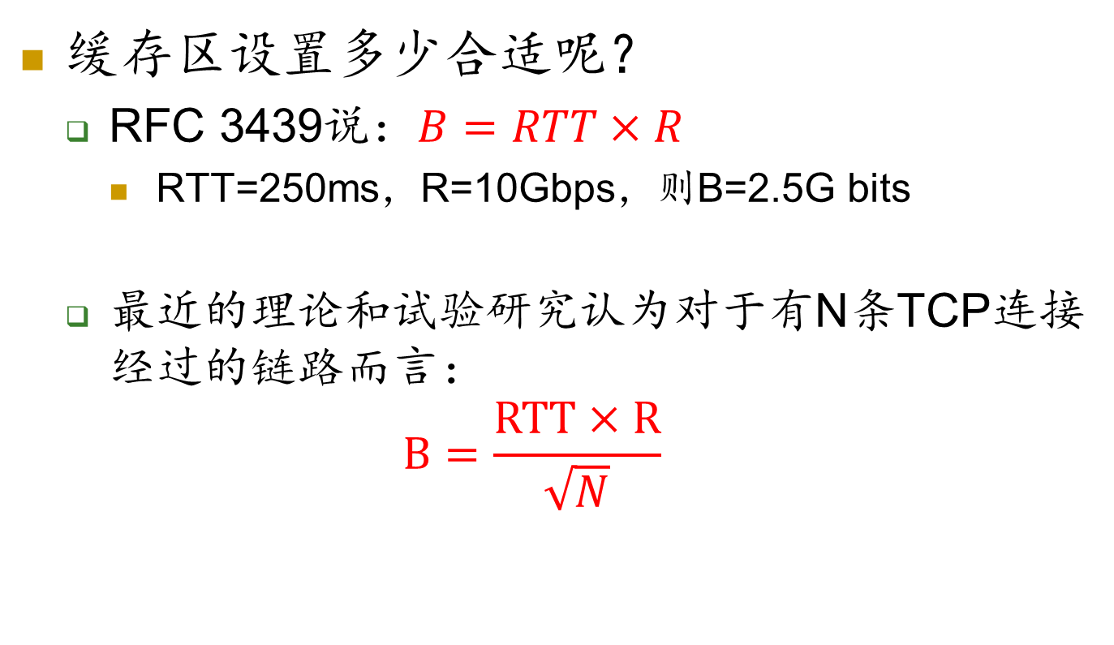
缓存区大小How much buffering?
Notes:
Given that router buffers are needed to absorb the fluctuations in traffic load, the natural question to ask is how much buffering is required.
For many years, the rule of thumb [RFC 3439] for buffer sizing was that the amount of buffering (B) should be equal to an average round-trip time (RTT, say 250 msec) times the link capacity (C).
This result is based on an analysis of the queueing dynamics of a relatively small number of TCP flows [Villamizar 1994].
Thus, a 10 Gbps link with an RTT of 250 msec would need an amount of buffering equal to B = RTT · C = 2.5 Gbits of buffers.
Recent theoretical and experimental efforts [Appenzeller 2004], however, suggest that when there are a large number of TCP flows (N) passing through a link, the amount of buffering needed is B = RTTC/√N .
With a large number of flows typically passing through large backbone router links (see, e.g., [Fraleigh 2003]), the value of N can be large, with the decrease in needed buffer size becoming quite significant.
[Appenzellar 2004; Wischik 2005; Beheshti 2008] provide very readable discussions of the buffer sizing problem from a theoretical, implementation, and operational standpoint.

Slide 48
第4章 网络层: 数据平面
4.1 网络层概述
转发和路由选择: 数据平面和控制平面
网络服务模型
4.2 路由器工作原理
输入端口处理和基于目的地转发
交换
输出端口处理
何处出现排队
分组调度
4.4 网际协议: IPv4、寻址、IPv6及其它
IPv4 数据报格式
IPv4 数据报分片
IPv4 编址
网络地址转换
IPv6
4.5 通用转发和SDN
匹配
动作
匹配加动作操作中的OpenFlow例子
4.8 小结

Slide 49
调度机制
scheduling: choose next packet to send on link
FIFO (first in first out) scheduling: send in order of arrival to queue
real-world example ?
discard policy: if packet arrives to full queue: who to discard?
tail drop: drop arriving packet
priority: drop/remove on priority basis
random: drop/remove randomly
packet
arrivals
packet
departures
queue
(waiting area)
link
(server)
Notes:
Let’s now return to the question of determining the order in which queued packets are transmitted over an outgoing link.
Since you yourself have undoubtedly had to wait in long lines on many occasions and observed how waiting customers are served, you’re no doubt familiar with many of the queueing disciplines commonly used in routers.
There is first-come-first-served (FCFS, also known as first-in-first-out, FIFO).
The British are famous for patient and orderly FCFS queueing at bus stops and in the marketplace (“Oh, are you queueing?”).
Other countries operate on a priority basis, with one class of waiting customers given priority service over other waiting customers.
There is also round-robin queueing, where customers are again divided into classes (as in priority queueing) but each class of customer is given service in turn.
First-in-First-Out (FIFO)
Figure 4.10 shows the queuing model abstraction for the FIFO link-scheduling discipline.
Packets arriving at the link output queue wait for transmission if the link is currently busy transmitting another packet.
If there is not sufficient buffering space to hold the arriving packet, the queue’s packet discarding policy then determines whether the packet will be dropped (lost) or whether other packets will be removed from the queue to make space for the arriving packet, as discussed above.
In our discussion below, we’ll ignore packet discard.
When a packet is completely transmitted over the outgoing link (that is, receives service) it is removed from the queue.
The FIFO (also known as first-come-first-served, or FCFS) scheduling discipline selects packets for link
transmission in the same order in which they arrived at the output link queue.
We’re all familiar with FIFO queuing from service centers, where arriving customers join the back of the single waiting line, remain in order, and are then served when they reach the front of the line.

Slide 50
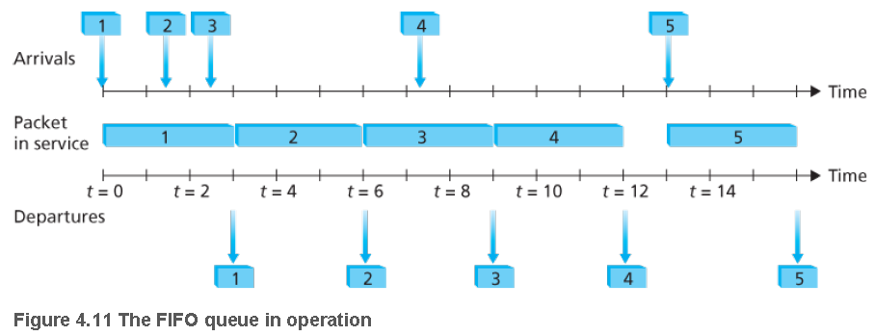
先进先出
Notes:
Figure 4.11 shows the FIFO queue in operation.
Packet arrivals are indicated by numbered arrows above the upper timeline, with the number indicating the order in which the packet arrived.
Individual packet departures are shown below the lower timeline.
The time that a packet spends in service (being transmitted) is indicated by the shaded rectangle between the two timelines.
In our examples here, let’s assume that each packet takes three units of time to be transmitted.
Under the FIFO discipline, packets leave in the same order in which they arrived.
Note that after the departure of packet 4, the link remains idle (since packets 1 through 4 have been transmitted and removed from the queue) until the arrival of packet 5.

Slide 51
调度策略：优先级
优先级调度: 发送优先级最高的排队数据包
多个类，具有不同的优先级
分类可能依赖于标记或其他首部信息，例如IP源/目的地址，端口号，等等。
真实世界的例子 ?
high priority queue
(waiting area)
arrivals
departures
classify
link
(server)
low priority queue
(waiting area)
2
1
3
4
5
arrivals
packet in service
1
3
2
4
5
departures
1
3
2
4
5
Notes:
Under priority queuing, packets arriving at the output link are classified into priority classes upon arrival at the queue, as shown in Figure 4.12.
In practice, a network operator may configure a queue so that packets carrying network management information (e.g., as indicated by the source or destination TCP/UDP port number) receive priority over user traffic; additionally, real-time voice-over-IP packets might receive priority over non-real traffic such as SMTP or IMAP e-mail packets.
Each priority class typically has its own queue.
When choosing a packet to transmit, the priority queuing discipline will transmit a packet from the highest priority class that has a nonempty queue (that is, has packets waiting for transmission).
The choice among packets in the same priority class is typically done in a FIFO manner.
Figure 4.13 illustrates the operation of a priority queue with two priority classes.
Packets 1, 3, and 4 belong to the high-priority class, and packets 2 and 5 belong to the low-priority class.
Packet 1 arrives and, finding the link idle, begins transmission.
During the transmission of packet 1, packets 2 and 3 arrive and are queued in the low- and high-priority queues, respectively.
After the transmission of packet 1, packet 3 (a high-priority packet) is selected for transmission over packet 2 (which, even though it arrived earlier, is a low-priority packet).
At the end of the transmission of packet 3, packet 2 then begins transmission.
Packet 4 (a high-priority packet) arrives during the transmission of packet 2 (a low-priority packet).
Under a non-preemptive priority queuing discipline, the transmission of a packet is not interrupted once it has begun.
In this case, packet 4 queues for transmission and begins being transmitted after the transmission of packet 2 is completed.

Slide 52
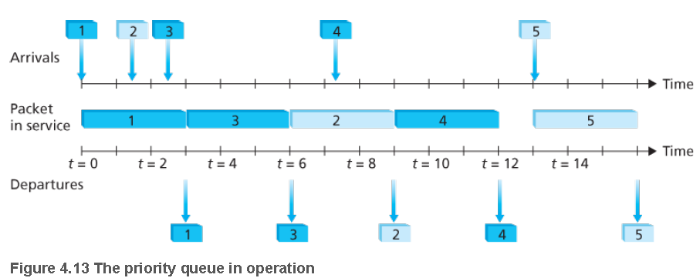
优先级排队
Notes:
Figure 4.13 illustrates the operation of a priority queue with two priority classes.
Packets 1, 3, and 4 belong to the high-priority class, and packets 2 and 5 belong to the low-priority class.
Packet 1 arrives and, finding the link idle, begins transmission.
During the transmission of packet 1, packets 2 and 3 arrive and are queued in the low- and high-priority queues, respectively.
After the transmission of packet 1, packet 3 (a high-priority packet) is selected for transmission over packet 2 (which, even though it arrived earlier, is a low-priority packet).
At the end of the transmission of packet 3, packet 2 then begins transmission.
Packet 4 (a high-priority packet) arrives during the transmission of packet 2 (a low-priority packet).
Under a non-preemptive priority queuing discipline, the transmission of a packet is not interrupted once it has begun.
In this case, packet 4 queues for transmission and begins being transmitted after the transmission of packet 2 is completed.

Slide 53
调度策略: 还有更多
循环(RR)调度:
多个分类
循环扫描类队列，从每个类发送一个完整的数据包(如果可用)
真实世界的例子?
2
1
3
4
5
arrivals
packet in service
1
3
2
4
5
departures
1
3
3
4
5
Figure 4.14 The two-class robin queue in operation
Notes:
Round Robin and Weighted Fair Queuing (WFQ)
Under the round robin queuing discipline, packets are sorted into classes as with priority queuing.
However, rather than there being a strict service priority among classes, a round robin scheduler alternates service among the classes.
In the simplest form of round robin scheduling, a class 1 packet is transmitted, followed by a class 2 packet, followed by a class 1 packet, followed by a class 2 packet, and so on.
A so-called work-conserving queuing discipline will never allow the link to remain idle whenever there are packets (of any class) queued for transmission.
A work-conserving round robin discipline that looks for a packet of a given class but finds none will immediately check the next class in the round robin sequence.
Figure 4.14 illustrates the operation of a two-class round robin queue.
In this example, packets 1, 2, and 4 belong to class 1, and packets 3 and 5 belong to the second class.
Packet 1 begins transmission immediately upon arrival at the output queue.
Packets 2 and 3 arrive during the transmission of packet 1 and thus queue for transmission.
After the transmission of packet 1, the link scheduler looks for a class 2 packet and thus transmits packet 3.
After the transmission of packet 3, the scheduler looks for a class 1 packet and thus transmits packet 2.
After the transmission of packet 2, packet 4 is the only queued packet; it is thus transmitted immediately after packet 2.

Slide 54
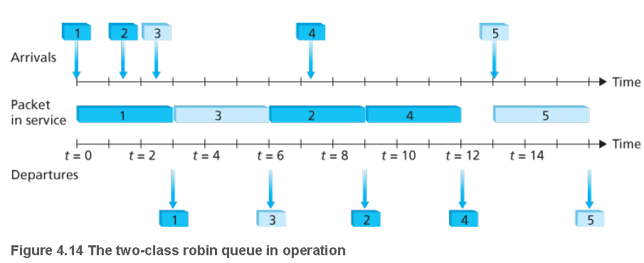
循环和加权公平排队
Notes:
Figure 4.14 illustrates the operation of a two-class round robin queue.
In this example, packets 1, 2, and 4 belong to class 1, and packets 3 and 5 belong to the second class.
Packet 1 begins transmission immediately upon arrival at the output queue.
Packets 2 and 3 arrive during the transmission of packet 1 and thus queue for transmission.
After the transmission of packet 1, the link scheduler looks for a class 2 packet and thus transmits packet 3.
After the transmission of packet 3, the scheduler looks for a class 1 packet and thus transmits packet 2.
After the transmission of packet 2, packet 4 is the only queued packet; it is thus transmitted immediately after packet 2.

Slide 55
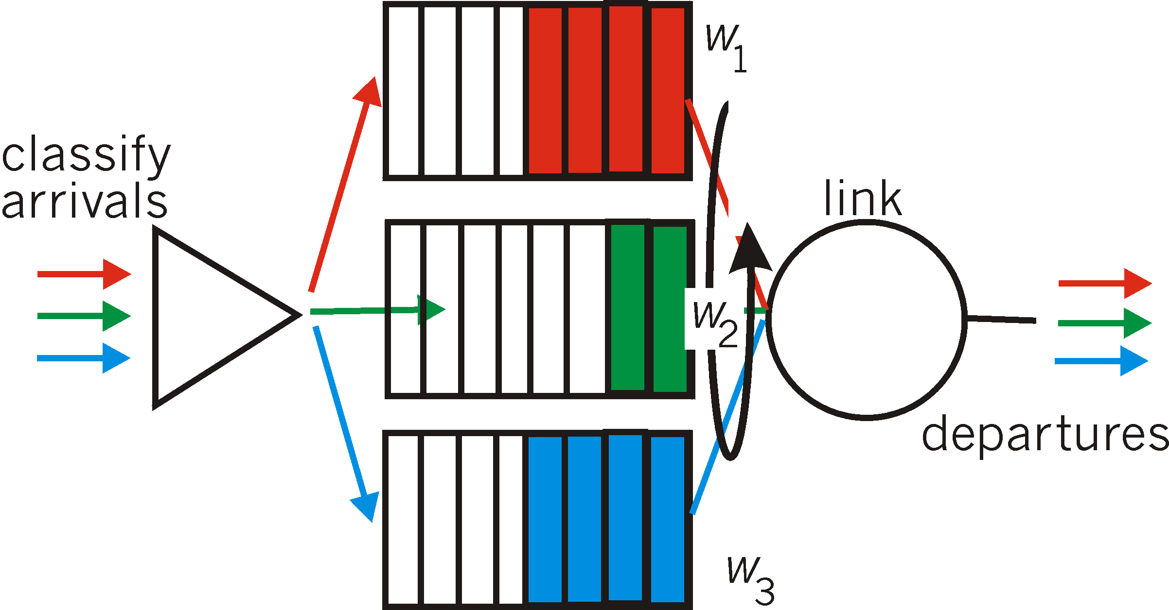
调度策略: 还有更多
加权公平排队(WFQ):
通用形式的循环排队
each class gets weighted amount of service in each cycle
真实世界的例子?
Notes:
A generalized form of round robin queuing that has been widely implemented in routers is the so-called weighted fair queuing (WFQ) discipline [Demers 1990; Parekh 1993; Cisco QoS 2016].
WFQ is illustrated in Figure 4.15.
Here, arriving packets are classified and queued in the appropriate per-class waiting area.
As in round robin scheduling, a WFQ scheduler will serve classes in a circular manner — first serving class 1, then serving class 2, then serving class 3, and then (assuming there are three classes) repeating the service pattern.
WFQ is also a work-conserving queuing discipline and thus will immediately move on to the next class in the service sequence when it finds an empty class queue.
WFQ differs from round robin in that each class may receive a differential amount of service in any interval of time.
Specifically, each class, i, is assigned a weight, w_{i} .
Under WFQ, during any interval of time during which there are class i packets to send, class i will then be guaranteed to receive a fraction of service equal to w_{i}/(Σw_{j}), where the sum in the denominator is taken over all classes that also have packets queued for transmission.
In the worst case, even if all classes have queued packets, class i will still be guaranteed to receive a fraction of the bandwidth, where in this worst case the sum in the denominator is over all classes.
Thus, for a link with transmission rate R, class i will always achieve a throughput of at least R⋅w_{i}/(Σw_{j}).
Our description of WFQ has been idealized, as we have not considered the fact that packets are discrete and a packet’s transmission will not be interrupted to begin transmission of another packet; [Demers 1990; Parekh 1993] discuss this packetization issue.

Slide 56
第4章 网络层: 数据平面
4.1 网络层概述
转发和路由选择: 数据平面和控制平面
网络服务模型
4.2 路由器工作原理
输入端口处理和基于目的地转发
交换
输出端口处理
何处出现排队
分组调度
4.4 网际协议: IPv4、寻址、IPv6及其它
IPv4 数据报格式
IPv4 数据报分片
IPv4 编址
网络地址转换
IPv6
4.5 通用转发和SDN
匹配
动作
匹配加动作操作中的OpenFlow例子
4.8 小结

Slide 57
主机、路由器的网络层组件
运输层: TCP, UDP
选路协议
路径选择
RIP, OSPF, BGP
IP 协议
编址规则
数据报格式
分组处理规则
网络层
转发表
ICMP 协议
错误报告
路由器 信令
链路层
物理层
Notes:
Our study of the network layer thus far in Chapter 4 — the notion of the data and control plane component of the network layer, our distinction between forwarding and routing, the identification of various network service models, and our look inside a router — have often been without reference to any specific computer network architecture or protocol.
In this section we’ll focus on key aspects of the network layer on today’s Internet and the celebrated Internet Protocol (IP).
There are two versions of IP in use today.
We’ll first examine the widely deployed IP protocol version 4, which is usually referred to simply as IPv4 [RFC 791] in Section 4.3.1.
We’ll examine IP version 6 [RFC 2460; RFC 4291], which has been proposed to replace IPv4, in Section 4.3.5.
In between, we’ll primarily cover Internet addressing — a topic that might seem rather dry and detail-oriented but we’ll see is crucial to understanding how the Internet’s network layer works.
To master IP addressing is to master the Internet’s network layer itself!

Slide 58
IP protocol version
number
32 bits
total datagram
length (bytes)
header length
(4-byte)
head.
len
type of
service
ver
length
for
fragmentation/
reassembly
“type” of data
flgs
fragment
offset
16-bit identifier
max number
remaining hops
(decremented at
each router)
time to
live
Protocol
Header
checksum
32 bit source IP address
upper layer protocol
to deliver payload to
32 bit destination IP address
Options (if any)
E.g. timestamp,
record route
taken, specify
list of routers
to visit.
how much overhead with TCP?
20 bytes of TCP
20 bytes of IP
= 40 bytes + app layer overhead
data
(variable length,
typically a TCP
or UDP segment)
Notes:
Recall that a network-layer packet is referred to as a datagram.
We begin our study of IP with an overview of the syntax and semantics of the IPv4 datagram.
You might be thinking that nothing could be drier than the syntax and semantics of a packet’s bits.
Nevertheless, the datagram plays a central role in the Internet — every networking student and professional needs to see it, absorb it, and master it.
The IPv4 datagram format is shown in Figure 4.16.
The key fields in the IPv4 datagram are the following:
• Version number. These 4 bits specify the IP protocol version of the datagram.
By looking at the version number, the router can determine how to interpret the remainder of the IP datagram.
Different versions of IP use different datagram formats.
The datagram format for the current version of IP, IPv4, is shown in Figure 4.16.
The datagram format for the new version of IP (IPv6) is discussed at the end of this section.
• Header length. Because an IPv4 datagram can contain a variable number of options (which are included in the IPv4 datagram header), these 4 bits are needed to determine where in the IP datagram the data actually begins.
Most IP datagrams do not contain options, so the typical IP datagram has a 20-byte header.
• Type of service. The type of service (TOS) bits were included in the IPv4 header to allow different types of IP datagrams (for example, datagrams particularly requiring low delay, high throughput, or reliability) to be distinguished from each other.
For example, it might be useful to distinguish real-time datagrams (such as those used by an IP telephony application) from non-real-time traffic (for example, FTP).
The specific level of service to be provided is a policy issue determined by the router’s administrator.
We’ll explore the topic of differentiated service in Chapter 7.
• Datagram length. This is the total length of the IP datagram (header plus data), measured in bytes.
Since this field is 16 bits long, the theoretical maximum size of the IP datagram is 65,535 bytes.
However, datagrams are rarely larger than 1,500 bytes.
• Identifier, flags, fragmentation offset. These three fields have to do with so-called IP fragmentation, a topic we will consider in depth shortly.
Interestingly, the new version of IP, IPv6, does not allow for fragmentation at routers.
• Time-to-live. The time-to-live (TTL) field is included to ensure that datagrams do not circulate forever (due to, for example, a long-lived routing loop) in the network.
This field is decremented by one each time the datagram is processed by a router.
If the TTL field reaches 0, the datagram must be dropped.
• Protocol. This field is used only when an IP datagram reaches its final destination.
The value of this field indicates the specific transport-layer protocol to which the data portion of this IP datagram should be passed.
For example, a value of 6 indicates that the data portion is passed to TCP, while a value of 17 indicates that the data is passed to UDP.
For a list of all possible values, see [IANA Protocol Numbers 2012].
Note that the protocol number in the IP datagram has a role that is analogous to the role of the port number field in the transport layer segment.
The protocol number is the glue that binds the network and transport layers together, whereas the port number is the glue that binds the transport and application layers together.
We’ll see in Chapter 5 that the link-layer frame also has a special field that binds the link layer to the network layer.
• Header checksum. The header checksum aids a router in detecting bit errors in a received IP datagram.
The header checksum is computed by treating each 2 bytes in the header as a number and summing these numbers using 1s complement arithmetic.
As discussed in Section 3.3, the 1s complement of this sum, known as the Internet checksum, is stored in the checksum field.
A router computes the header checksum for each received IP datagram and detects an error condition if the checksum carried in the datagram header does not equal the computed checksum.
Routers typically discard datagrams for which an error has been detected.
Note that the checksum must be recomputed and stored again at each router, as the TTL field, and possibly the options field as well, may change.
An interesting discussion of fast algorithms for computing the Internet checksum is [RFC 1071].
A question often asked at this point is, why does TCP/IP perform error checking at both the transport and network layers?
There are several reasons for this repetition.
First, note that only the IP header is checksummed at the IP layer, while the TCP/UDP checksum is computed over the entire TCP/UDP segment.
Second, TCP/UDP and IP do not necessarily both have to belong to the same protocol stack.
TCP can, in principle, run over a different protocol (for example, ATM) and IP can carry data that will not be passed to TCP/UDP.
• Source and destination IP addresses. When a source creates a datagram, it inserts its IP address into the source IP address field and inserts the address of the ultimate destination into the destination IP address field.
Often the source host determines the destination address via a DNS lookup, as discussed in Chapter 2.
We’ll discuss IP addressing in detail in Section 4.4.2.
• Options. The options fields allow an IP header to be extended.
Header options were meant to be used rarely — hence the decision to save overhead by not including the information in options fields in every datagram header.
However, the mere existence of options does complicate matters — since datagram headers can be of variable length, one cannot determine a priori where the data field will start.
Also, since some datagrams may require options processing and others may not, the amount of time needed to process an IP datagram at a router can vary greatly.
These considerations become particularly important for IP processing in high-performance routers and hosts.
For these reasons and others, IP options were dropped in the IPv6 header, as discussed in Section 4.4.4.
• Data (payload). Finally, we come to the last and most important field — the raison d’être for the datagram in the first place!
In most circumstances, the data field of the IP datagram contains the transport-layer segment (TCP or UDP) to be delivered to the destination.
However, the data field can carry other types of data, such as ICMP messages (discussed in Section 4.4.3).
Note that an IP datagram has a total of 20 bytes of header (assuming no options).
If the datagram carries a TCP segment, then each (non-fragmented) datagram carries a total of 40 bytes of header (20 bytes of IP header plus 20 bytes of TCP header) along with the application-layer message.

Slide 59
IP数据报的格式
IP数据报的格式能够说明IP协议都具有什么功能。
在TCP/IP的标准中，各种格式常常以32 bit (即4个字节) 为单位来描述。
一个IP数据报由首部和数据两部分组成。
首部的前一部分是固定长度，共20字节，是所有IP数据报必须具有的。
在首部的固定部分的后面是一些可选字段，其长度是可变的。
Notes:
Common part/optional part

Slide 60
IP数据报的格式
位
0
4
8
16
19
24
31
版 本
首部长度
区 分 服 务
总 长 度
固
定
部
分
标 识
标志
片 偏 移
首
部
生 存 时 间
协 议
首 部 检 验 和
源 地 址
目 的 地 址
可变
部分
可 选 字 段 (长 度 可 变)
填 充
数 据 部 分
首 部
数 据 部 分
IP 数据报
发送在前

Slide 61
位
0
4
8
16
19
24
31
版 本
首部长度
区 分 服 务
总 长 度
固
定
部
分
标 识
标志
片 偏 移
首
部
生 存 时 间
协 议
首 部 检 验 和
源 地 址
目 的 地 址
可变
部分
可 选 字 段 (长 度 可 变)
填 充
数 据 部 分
首 部
数 据 部 分
IP 数据报
发送在前
Notes:
variable part

Slide 62
位
0
4
8
16
19
24
31
版 本
首部长度
区 分 服 务
总 长 度
固
定
部
分
标 识
标志
片 偏 移
首
部
生 存 时 间
协 议
首 部 检 验 和
源 地 址
目 的 地 址
可变
部分
可 选 字 段 (长 度 可 变)
填 充
数 据 部 分
首 部
数 据 部 分
IP 数据报
发送在前

Slide 63
1. IP 数据报首部的固定部分中的各字段
位
0
4
8
16
19
24
31
版 本
首部长度
区 分 服 务
总 长 度
固
定
部
分
标 识
标志
片 偏 移
首
部
生 存 时 间
协 议
首 部 检 验 和
源 地 址
目 的 地 址
可变
部分
可 选 字 段 (长 度 可 变)
填 充
数 据 部 分
版本 — 占 4 位，指 IP 协议的版本
目前的 IP 协议版本号为 4 (即 IPv4)

Slide 64
位
0
4
8
16
19
24
31
版 本
首部长度
区 分 服 务
总 长 度
固
定
部
分
标 识
标志
片 偏 移
首
部
生 存 时 间
协 议
首 部 检 验 和
源 地 址
目 的 地 址
可变
部分
可 选 字 段 (长 度 可 变)
填 充
数 据 部 分
首部长度 — 占 4 位，可表示的最大数值
是 15 个单位 (一个单位为 4 字节)，
因此 IP 的首部长度的最大值是 60 字节。

Slide 65
位
0
4
8
16
19
24
31
版 本
首部长度
区 分 服 务
总 长 度
固
定
部
分
标 识
标志
片 偏 移
首
部
生 存 时 间
协 议
首 部 检 验 和
源 地 址
目 的 地 址
可变
部分
可 选 字 段 (长 度 可 变)
填 充
数 据 部 分
区分服务 — 占 8 位，用来获得更好的服务。
在旧标准中叫做服务类型(ToS)，但实际上一直未被使用过。
1998 年这个字段改名为区分服务。
只有在使用区分服务(DiffServ)时，这个字段才起作用。
在一般的情况下都不使用这个字段

Slide 66
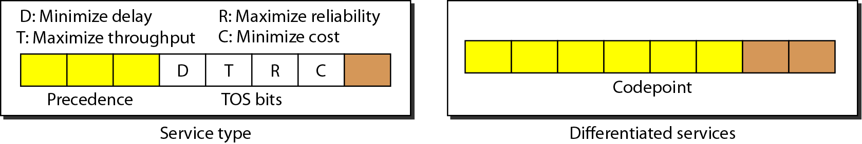
服务类型或区分服务
区分服务
(a) 当最右边的3位为0时，最左边的3位的解释与服务类型解释中的优先比特相同。
(b) 当最右边的3位不全是0时，6位根据互联网或地方当局分配的优先级定义63种服务。000001 ～ 111110】
Notes:
From data communications and networking
This field, previously called service type, is now called differentiated services.
(1) Service Type
In this interpretation, the first 3 bits are called precedence bits.
The next 4 bits are called type of service (TOS) bits, and the last bit is not used.
The precedence defines the priority of the datagram in issues such as congestion.
(2) Differentiated Service
In this interpretation, the first 6 bits make up the code point subfield, and the last 2 bits are not used.
The code point subfield can be used in two different ways.
(a) When the 3 rightmost bits are 0s, the 3 leftmost bits are interpreted the same as the precedence bits in the service type interpretation.
In other words, it is compatible with the old interpretation.
(b) When the 3 rightmost bits are not all 0s, the 6 bits define 63 services based on the priority assignment by the Internet or local authorities.【000001 ～ 111110】
Category Codepoint Assigning authority
1 XXXXX0 Internet (inclusive of part a)
2 XXXX11 Local
3 XXXX01 Temporary or experimental

Slide 67
位
0
4
8
16
19
24
31
版 本
首部长度
区 分 服 务
总 长 度
固
定
部
分
标 识
标志
片 偏 移
首
部
生 存 时 间
协 议
首 部 检 验 和
源 地 址
目 的 地 址
可变
部分
可 选 字 段 (长 度 可 变)
填 充
数 据 部 分
总长度 — 占 16 位，指首部和数据之和的长度，
单位为字节，因此数据报的最大长度为 65535 字节。
总长度必须不超过最大传送单元 MTU。

Slide 68
位
0
4
8
16
19
24
31
版 本
首部长度
区 分 服 务
总 长 度
固
定
部
分
标 识
标志
片 偏 移
首
部
生 存 时 间
协 议
首 部 检 验 和
源 地 址
目 的 地 址
可变
部分
可 选 字 段 (长 度 可 变)
填 充
数 据 部 分
标识 (identification) 占 16 位，
它是一个计数器，用来产生数据报的标识。

Slide 69
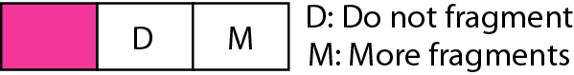
位
0
4
8
16
19
24
31
版 本
首部长度
区 分 服 务
总 长 度
固
定
部
分
标 识
标志
片 偏 移
首
部
生 存 时 间
协 议
首 部 检 验 和
源 地 址
目 的 地 址
可变
部分
可 选 字 段 (长 度 可 变)
填 充
数 据 部 分
标志(flag) 占3位，目前只有两位有意义。标志字段的最低位是MF (More Fragment)。MF = 1 表示后面"还有分片"。MF = 0 表示最后一个分片。标志字段中间的一位是DF (Don't Fragment) 。只有当 DF = 0 时才允许分片。

Slide 70
位
0
4
8
16
19
24
31
版 本
首部长度
区 分 服 务
总 长 度
固
定
部
分
标 识
标志
片 偏 移
首
部
生 存 时 间
协 议
首 部 检 验 和
源 地 址
目 的 地 址
可变
部分
可 选 字 段 (长 度 可 变)
填 充
数 据 部 分
片偏移(13 位)指出：较长的分组在分片后，某片在原分组中的相对位置。
片偏移以8个字节为偏移单位。

Slide 71
IP数据报分片
一数据报的总长度为3820字节，其数据部分的长度为3800 字节(使用固定首部)，需要分片为长度不超过1420字节的数据报片。
因固定首部长度为20字节，因此每个数据报片的数据部分长度不能超过1400字节。
于是分为3个数据报片，其数据部分的长度分别为1400、1400和1000字节。
原始数据报首部被复制为各数据报片的首部，但必须修改有关字段的值。

Slide 72
IP数据报分片
数据部分共 3800 字节
需分片的
数据报
首部
偏移 = 0/8
= 0
字节 0
1400
2800
3799
首部 1
首部 2
首部 3
字节 0
1399
1400
2799
2800
3799
数据报片 1
数据报片 2
数据报片 3
偏移 = 0/8 = 0
偏移 = 1400/8 = 175
偏移 = 2800/8 = 350
Notes:
Greedy algorithm

Slide 73
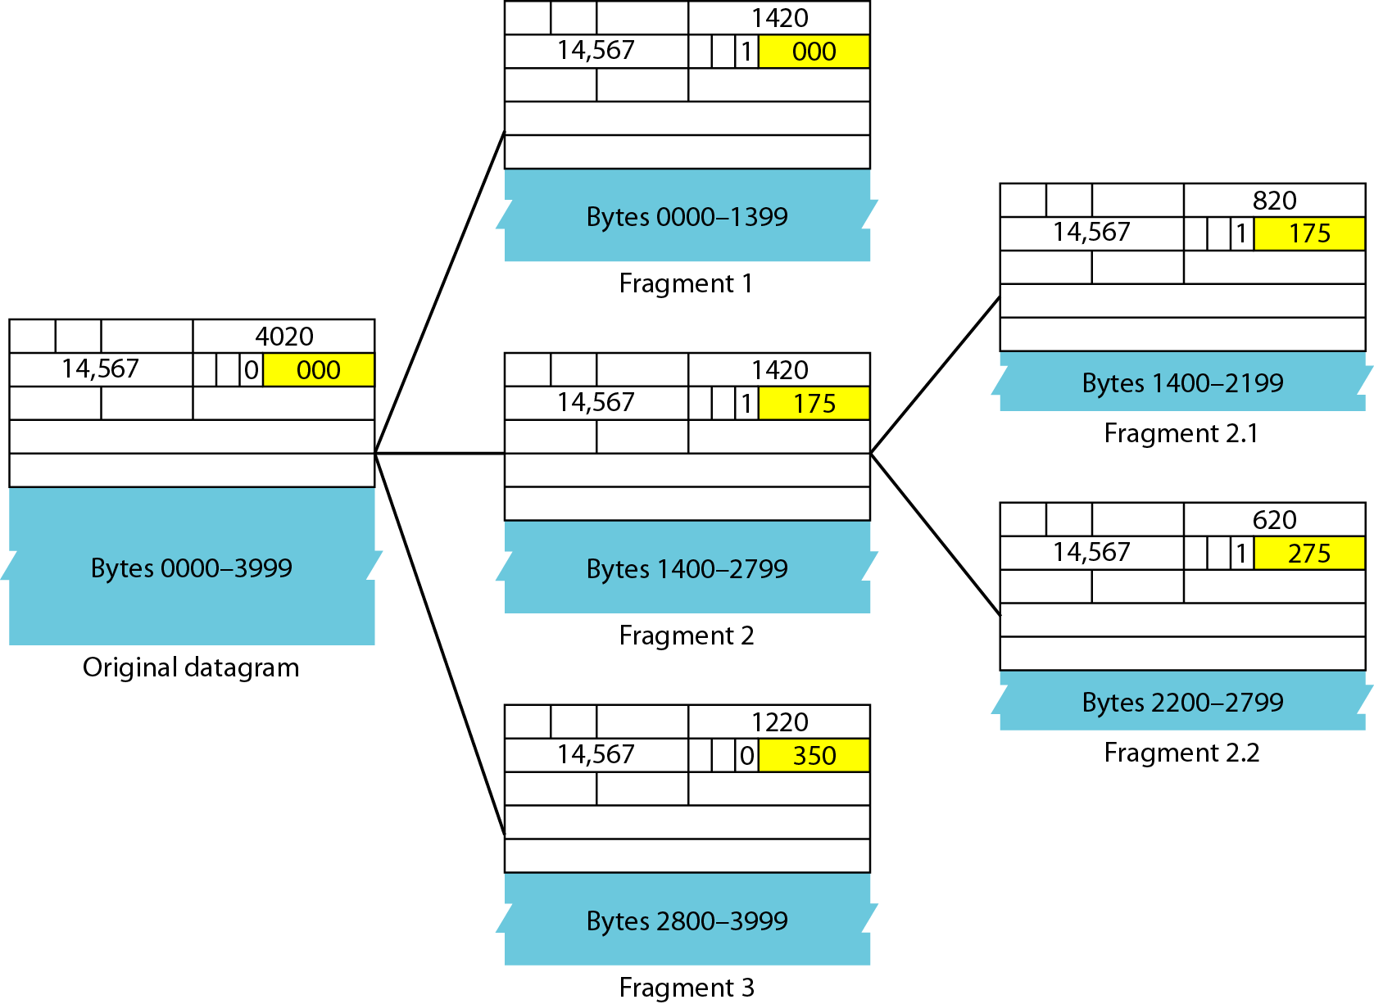
详细分片的举例
Notes:
original datagram

Slide 74
位
0
4
8
16
19
24
31
版 本
首部长度
区 分 服 务
总 长 度
固
定
部
分
标 识
标志
片 偏 移
首
部
生 存 时 间
协 议
首 部 检 验 和
源 地 址
目 的 地 址
可变
部分
可 选 字 段 (长 度 可 变)
填 充
数 据 部 分
生存时间(8位) 记为TTL(Time To Live)
数据报在网络中可经过的路由器数的最大值。

Slide 75
位
0
4
8
16
19
24
31
版 本
首部长度
区 分 服 务
总 长 度
固
定
部
分
标 识
标志
片 偏 移
首
部
生 存 时 间
协 议
首 部 检 验 和
源 地 址
目 的 地 址
可变
部分
可 选 字 段 (长 度 可 变)
填 充
数 据 部 分
协议(8 位)字段指出此数据报携带的数据使用何种协议,
以便目的主机的IP层将数据部分上交给哪个处理过程。

Slide 76
6
17
运输层
TCP
UDP
1
2
89
ICMP
IGMP
OSPF
网络层
首部
数 据 部 分
IP 数据报
协议字段指出应将数据
部分交给哪一个进程

Slide 77
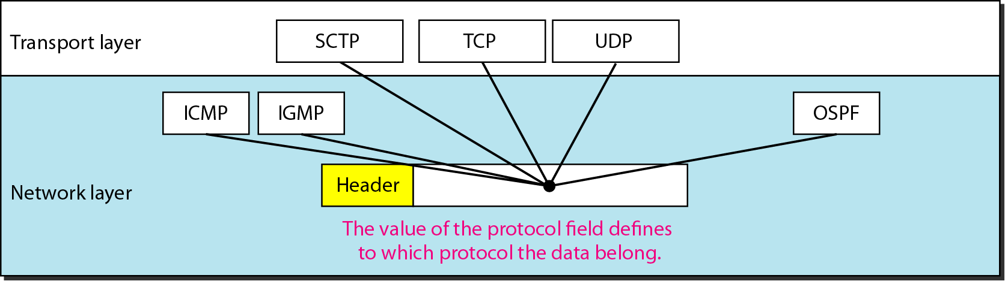
协议字段和封装数据
6
17
1
2
89

Slide 78
位
0
4
8
16
19
24
31
版 本
首部长度
区 分 服 务
总 长 度
固
定
部
分
标 识
标志
片 偏 移
首
部
生 存 时 间
协 议
首 部 检 验 和
源 地 址
目 的 地 址
可变
部分
可 选 字 段 (长 度 可 变)
填 充
数 据 部 分
首部检验和(16 位)字段只检验数据报的首部，不检验数据部分。
这里不采用CRC检验码而采用简单的计算方法。

Slide 79
发送端
接收端
字 1
16 位
字 1
16 位
数
据
报
首
部
字 2
16 位
字 2
16 位
…
…
检验和
置为全 0
检验和
16 位
…
…
字 n
16 位
字 n
16 位
反码算术
运算求和
反码算术
运算求和
16 位
16 位
取反码
IP 数据报
取反码
检验和
16 位
结果
16 位
数据部分
不参与检验和的计算
数据部分
若结果为 0, 则保留；
否则，丢弃该数据报

Slide 80
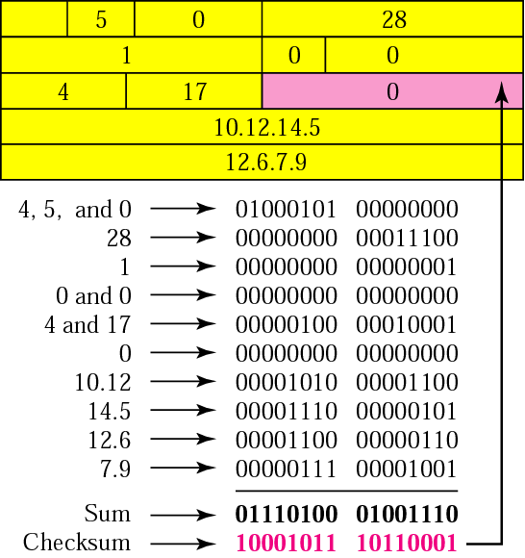
Header checksum calculation in binary

Slide 81
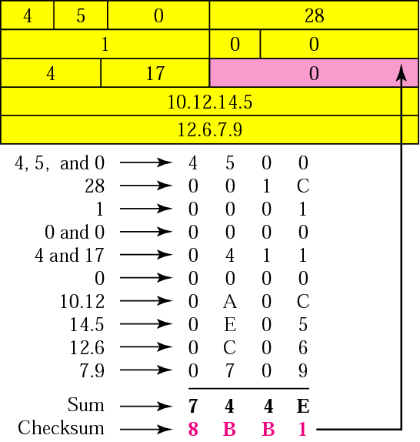
Header checksum calculation in hexadecimal

Slide 82
位
0
4
8
16
19
24
31
版 本
首部长度
区 分 服 务
总 长 度
固
定
部
分
标 识
标志
片 偏 移
首
部
生 存 时 间
协 议
首 部 检 验 和
源 地 址
目 的 地 址
可变
部分
可 选 字 段 (长 度 可 变)
填 充
数 据 部 分
源地址和目的地址都各占 4 字节

Slide 83
第4章 网络层: 数据平面
4.1 网络层概述
转发和路由选择: 数据平面和控制平面
网络服务模型
4.2 路由器工作原理
输入端口处理和基于目的地转发
交换
输出端口处理
何处出现排队
分组调度
4.4 网际协议: IPv4、寻址、IPv6及其它
IPv4 数据报格式
IPv4 数据报分片
IPv4 编址
网络地址转换
IPv6
4.5 通用转发和SDN
匹配
动作
匹配加动作操作中的OpenFlow例子
4.8 小结

Slide 84

IPv4 数据报分片
IP分片和重组
网络链路具有 MTU (最大传输单位)属性 —— 是由链路层最大帧的限制决定的
不同类型的链路有不同的MTU值
大的IP数据报在网络中会被分成小的分片
一个数据报变成了几个数据报
重组只在目的主机进行
数据报头部的标识、标志以及片偏移字段用于目的主机对接收的分片进行重组
…
分片:
in: 1个大数据报
out: 3个小数据报
重组
…
Notes:
We’ll see in Chapter 6 that not all link-layer protocols can carry network-layer packets of the same size.
Some protocols can carry big datagrams, whereas other protocols can carry only little packets.
For example, Ethernet frames can carry up to 1,500 bytes of data, whereas frames for some wide-area links can carry no more than 576 bytes.
The maximum amount of data that a link-layer frame can carry is called the maximum transmission unit (MTU).
Because each IP datagram is encapsulated within the link-layer frame for transport from one router to the next router, the MTU of the link-layer protocol places a hard limit on the length of an IP datagram.
Having a hard limit on the size of an IP datagram is not much of a problem.
What is a problem is that each of the links along the route between sender and destination can use different link-layer protocols, and each of these protocols can have different MTUs.
To understand the forwarding issue better, imagine that you are a router that interconnects several links, each running different link-layer protocols with different MTUs.
Suppose you receive an IP datagram from one link.
You check your forwarding table to determine the outgoing link, and this outgoing link has an MTU that is smaller than the length of the IP datagram.
Time to panic — how are you going to squeeze this oversized IP datagram into the payload field of the link-layer frame?
The solution is to fragment the data in the IP datagram into two or more smaller IP datagrams, encapsulate each of these smaller IP datagrams in a separate link-layer frame; and send these frames over the outgoing link.
Each of these smaller datagrams is referred to as a fragment.
Fragments need to be reassembled before they reach the transport layer at the destination.
Indeed, both TCP and UDP are expecting to receive complete, unfragmented segments from the network layer.
The designers of IPv4 felt that reassembling datagrams in the routers would introduce significant complication into the protocol and put a damper on router performance.
(If you were a router, would you want to be reassembling fragments on top of everything else you had to do?)
Sticking to the principle of keeping the network core simple, the designers of IPv4 decided to put the job of datagram reassembly in the end systems rather than in network routers.
When a destination host receives a series of datagrams from the same source, it needs to determine whether any of these datagrams are fragments of some original, larger datagram.
If some datagrams are fragments, it must further determine when it has received the last fragment and how the fragments it has received should be pieced back together to form the original datagram.
To allow the destination host to perform these reassembly tasks, the designers of IP (version 4) put identification, flag, and fragmentation offset fields in the IP datagram header.
When a datagram is created, the sending host stamps the datagram with an identification number as well as source and destination addresses.
Typically, the sending host increments the identification number for each datagram it sends.
When a router needs to fragment a datagram, each resulting datagram (that is, fragment) is stamped with the source address, destination address, and identification number of the original datagram.
When the destination receives a series of datagrams from the same sending host, it can examine the identification numbers of the datagrams to determine which of the datagrams are actually fragments of the same larger datagram.
Because IP is an unreliable service, one or more of the fragments may never arrive at the destination.
For this reason, in order for the destination host to be absolutely sure it has received the last fragment of the original datagram, the last fragment has a flag bit set to 0, whereas all the other fragments have this flag bit set to 1.
Also, in order for the destination host to determine whether a fragment is missing (and also to be able to reassemble the fragments in their proper order), the offset field is used to specify where the fragment fits within the original IP datagram.

Slide 85
Flags
flags
0
DF
MF
Reserved
DF=0: May Fragment; DF=1: Don’t Fragment
MF=0: Last Fragment; MF=1: More Fragment
Notes:
When a destination host receives a series of datagrams from the same source, it needs to determine whether any of these datagrams are fragments of some original, larger datagram.
If some datagrams are fragments, it must further determine when it has received the last fragment and how the fragments it has received should be pieced back together to form the original datagram.
To allow the destination host to perform these reassembly tasks, the designers of IP (version 4) put identification, flag, and fragmentation offset fields in the IP datagram header.
When a datagram is created, the sending host stamps the datagram with an identification number as well as source and destination addresses.
Typically, the sending host increments the identification number for each datagram it sends.
When a router needs to fragment a datagram, each resulting datagram (that is, fragment) is stamped with the source address, destination address, and identification number of the original datagram.
When the destination receives a series of datagrams from the same sending host, it can examine the identification numbers of the datagrams to determine which of the datagrams are actually fragments of the same larger datagram.
Because IP is an unreliable service, one or more of the fragments may never arrive at the destination.
For this reason, in order for the destination host to be absolutely sure it has received the last fragment of the original datagram, the last fragment has a flag bit set to 0, whereas all the other fragments have this flag bit set to 1.
Also, in order for the destination host to determine whether a fragment is missing (and also to be able to reassemble the fragments in their proper order), the offset field is used to specify where the fragment fits within the original IP datagram.

Slide 86
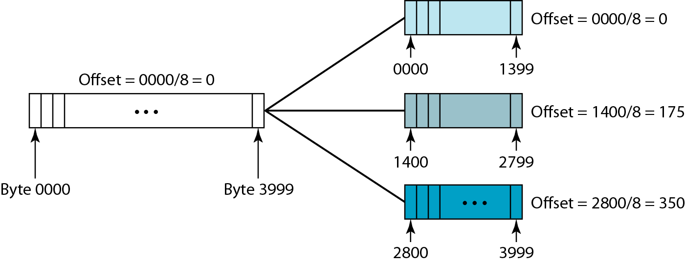
IP Fragmentation and Reassembly
Notes:
From Computer networks a systems approach
This 13-bit field shows the relative position of this fragment with respect to the whole datagram.
It is the offset of the data in the original datagram measured in units of 8 bytes.
Figure shows a datagram with a data size of 4000 bytes fragmented into three fragments.

Slide 87
Detailed fragmentation example
Notes:
It is obvious that even if each fragment follows a different path and arrives out of order, the final destination host can reassemble the original datagram from the fragments received (if none of them is lost) by using the following strategy:
1. The first fragment has an offset field value of zero.
2. Divide the length of the first fragment by 8.
The second fragment has an offset value equal to that result.
3. Divide the total length of the first and second fragments by 8.
The third fragment has an offset value equal to that result.
4. Continue the process.
The last fragment has a more bit value of 0.

Slide 88
IPv4 数据报分片
length
=4000
ID
=x
fragflag
=0
offset
=0
示例:
4000 字节的数据报
MTU = 1500 字节
1个大数据报切分成若干个小数据报
数据字段中有1480字节
length
=1500
ID
=x
fragflag
=1
offset
=0
offset =
1480/8
length
=1500
ID
=x
fragflag
=1
offset
=185
length
=1040
ID
=x
fragflag
=0
offset
=370
Notes:
From Computer networking a top down approach 6th edition
Figure 4.17 illustrates an example.
A datagram of 4,000 bytes (20 bytes of IP header plus 3,980 bytes of IP payload) arrives at a router and must be forwarded to a link with an MTU of 1,500 bytes. [3980 = 1480 + 1480 + 1020]
This implies that the 3,980 data bytes in the original datagram must be allocated to three separate fragments (each of which is also an IP datagram).
Suppose that the original datagram is stamped with an identification number of 777.
The characteristics of the three fragments are shown in Table 4.2.
The values in Table 4.2 reflect the requirement that the amount of original payload data in all but the last fragment be a multiple of 8 bytes, and that the offset value be specified in units of 8-byte chunks.
At the destination, the payload of the datagram is passed to the transport layer only after the IP layer has fully reconstructed the original IP datagram.
If one or more of the fragments does not arrive at the destination, the incomplete datagram is discarded and not passed to the transport layer.
But, as we learned in the previous chapter, if TCP is being used at the transport layer, then TCP will recover from this loss by having the source retransmit the data in the original datagram.
We have just learned that IP fragmentation plays an important role in gluing together the many disparate link-layer technologies.
But fragmentation also has its costs.
First, it complicates routers and end systems, which need to be designed to accommodate datagram fragmentation and reassembly.
Second, fragmentation can be used to create lethal DoS attacks, whereby the attacker sends a series of bizarre and unexpected fragments.
A classic example is the Jolt2 attack, where the attacker sends a stream of small fragments to the target host, none of which has an offset of zero.
The target can collapse as it attempts to rebuild datagrams out of the degenerate packets.
Another class of exploits [开发、利用] sends overlapping IP fragments, that is, fragments whose offset values are set so that the fragments do not align properly.
Vulnerable operating systems, not knowing what to do with overlapping fragments, can crash [Skoudis 2006].
As we’ll see at the end of this section, a new version of the IP protocol, IPv6, does away with fragmentation altogether, thereby streamlining IP packet processing and making IP less vulnerable to attack.
The online material for this book, and the problems at the end of this chapter will allow you to explore
fragmentation in more detail.
Also, on this book’s Web site, we provide a Java applet that generates fragments.
You provide the incoming datagram size, the MTU, and the incoming datagram identification.
The applet automatically generates the fragments for you.
See http://www.pearsonhighered.com/csresources/.

Slide 89
第4章 网络层: 数据平面
4.1 网络层概述
转发和路由选择: 数据平面和控制平面
网络服务模型
4.2 路由器工作原理
输入端口处理和基于目的地转发
交换
输出端口处理
何处出现排队
分组调度
4.4 网际协议: IPv4、寻址、IPv6及其它
IPv4 数据报格式
IPv4 数据报分片
IPv4 编址
网络地址转换
IPv6
4.5 通用转发和SDN
匹配
动作
匹配加动作操作中的OpenFlow例子
4.8 小结

Slide 90
IP寻址: 介绍
IP address: 32-bit identifier for host, router interface.
interface: boundary between host/router and physical link
router typically has multiple interfaces
host may have multiple interfaces
IP address associated with an interface
dotted decimal notation
4 bytes
223.1.1.1
223.1.2.1
223.1.1.2
223.1.1.4
223.1.2.9
223.1.1.3
223.1.3.27
223.1.2.2
223.1.3.1
223.1.3.2
223.1.1.1 = 11011111 00000001 00000001 00000001
223
1
1
1
Notes:
We now turn our attention to IPv4 addressing.
Although you may be thinking that addressing must be a straightforward topic, hopefully by the end of this chapter you’ll be convinced that Internet addressing is not only a juicy, subtle, and interesting topic but also one that is of central importance to the Internet.
Excellent treatments of IPv4 addressing are [3Com Addressing 2012] and the first chapter in [Stewart 1999].
Before discussing IP addressing, however, we’ll need to say a few words about how hosts and routers
are connected into the Internet.
A host typically has only a single link into the network; when IP in the host wants to send a datagram, it does so over this link.
The boundary between the host and the physical link is called an interface.
Now consider a router and its interfaces.
Because a router’s job is to receive a datagram on one link and forward the datagram on some other link, a router necessarily has two or more links to which it is connected.
The boundary between the router and any one of its links is also called an interface.
A router thus has multiple interfaces, one for each of its links.
Because every host and router is capable of sending and receiving IP datagrams, IP requires each host and router interface to have its own IP address.
Thus, an IP address is technically associated with an interface, rather than with the host or router containing that interface.
Each IP address is 32 bits long (equivalently, 4 bytes), and there are thus a total of 2³² (or approximately 4 billion) possible IP addresses.
These addresses are typically written in so-called dotted-decimal notation, in which each byte of the address is written in its decimal form and is separated by a period (dot) from other bytes in the address.
For example, consider the IP address 193.32.216.9.
The 193 is the decimal equivalent of the first 8 bits of the address; the 32 is the decimal equivalent of the second 8 bits of the address, and so on.
Thus, the address 193.32.216.9 in binary notation is 11000001 00100000 11011000 00001001.
Each interface on every host and router in the global Internet must have an IP address that is globally unique (except for interfaces behind NATs, as discussed in Section 4.3.4).
These addresses cannot be chosen in a willy-nilly manner, however.
A portion of an interface’s IP address will be determined by the subnet to which it is connected.

Slide 91

IP寻址: 介绍
Q: how are interfaces actually connected?
A: we’ll learn about that in chapter 6, 7.
223.1.1.1
223.1.2.1
223.1.1.2
223.1.1.4
223.1.2.9
223.1.1.3
223.1.3.27
223.1.2.2
A: wired Ethernet interfaces connected by Ethernet switches
223.1.3.1
223.1.3.2
For now: don’t need to worry about how one interface is connected to another (with no intervening router)
A: wireless WiFi interfaces connected by WiFi base station
Notes:
Figure 4.18 provides an example of IP addressing and interfaces.
In this figure, one router (with three interfaces) is used to interconnect seven hosts.
Take a close look at the IP addresses assigned to the host and router interfaces, as there are several things to notice.
The three hosts in the upper-left portion of Figure 4.18, and the router interface to which they are connected, all have an IP address of the form 223.1.1.xxx.
That is, they all have the same leftmost 24 bits in their IP address.
These four interfaces are also interconnected to each other by a network that contains no routers.
This network could be interconnected by an Ethernet LAN, in which case the interfaces would be interconnected by an Ethernet switch (as we’ll discuss in Chapter 6), or by a wireless access point (as we’ll discuss in Chapter 7).
We’ll represent this routerless network connecting these hosts as a cloud for now, and dive into the internals of such networks in Chapters 6 and 7.

Slide 92
2. 子网
IP address:
subnet part - high order bits
host part - low order bits
what’s a subnet ?
device interfaces with same subnet part of IP address
can physically reach each other without intervening router
223.1.1.1
223.1.1.2
223.1.2.1
223.1.1.4
223.1.2.9
223.1.2.2
223.1.1.3
223.1.3.27
subnet
223.1.3.1
223.1.3.2
network consisting of 3 subnets
Notes:
将网络中所有Host 和路由器的接口拆下后所形成的一个一个孤立的网络就叫子网。
子网的表示方法：
1、子网掩码：用从最高位开始的连续1表示IP地址中的子网号部分。
2、前缀/长度：223.1.1.0/24，表示前24位为子网号部分。
In IP terms, this network interconnecting three host interfaces and one router interface forms a subnet
[RFC 950].
(A subnet is also called an IP network or simply a network in the Internet literature.)
IP addressing assigns an address to this subnet: 223.1.1.0/24, where the /24 (“slash-24”) notation, sometimes known as a subnet mask, indicates that the leftmost 24 bits of the 32-bit quantity define the subnet address.
The 223.1.1.0/24 subnet thus consists of the three host interfaces (223.1.1.1, 223.1.1.2, and 223.1.1.3) and one router interface (223.1.1.4).
Any additional hosts attached to the 223.1.1.0/24 subnet would be required to have an address of the form 223.1.1.xxx.
There are two additional subnets shown in Figure 4.18: the 223.1.2.0/24 network and the 223.1.3.0/24 subnet.
Figure 4.19 illustrates the three IP subnets present in Figure 4.18.

Slide 93
2. 子网
识别子网的方法
为了确定子网，分开主机和路由器的每个接口，产生几个隔离的的网络孤岛
每个隔离的网络称为子网
223.1.1.0/24
223.1.2.0/24
223.1.1.1
223.1.1.2
223.1.2.1
223.1.1.4
223.1.2.9
223.1.2.2
223.1.1.3
223.1.3.27
subnet
223.1.3.1
223.1.3.2
223.1.3.0/24
subnet mask: /24

Slide 94
子网
223.1.1.2
how many?
223.1.1.1
223.1.1.4
223.1.1.3
223.1.9.2
223.1.7.0
223.1.9.1
223.1.7.1
223.1.8.1
223.1.8.0
223.1.2.6
223.1.3.27
223.1.2.1
223.1.2.2
223.1.3.1
223.1.3.2
Notes:
The IP definition of a subnet is not restricted to Ethernet segments that connect multiple hosts to a
router interface.
To get some insight here, consider Figure 4.20, which shows three routers that are interconnected with each other by point-to-point links.
Each router has three interfaces, one for each point-to-point link and one for the broadcast link that directly connects the router to a pair of hosts.
What subnets are present here?
Three subnets, 223.1.1.0/24, 223.1.2.0/24, and 223.1.3.0/24, are similar to the subnets we encountered in Figure 4.18.
But note that there are three additional subnets in this example as well: one subnet, 223.1.9.0/24, for the interfaces that connect routers R1 and R2; another subnet, 223.1.8.0/24, for the interfaces that connect routers R2 and R3; and a third subnet, 223.1.7.0/24, for the interfaces that connect routers R3 and R1.
For a general interconnected system of routers and hosts, we can use the following recipe to define the subnets in the system:
To determine the subnets, detach each interface from its host or router, creating islands of isolated networks, with interfaces terminating the end points of the isolated networks.
Each of these isolated networks is called a subnet.
If we apply this procedure to the interconnected system in Figure 4.20, we get six islands or subnets.
From the discussion above, it’s clear that an organization (such as a company or academic institution) with multiple Ethernet segments and point-to-point links will have multiple subnets, with all of the devices on a given subnet having the same subnet address.
In principle, the different subnets could have quite different subnet addresses.
In practice, however, their subnet addresses often have much in common.
To understand why, let’s next turn our attention to how addressing is handled in the global Internet.

Slide 95
3. 分类寻址
IPv4寻址一开始就使用分类的概念。
这种架构称为分类寻址。
虽然这个方案已经过时了，但我们在这里简要地讨论它，以展示无类寻址背后的基本原理。
在分类寻址中，地址空间分为五个类: A、B、C、D和E。
每个类占用部分地址空间。
Notes:
在CIDR采用之前，IP地址的分配策略叫做Classful addressing，即将IP地址分为不同的类别。
比如，A、B、C。基于分类的IP地址分配策略最大的问题是IP地址的利用效率，特别是在当前IPv4地址越来越匮乏的现在。
1、A类：网络号部分为高8位：0.0.0.0 Reserved for default route; 127. Reserved for loopback
2、B类：网络号部分为高16位
3、C类：网络号部分部分为高24位
Host Number部分全为0，表示网络；全为1为本网络内的广播地址。
IPv4 addressing, at its inception, used the concept of classes.
This architecture is called classful addressing.
Although the scheme is becoming obsolete, we briefly discuss it here to show the rationale behind classless addressing.
In classful addressing, the address space is divided into five classes: A, B, C, D, and E.
Each class occupies some part of the address space .

Slide 96
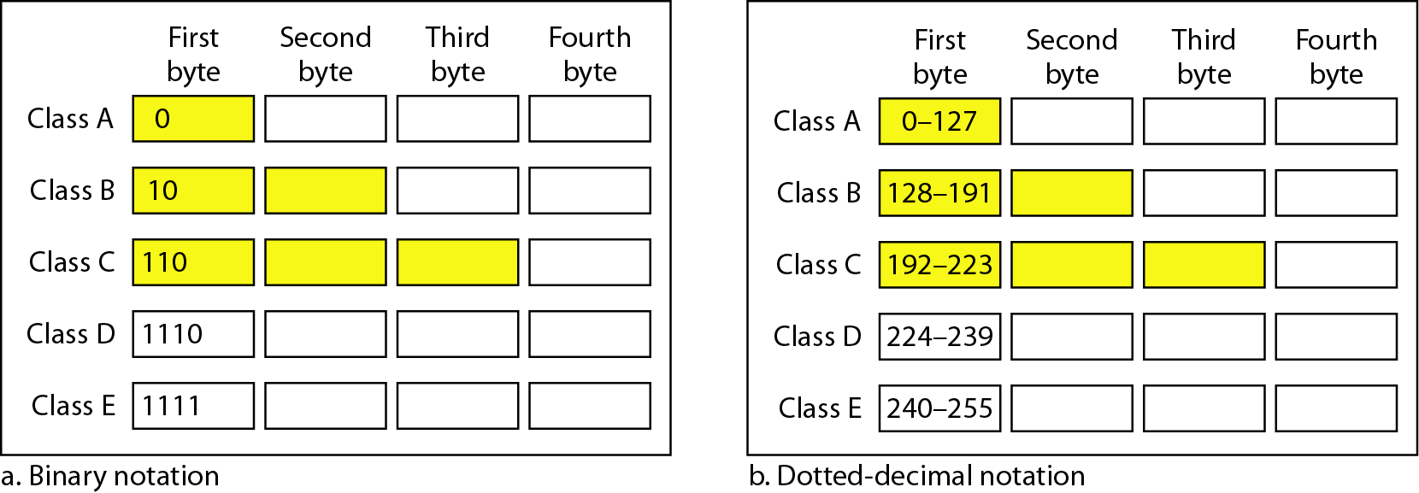
3. 分类寻址
辨别二进制和点十进制记数法中的分类类别
Notes:
From Data Communications and Networking
In classful addressing, an IP address in class A, B, or C is divided into netid and hostid.
These parts are of varying lengths, depending on the class of the address.
The Figure shows some netid and hostid bytes.
The netid is in color, the hostid is in white.
Note that the concept does not apply to classes D and E.
In class A, one byte defines the netid and three bytes define the hostid.
In class B, two bytes define the netid and two byte define the hostid.
In class C, three bytes defines the netid and one byte defines the hostid.
In classful addressing, an IP address in class A, B, or C is divided into netid and hostid.
These parts are of varying lengths, depending on the class of the address.
The figure above shows some netid and hostid bytes.
The netid is in color, the hostid is in white.
Note that the concept does not apply to classes D and E.

Slide 97
3. 分类寻址
Find the class of each address.
a. 00000001 00001011 00001011 11101111
b. 11000001 10000011 00011011 11111111
c. 14.23.120.8
d. 252.5.15.111
Solution
a. The first bit is 0. This is a class A address.
b. The first 2 bits are 1; the third bit is 0. This is a class C address.
c. The first byte is 14; the class is A.
d. The first byte is 252; the class is E.

Slide 98
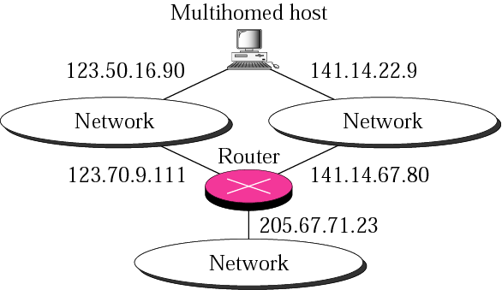
3. 分类寻址
多归属设备

Slide 99
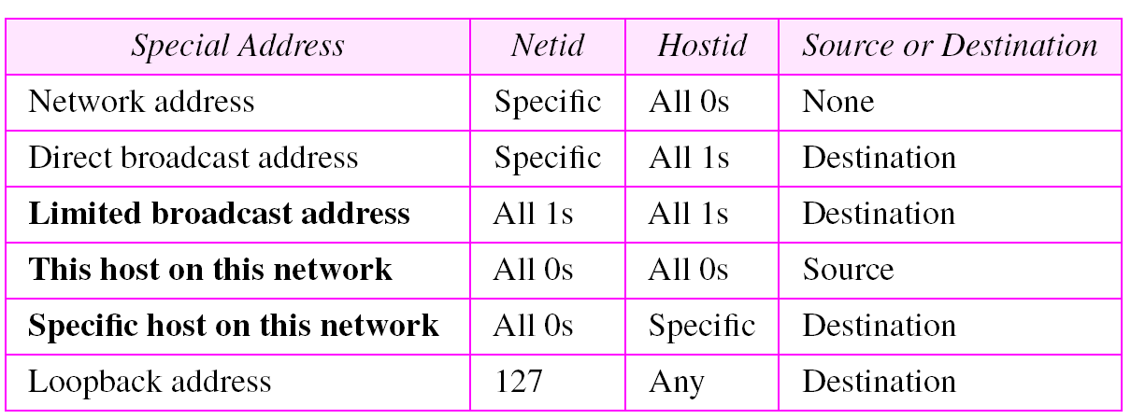
Special addresses

Slide 100
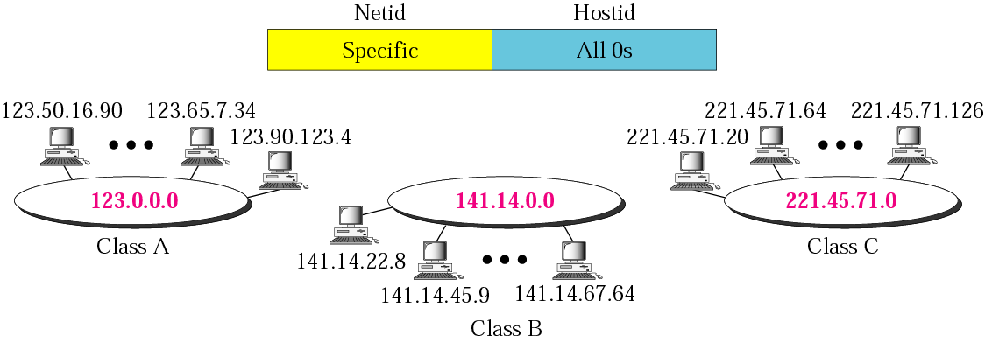
网络地址

Slide 101
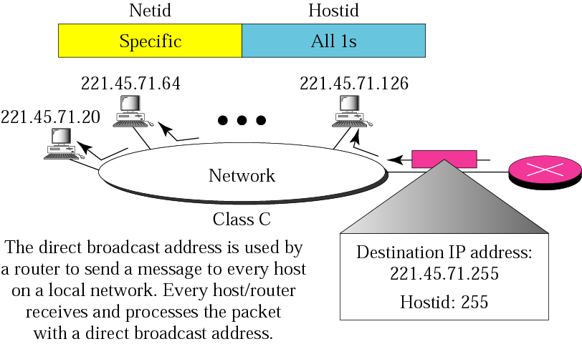
直接广播地址

Slide 102
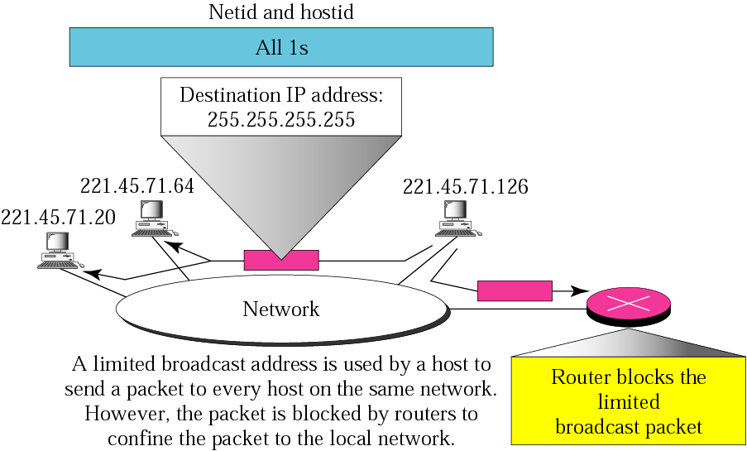
受限的广播地址

Slide 103
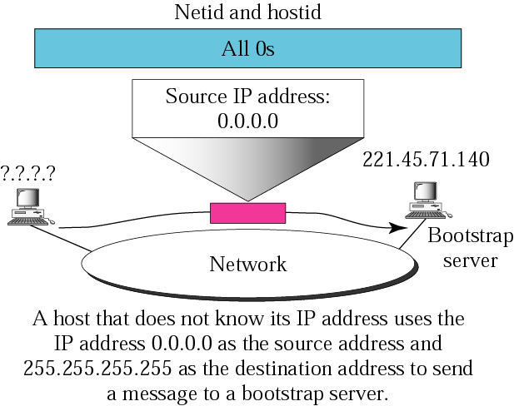
本网络上本主机

Slide 104
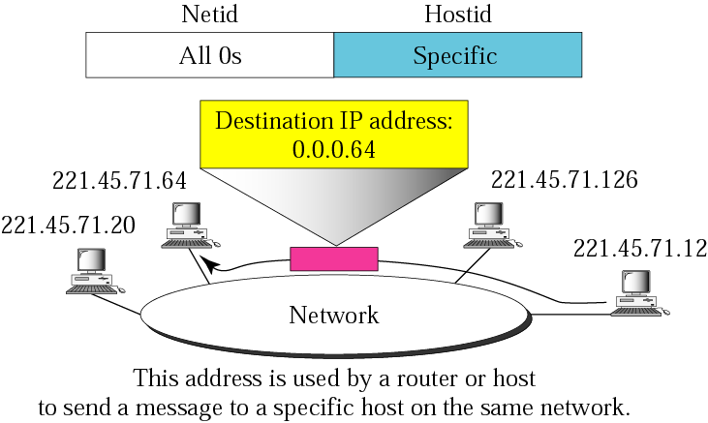
本网络上特定主机

Slide 105
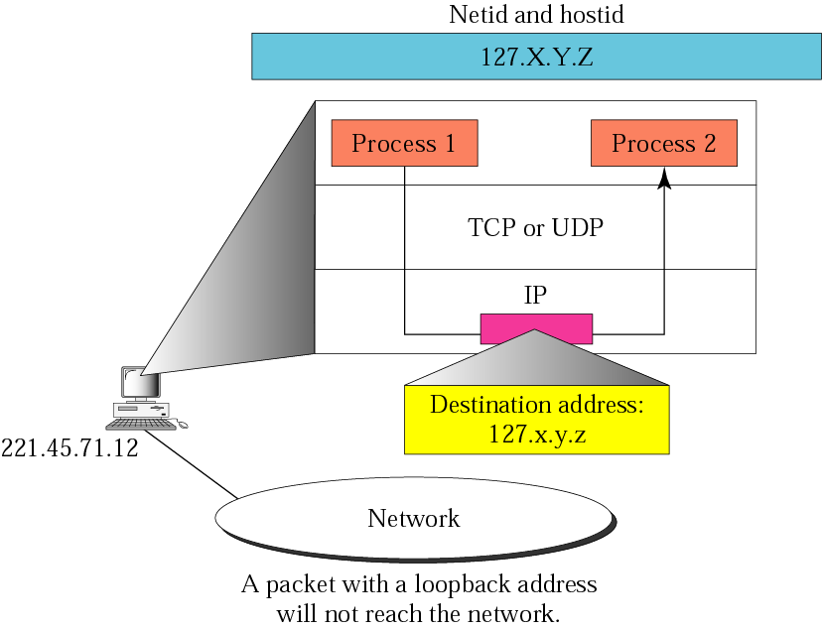
环回地址

Slide 106
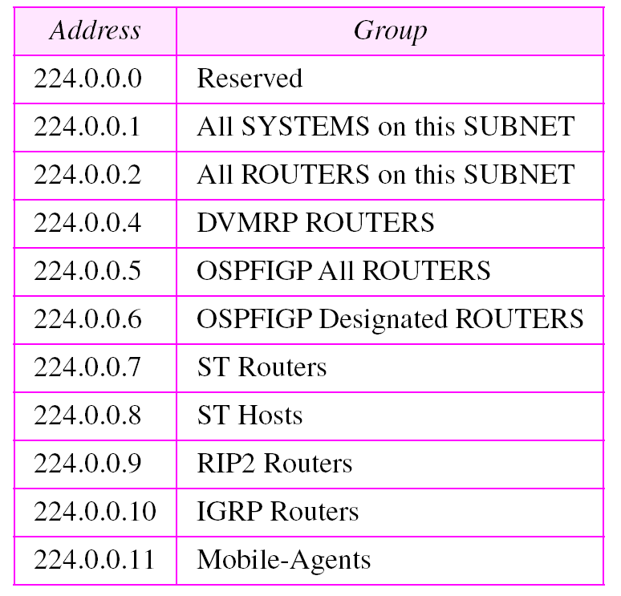
Permanent multicast addresses

Slide 107
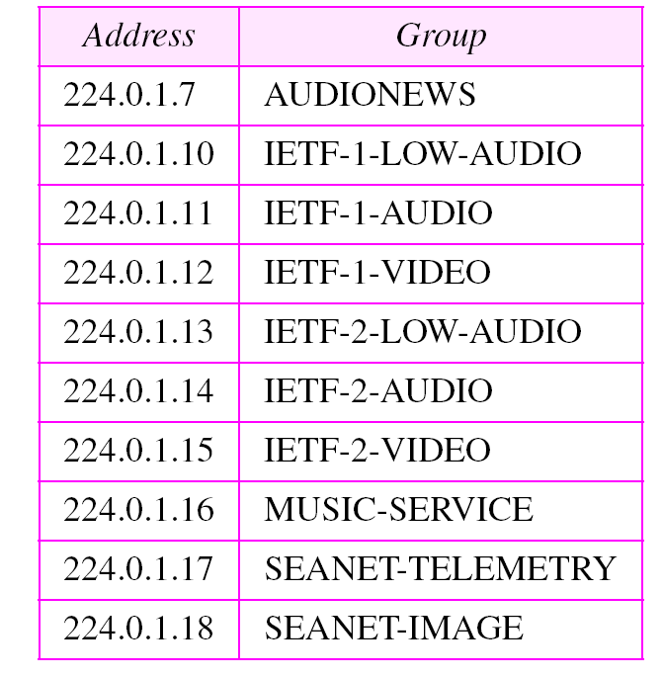
用于会议的多播地址

Slide 108
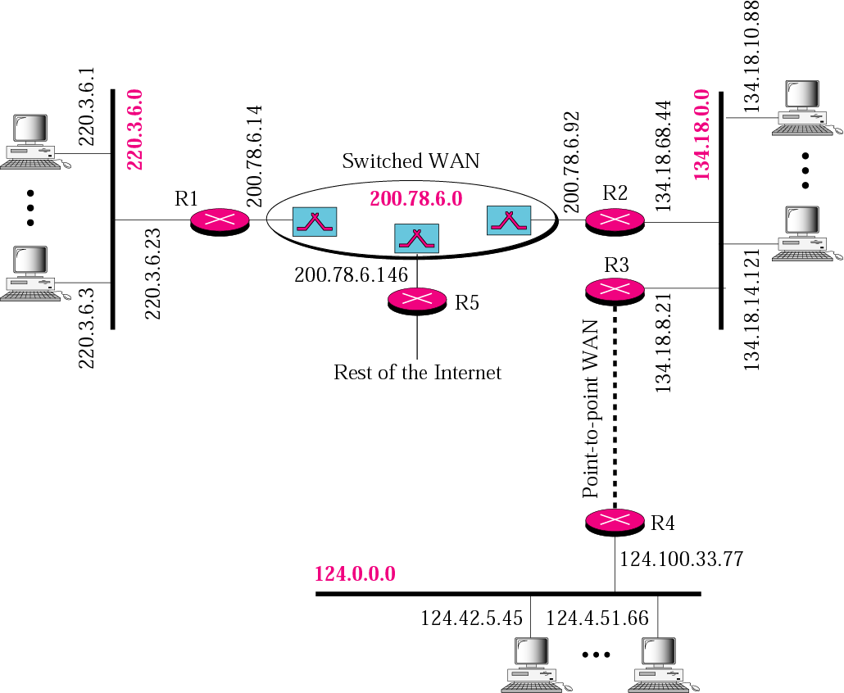
互连网举例

Slide 109
2. 常用的三种类别的 IP地址
IP地址的指派范围
网络 最大 第一个 最后一个 每个网络
类别 网络数 可用的 可用的 中最大的
网络号 网络号 主机数
A 126 (2⁷ – 2) 1 126 16,777,214
B 16,383 (2¹⁴ − 1) 128.1 191.255 65,534
C 2,097,151 (2²¹ − 1) 192.0.1 223.255.255 254

Slide 110
分类和块
Table. Number of blocks and block size in classful IPv4 addressing

Slide 111
掩码
虽然netid和hostid(以位计)的长度在分类寻址中预先确定，
我们还可以使用一个掩码(也称为默认掩码)，一个由连续的1和连续的0组成的32比特数字。
类A、B和C的掩码如下表所示。
这个概念不适用于类D和类E
Notes:
Although the length of the netid and hostid (in bits) is predetermined in classful addressing, we can also use a mask (also called the default mask), a 32-bit number made of contiguous 1s followed by contiguous 0s.
The masks for classes A, B, and C are shown in the following table.
The concept does not apply to classes D and E.

Slide 112
掩码
表. 分类寻址的默认掩码

Slide 113
掩码
掩码可以帮助我们找到netid和hostid。
例如，类A的掩码有8个1，这意味着类A中任何地址的前8位定义了netid；接下来的24位定义hostid。
上表的最后一列以/n的形式显示了掩码，其中n在类寻址中可以是8、16或24。
Notes:
The mask can help us to find the netid and the hostid.
For example, the mask for a class A has eight 1s, which means the first 8 bits of any address in class A define the netid; the next 24 bits define the hostid.
The last column of Table above shows the mask in the form /n where n can be 8, 16 or 24 in classful addressing.

Slide 114
掩码
这种表示法也称为斜杠表示法或无类域间路由(Classless Interdomain Routing, CIDR)表示法。
这种表示法用于无分类寻址。
我们在这里引入它是因为它也可以应用于分类寻址。
Notes:
This notation is also called slash notation or Classless Interdomain Routing (CIDR) notation.
This notation is used in classless addressing.
We introduce it here because it can also be applied to classful addressing.

Slide 115
4. 子网划分
在分类寻址时代，引入了子网。
如果一个组织被授予了A类或B类的大块，它就可以
将地址分成几个连续的组
将每个组分配到较小的网络(子网)，或者，在极少数情况下，与邻居共享部分地址。
子网划分增加了掩码中的1的数量，我们将在后面讨论无分类寻址时看到这一点。
Notes:
During the era of classful addressing, subnetting was introduced.
If an organization was granted a large block in class A or B, it could
divide the addresses into several contiguous groups and
assign each group to smaller networks (subnets) or, in rare cases, share part of the addresses with neighbors.
Subnetting increases the number of 1s in the mask, as we will see later when we discuss classless addressing.

Slide 116
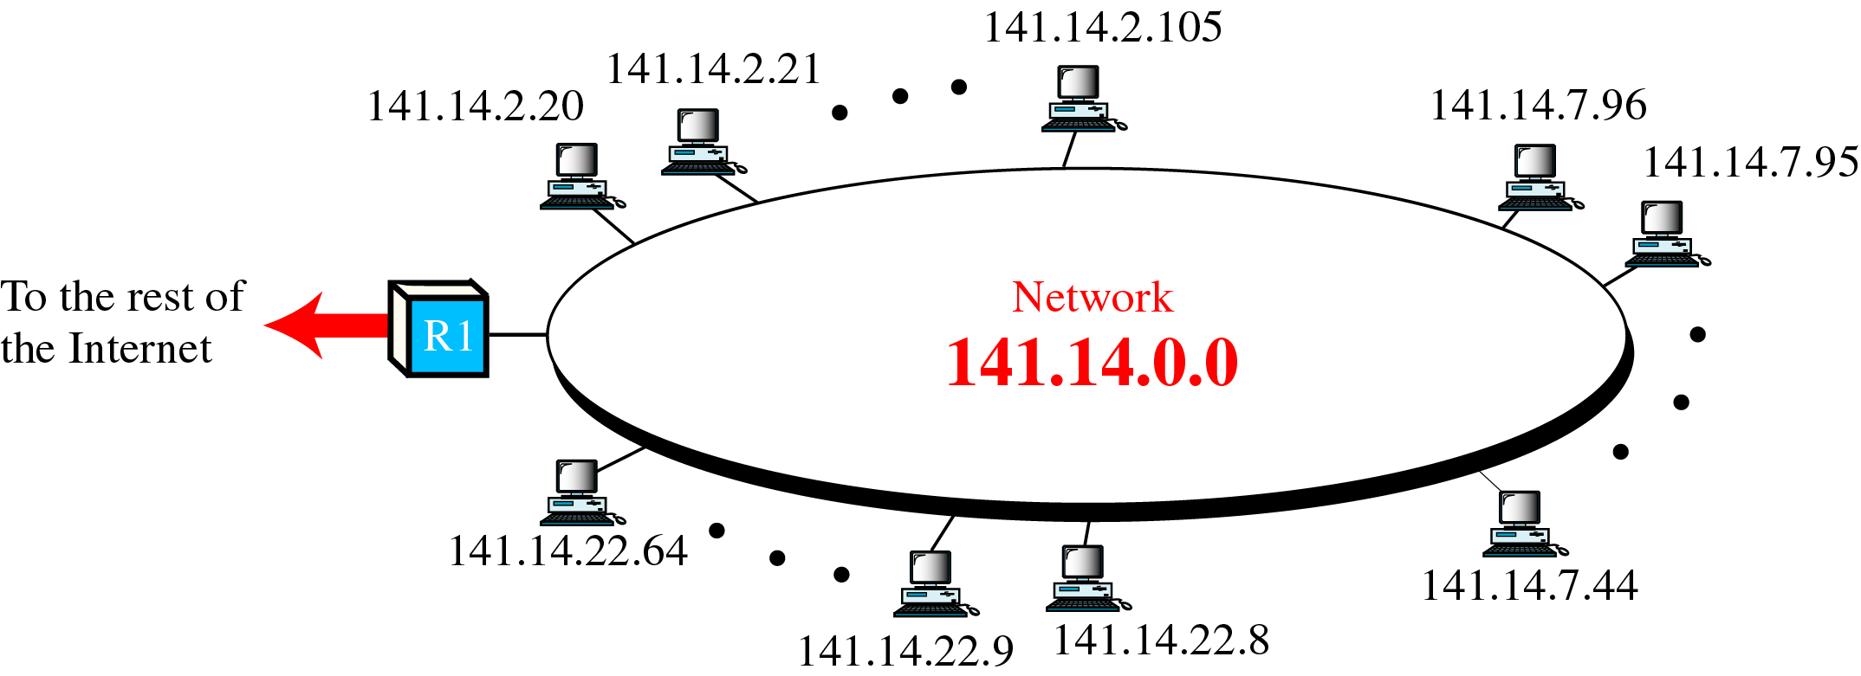
有两级层次的网络

Slide 117
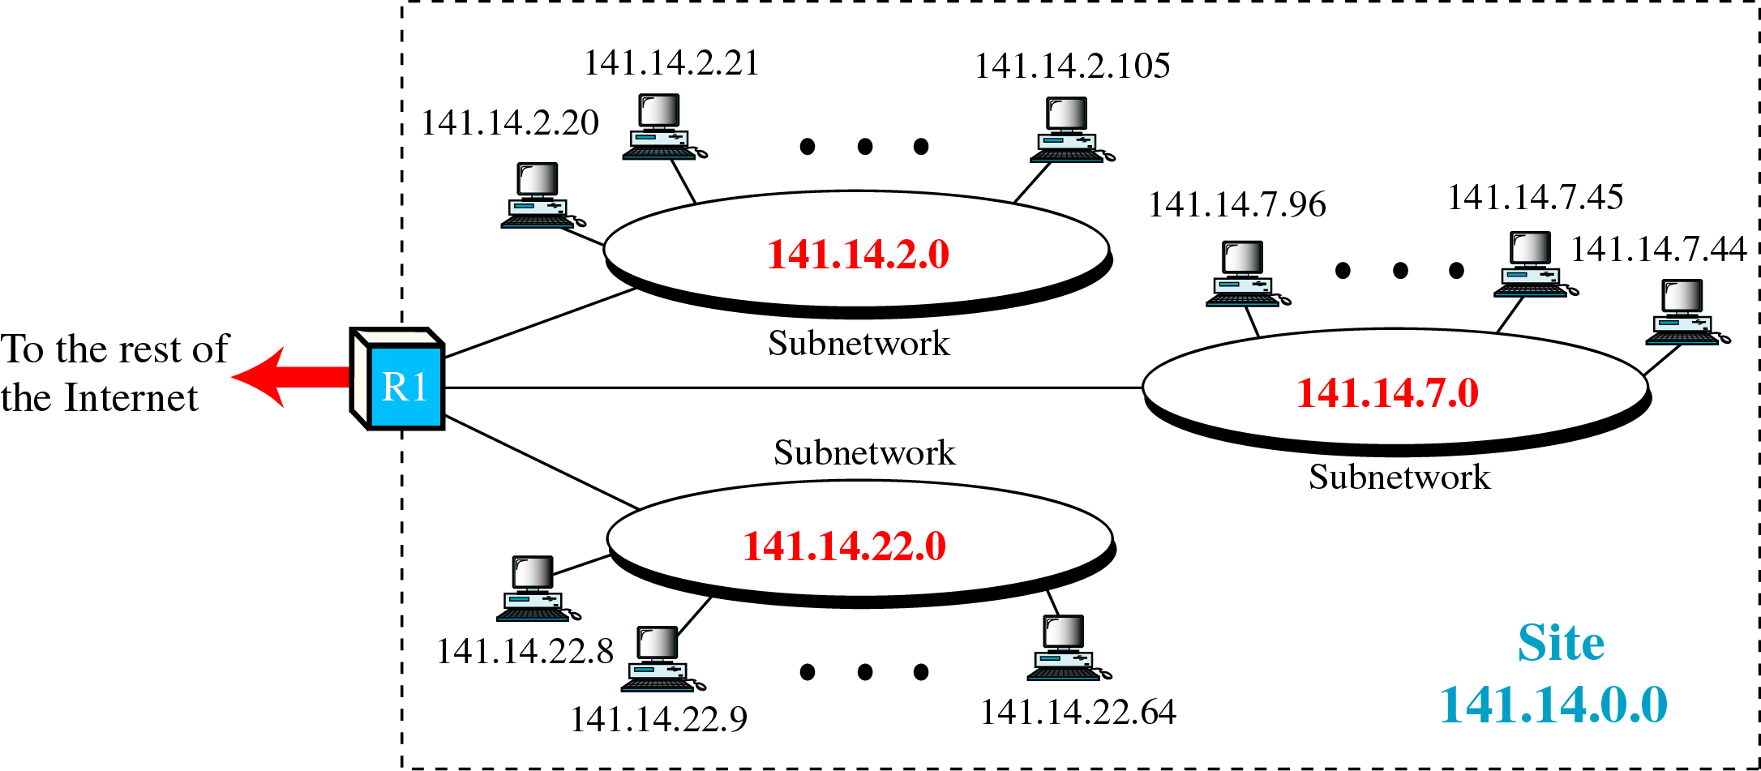
有三级层次的网络

Slide 118
划分子网的基本思路
一个拥有许多物理网络的单位，可将所属的物理网络划分为若干子网，划分子网纯属一个单位内部的事情。单位对外仍然表现为没有划分子网的网络。
划分子网的方法是从主机号借用若干个位作为子网号subnet-id，而主机号host-id也就相应减少了若干个位。
本地地址
网络号
子网号
主机号
32 位
IP地址::= {<网络号>, <子网号>, <主机号>}

Slide 119
划分子网的基本思路(续)
(3)凡是从其他网络发送给本单位某个主机的IP数据报，仍然是根据IP数据报的目的网络号net-id，找到连接在本单位网络上的路由器。
但此路由器在收到IP数据报后，再按目的网络号net-id和子网号subnet-id找到目的子网。
最后就将IP数据报直接交付目的主机。

Slide 120
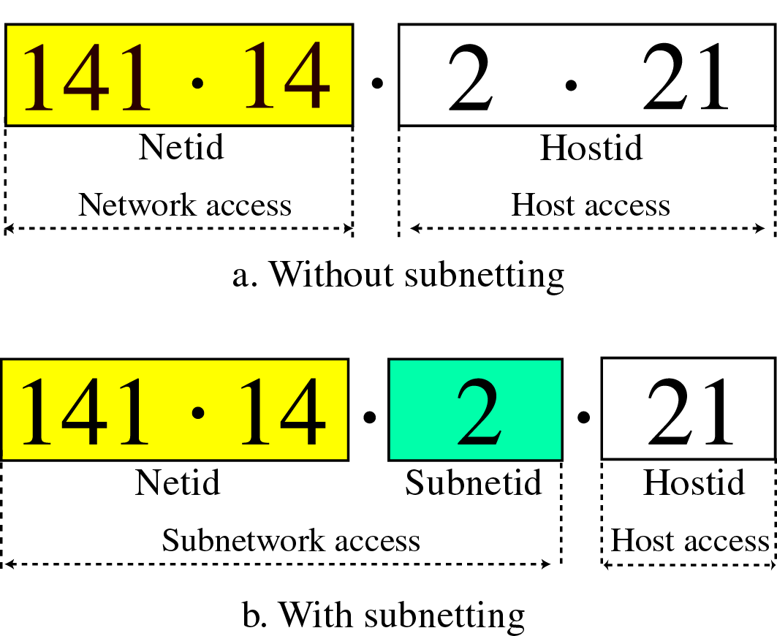
Addresses without and with Subnetting

Slide 121
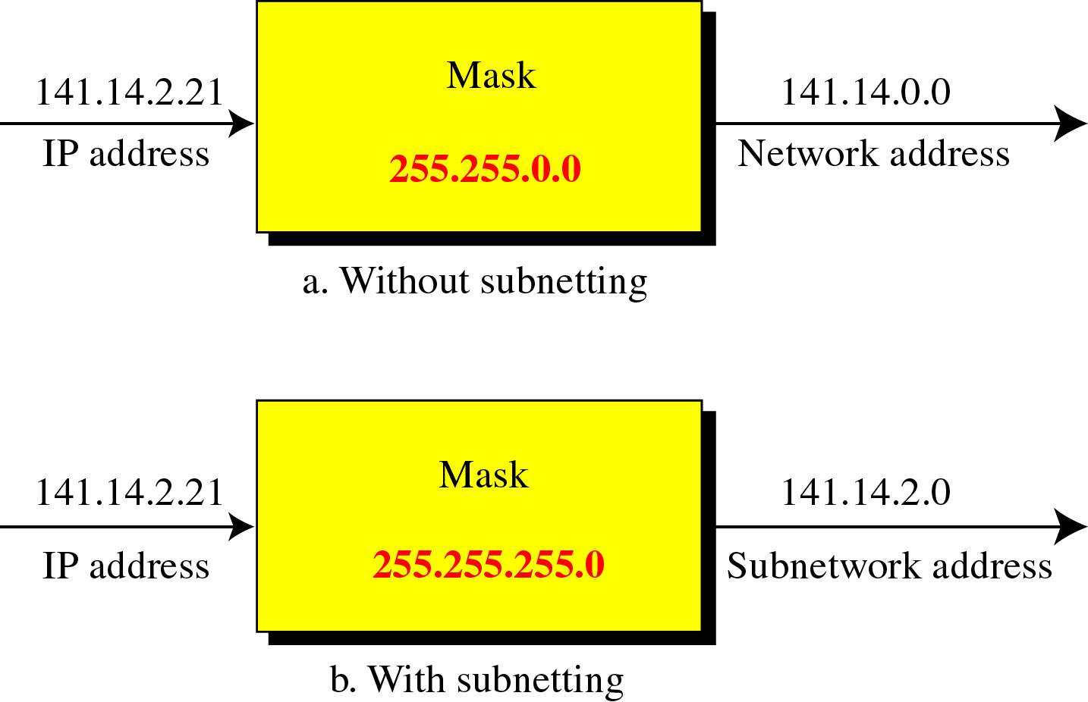
掩码

Slide 122
5. 构成超网
大多数的A类和B类地址被耗尽的时候，已经到来了。
不过，对中等规模大小的块需求仍然很大。
具有最大数目为256个地址的C类块的大小不能满足大多数组织的需要。
甚至中型企业也需要更多的地址。
Notes:
The time came when most of the class A and class B addresses were depleted. However, there was still a huge demand for midsize blocks. The size of a class C block with a maximum number of 256 addresses did not satisfy the needs of most organizations. Even a midsize organization needed more addresses.

Slide 123
5. 构造超网
一个解决方案是构造超网。
在构造超网中，一个组织可以组合几个类C块来创建更大范围的地址。
换句话说，几个网络组合在一起就形成了一个超级网络(supernetwork or supernet)。
超网减少了掩码中的1的数量。
例如，如果一个组织有4个类C地址，掩码将从/24更改为/22。
Notes:
One solution was supernetting (构造超网).
In supernetting, an organization can combine several class C blocks to create a larger range of addresses.
In other words, several networks are combined to create a supernetwork or supernet.
Supernetting decreases the number of 1s in the mask.
For example, if an organization is given four class C address, the mask changes from /24 to /22.
We will see that classless addressing eliminated the need for supernetting.

Slide 124
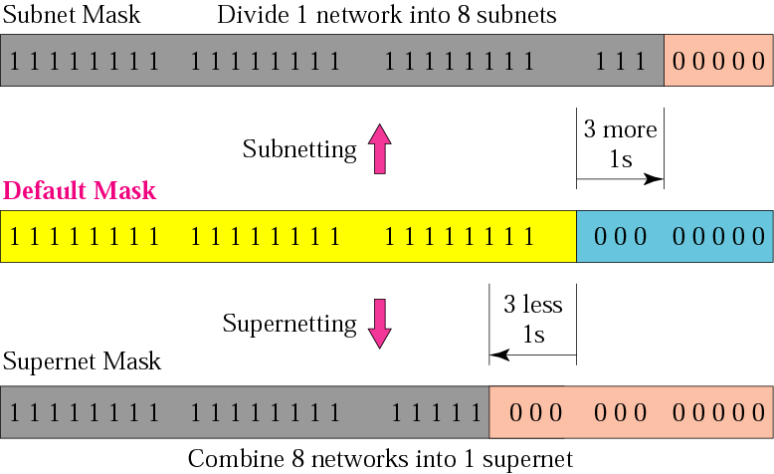
Comparison of subnet, default, and supernet masks

Slide 125
6. 分类寻址的缺陷
A类地址中的一个块对于几乎任何组织都太大。
这意味着类A中的大多数地址都被浪费了，没有被使用。
B类中的块也非常大，可能对于许多接收到类B块的组织来说太大了。
对于许多组织来说，类C中的块可能太小了。
Notes:
A block in class A address is too large for almost any organization.
This means most of the addresses in class A were wasted and were not used.
A block in class B is also very large, probably too large for many of the organizations that received a class B block.
A block in class C is probably too small for many organizations.

Slide 126
6. 分类寻址的缺陷
D类中的每个地址用于定义互联网上的一组主机。
互联网权威机构错误地预测需要268,435,456个组。
这从来没有发生过，许多地址也浪费在这里。
最后，类E地址被保留为未来使用，只有少数被使用，导致另一个地址浪费。
Notes:
Each address in class D is used to define one group of hosts on the Internet.
The Internet authorities wrongly predicted a need for 268,435,456 groups.
This never happened and many addresses were wasted here too.
And lastly, the class E addresses were reserved for future use, only a few were used, resulting in another waste of addresses.

Slide 127
7. 无分类寻址
为了克服地址枯竭[depletion]的问题，让更多的组织访问互联网，无分类地址被设计和实施。
在这个方案中，没有类别，但是地址仍然以块的形式给予。
在无分类寻址中，当一个实体，无论大小，需要连接到互联网时，它被给予一个地址块(范围)的地址。
块的大小(地址的个数)根据实体的性质和大小而变化。
Notes:
To overcome address depletion and give more organizations access to the Internet, classless addressing was designed and implemented.
In this scheme, there are no class, but the addresses are still granted in blocks.
In classless addressing, when an entity, small or large, needs to be connected to the Internet, it is granted a block (range) of addresses.
The size of the block (the number of addresses) varies based on the nature and size of the entity.

Slide 128
对无分类地址块的一些限制
为了简化地址的处理，互联网权威机构对无分类地址块施加了3个限制:
一个块中的地址必须是连续的，一个接一个。
一个块中的地址个数必须是2的幂 (1, 4, 8, 16, …)。
第一个地址必须能被地址个数整除。
Notes:
To simplify the handling of addresses, the Internet authorities impose three restrictions on classless address block:
The addresses in a block must be contiguous, one after another.
The number of addresses in a block must be a power of 2 (1, 4, 8, 16, … ).
The first address must be evenly divisible by the number of addresses.

Slide 129
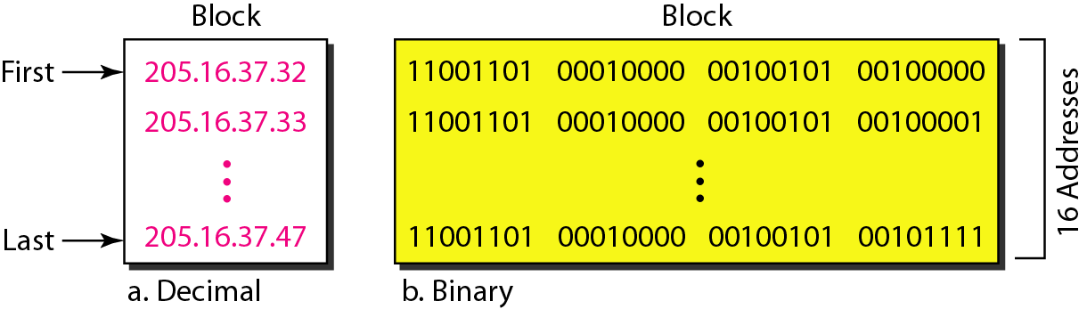
给予小组织机构的16个地址的地址块
Notes:
Data Communications and Networking
The figure above shows a block of addresses, in both binary and dotted-decimal notation, granted to a small business that needs 16 addresses.
We can see that the restrictions are applied to this block.
The addresses are contiguous.
The number of addresses is a power of 2 (16 = 2⁴)
(3) The first address is divisible by 16.
The first address, when converted to a decimal number, is 3,440,387,360, which when divided by 16 results in 215,024,210.
A better way to define a block of addresses is to select any address in the block and the mask.
As we discussed before, a mask is a 32-bit number in which the n leftmost bits are 1s and the 32－n rightmost bits are 0s.
However, in classless addressing the mask for a block can take any value from 0 to 32.
It is very convenient to give just the value of n preceded by a slash (CIDR notation)

Slide 130
CIDR
CIDR: Classless InterDomain Routing
subnet portion of address of arbitrary length
address format: a.b.c.d/x, where x is the number of bits in subnet portion of address.
prefix
suffix
subnet
part
host
part
11001000 00010111 00010001 11111111
200.23.16.0/23
Notes:
目前，Internet中的IP地址分配策略为CIDR (classless inter-domain routing，无类域间路由)。
CIDR将32位的IP地址分为两部分：子网地址和Host 地址。
地址的表示方式为：a.b.c.d/x，x表示子网地址的长度。
这样，IP地址的高x位为网络号，低32-x位为网络内部的Host 号部分。
From the discussion above, it’s clear that an organization (such as a company or academic institution) with multiple Ethernet segments and point-to-point links will have multiple subnets, with all of the devices on a given subnet having the same subnet address.
In principle, the different subnets could have quite different subnet addresses.
In practice, however, their subnet addresses often have much in common.
To understand why, let’s next turn our attention to how addressing is handled in the global Internet.
The Internet’s address assignment strategy is known as Classless Interdomain Routing (CIDR — pronounced cider) [RFC 4632].
CIDR generalizes the notion of subnet addressing.
As with subnet addressing, the 32-bit IP address is divided into two parts and again has the dotted-decimal form a.b.c.d/x, where x indicates the number of bits in the first part of the address.
The x most significant bits of an address of the form a.b.c.d/x constitute the network portion of the IP address, and are often referred to as the prefix (or network prefix) of the address.
An organization is typically assigned a block of contiguous addresses, that is, a range of addresses with a common prefix (see the Principles in Practice feature).
In this case, the IP addresses of devices within the organization will share the common prefix.
When we cover the Internet’s BGP routing protocol in Section 5.4, we’ll see that only these x leading prefix bits are considered by routers outside the organization’s network.
That is, when a router outside the organization forwards a datagram whose destination address is inside the organization, only the leading x bits of the address need be considered.
This considerably reduces the size of the forwarding table in these routers, since a single entry of the form a.b.c.d/x will be sufficient to forward packets to any destination within the organization.
The remaining 32-x bits of an address can be thought of as distinguishing among the devices within the organization, all of which have the same network prefix.
These are the bits that will be considered when forwarding packets at routers within the organization.
These lower-order bits may (or may not) have an additional subnetting structure, such as that discussed above.
For example, suppose the first 21 bits of the CIDRized address a.b.c.d/21 specify the organization’s network prefix and are common to the IP addresses of all devices in that organization.
The remaining 11 bits then identify the specific hosts in the organization.
The organization’s internal structure might be such that these 11 rightmost bits are used for subnetting within the organization, as discussed above.
For example, a.b.c.d/24 might refer to a specific subnet within the organization.
Before CIDR was adopted, the network portions of an IP address were constrained to be 8, 16, or 24 bits in length, an addressing scheme known as classful addressing, since subnets with 8-, 16-, and 24-bit subnet addresses were known as class A, B, and C networks, respectively.
The requirement that the subnet portion of an IP address be exactly 1, 2, or 3 bytes long turned out to be problematic for supporting the rapidly growing number of organizations with small and medium-sized subnets.
A class C (/24) subnet could accommodate only up to 2³² − 2 = 254 hosts (two of the 2⁸= 256 addresses are reserved for special use) — too small for many organizations.
However, a class B (/16) subnet, which supports up to 65,634 hosts, was too large.
Under classful addressing, an organization with, say, 2,000 hosts was typically allocated a class B (/16) subnet address.
This led to a rapid depletion of the class B address space and poor utilization of the assigned address space.
For example, the organization that used a class B address for its 2,000 hosts was allocated enough of the address space for up to 65,534 interfaces — leaving more than 63,000 addresses that could not be used by other organizations.
We would be remiss if we did not mention yet another type of IP address, the IP broadcast address 255.255.255.255.
When a host sends a datagram with destination address 255.255.255.255, the message is delivered to all hosts on the same subnet.
Routers optionally forward the message into neighboring subnets as well (although they usually don’t).
Having now studied IP addressing in detail, we need to know how hosts and subnets get their addresses in the first place.
Let’s begin by looking at how an organization gets a block of addresses for its devices, and then look at how a device (such as a host) is assigned an address from within the organization’s block of addresses.

Slide 131
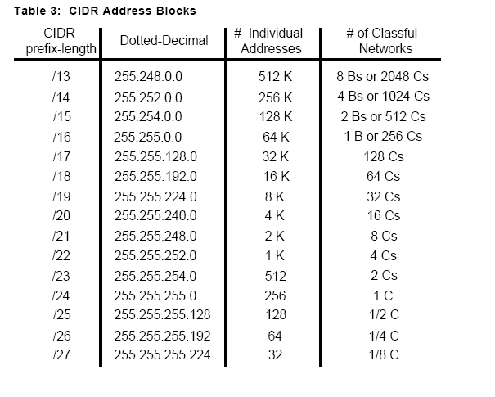
CIDR and Classful Addressing

Slide 132
层次编址
层次编址 —— 路由聚合
组织 0
200.23.16.0/23
组织1
“向我发送以200.23.16.0/20
开始的任何报文 ”
200.23.18.0/23
组织2
Fly-By-
Night-ISP
200.23.20.0/23
.
.
.
.
互联网
组织7
.
.
200.23.30.0/23
ISPs-R-Us
“向我发送以199.31.0.0/16
开始的任何报文”
Notes:
PRINCIPLES IN PRACTICE
This example of an ISP that connects eight organizations to the Internet nicely illustrates how carefully allocated CIDRized addresses facilitate routing.
Suppose, as shown in Figure 4.21, that the ISP (which we’ll call Fly-By-Night-ISP) advertises to the outside world that it should be sent any datagrams whose first 20 address bits match 200.23.16.0/20.
The rest of the world need not know that within the address block 200.23.16.0/20 there are in fact eight other organizations, each with its own subnets.
This ability to use a single prefix to advertise multiple networks is often referred to as address aggregation (also route aggregation or route summarization).

Slide 133
层次编址
组织 0
200.23.16.0/23
“向我发送以200.23.16.0/20
开始的任何报文 ”
组织2
200.23.20.0/23
.
Fly-By-Night-ISP
.
.
.
组织7
.
互联网
.
200.23.30.0/23
ISPs-R-Us
“向我发送以199.31.0.0/16或
200.23.18.0/23开始的任何报文”
组织1
200.23.18.0/23
Notes:
Address aggregation works extremely well when addresses are allocated in blocks to ISPs and then from ISPs to client organizations.
But what happens when addresses are not allocated in such a hierarchical manner?
What would happen, for example, if Fly-By-Night-ISP acquires [获得；取得] ISPs-R-Us and then has Organization 1 connect to the Internet through its subsidiary [附属的] ISPs-RUs?
As shown in Figure 4.21, the subsidiary ISPs-R-Us owns the address block 199.31.0.0/16, but Organization 1’s IP addresses are unfortunately outside of this address block.
What should be done here?
Certainly, Organization 1 could renumber all of its routers and hosts to have addresses within the ISPs-R-Us address block.
But this is a costly solution, and Organization 1 might well be reassigned to another subsidiary in the future.
The solution typically adopted is for Organization 1 to keep its IP addresses in 200.23.18.0/23.
In this case, as shown in Figure 4.22, Fly-By-Night-ISP continues to advertise the address block 200.23.16.0/20 and ISPs-R-Us continues to advertise 199.31.0.0/16.
However, ISPs-R-Us now also advertises the block of addresses for Organization 1, 200.23.18.0/23.
When other routers in the larger Internet see the address blocks 200.23.16.0/20 (from Fly-By-Night-ISP) and 200.23.18.0/23 (from ISPs-R-Us) and want to route to an address in the block 200.23.18.0/23, they will use longest prefix matching (see Section 4.2.1), and route toward ISPs-R-Us, as it advertises the longest (i.e., most-specific) address prefix that matches the destination address.

Slide 134
第4章 网络层: 数据平面
4.1 网络层概述
转发和路由选择: 数据平面和控制平面
网络服务模型
4.2 路由器工作原理
输入端口处理和基于目的地转发
交换
输出端口处理
何处出现排队
分组调度
4.4 网际协议: IPv4、寻址、IPv6及其它
IPv4 数据报格式
IPv4 数据报分片
IPv4 编址
网络地址转换
IPv6
4.5 通用转发和SDN
匹配
动作
匹配加动作操作中的OpenFlow例子
4.8 小结

Slide 135
获得一块地址
获取网络地址
Q: 一个网络如何获得一块地址？
A: 从ISP的地址空间中获得。
ISP的地址块 11001000 00010111 00010000 00000000 200.23.16.0/20
Organization 0 11001000 00010111 00010000 00000000 200.23.16.0/23
Organization 1 11001000 00010111 00010010 00000000 200.23.18.0/23
Organization 2 11001000 00010111 00010100 00000000 200.23.20.0/23
... ….. …. ….
Organization 7 11001000 00010111 00011110 00000000 200.23.30.0/23
Notes:
In order to obtain a block of IP addresses for use within an organization’s subnet, a network administrator might first contact its ISP, which would provide addresses from a larger block of addresses that had already been allocated to the ISP.
For example, the ISP may itself have been allocated the address block 200.23.16.0/20.
The ISP, in turn, could divide its address block into eight equal-sized contiguous address blocks and give one of these address blocks out to each of up to eight organizations that are supported by this ISP, as shown below.
(We have underlined the subnet part of these addresses for your convenience.)
ISP’s block: 200.23.16.0/20 11001000 00010111 00010000 00000000
Organization 0 200.23.16.0/23 11001000 00010111 00010000 00000000
Organization 1 200.23.18.0/23 11001000 00010111 00010010 00000000
Organization 2 200.23.20.0/23 11001000 00010111 00010100 00000000
… … …
Organization 7 200.23.30.0/23 11001000 00010111 00011110 00000000
While obtaining a set of addresses from an ISP is one way to get a block of addresses, it is not the only way.
Clearly, there must also be a way for the ISP itself to get a block of addresses.
Is there a global authority that has ultimate responsibility for managing the IP address space and allocating address blocks to ISPs and other organizations?
Indeed there is!
IP addresses are managed under the authority of the Internet Corporation for Assigned Names and Numbers (ICANN) [ICANN 2016], based on guidelines set forth in [RFC 7020].
The role of the nonprofit ICANN organization [NTIA 1998] is not only to allocate IP addresses, but also to manage the DNS root servers.
It also has the very contentious job of assigning domain names and resolving domain name disputes.
The ICANN allocates addresses to regional Internet registries (for example, ARIN, RIPE, APNIC, and LACNIC, which together form the Address Supporting Organization of ICANN [ASO-ICANN 2016]), and handle the allocation/management of addresses within their regions.

Slide 136
获得一块地址
Q: ISP 如何获得整块地址?
A: ICANN: Internet Corporation for Assigned Names and Numbers (互联网名字与号码分配机构)
分配IP地址
管理 DNS
分配域名，解决域名纠纷
Notes:
In order to obtain a block of IP addresses for use within an organization’s subnet, a network administrator might first contact its ISP, which would provide addresses from a larger block of addresses that had already been allocated to the ISP.
For example, the ISP may itself have been allocated the address block 200.23.16.0/20.
The ISP, in turn, could divide its address block into eight equal-sized contiguous address blocks and give one of these address blocks out to each of up to eight organizations that are supported by this ISP, as shown below.
(We have underlined the subnet part of these addresses for your convenience.)
ISP’s block: 200.23.16.0/20 11001000 00010111 00010000 00000000
Organization 0 200.23.16.0/23 11001000 00010111 00010000 00000000
Organization 1 200.23.18.0/23 11001000 00010111 00010010 00000000
Organization 2 200.23.20.0/23 11001000 00010111 00010100 00000000
… … …
Organization 7 200.23.30.0/23 11001000 00010111 00011110 00000000
While obtaining a set of addresses from an ISP is one way to get a block of addresses, it is not the only way.
Clearly, there must also be a way for the ISP itself to get a block of addresses.
Is there a global authority that has ultimate responsibility for managing the IP address space and allocating address blocks to ISPs and other organizations?
Indeed there is!
IP addresses are managed under the authority of the Internet Corporation for Assigned Names and Numbers (ICANN) [ICANN 2016], based on guidelines set forth in [RFC 7020].
The role of the nonprofit ICANN organization [NTIA 1998] is not only to allocate IP addresses, but also to manage the DNS root servers.
It also has the very contentious job of assigning domain names and resolving domain name disputes.
The ICANN allocates addresses to regional Internet registries (for example, ARIN, RIPE, APNIC, and LACNIC, which together form the Address Supporting Organization of ICANN [ASO-ICANN 2016]), and handle the allocation/management of addresses within their regions.

Slide 137
获得主机地址：动态主机配置协议
Q: 主机如何获得IP地址? (主机部分)
手工配置：系统管理员手工为一台主机配置IP地址
Windows: 控制面板->网络->配置->TCP/IP->属性
UNIX: /etc/rc.config
DHCP: Dynamic Host Configuration Protocol 动态主机配置协议: 从服务器上动态获取IP地址
“即插即用协议”
Notes:
一个组织或部分通常得到一块连续的IP地址，这些地址具有共同网络号部分。
在Internet内部的路由机制中，路由器所关心的也只是IP地址的网络号部分。
IP地址获取的方式：
1、静态配置：
2、动态获取：DHCP动态Host 配置协议。
DHCP是动态Host 配置协议，是Host 自动配置的关键协议，也叫即插即用协议。利用DHCP可以：
1)、自动配置IP协议
2)、支持移动性
3)、节省IP地址资源
Obtaining a Host Address: The Dynamic Host Configuration Protocol
Once an organization has obtained a block of addresses, it can assign individual IP addresses to the host and router interfaces in its organization.
A system administrator will typically manually configure the IP addresses into the router (often remotely, with a network management tool).
Host addresses can also be configured manually, but typically this is done using the Dynamic Host Configuration Protocol (DHCP) [RFC 2131].
DHCP allows a host to obtain (be allocated) an IP address automatically.
A network administrator can configure DHCP so that a given host receives the same IP address each time it connects to the network, or a host may be assigned a temporary IP address that will be different each time the host connects to the network.
In addition to host IP address assignment, DHCP also allows a host to learn additional information, such as its subnet mask, the address of its first-hop router (often called the default gateway), and the address of its local DNS server.
Because of DHCP’s ability to automate the network-related aspects of connecting a host into a network, it is often referred to as a plug-and-play or zeroconf (zero-configuration) protocol.
This capability makes it very attractive to the network administrator who would otherwise have to perform these tasks manually!
DHCP is also enjoying widespread use in residential Internet access networks, enterprise networks, and in wireless LANs, where hosts join and leave the network frequently.
Consider, for example, the student who carries a laptop from a dormitory room to a library to a classroom.
It is likely that in each location, the student will be connecting into a new subnet and hence will need a new IP address at each location.
DHCP is ideally suited to this situation, as there are many users coming and going, and addresses are needed for only a limited amount of time.
The value of DHCP’s plug-and-play capability is clear, since it’s unimaginable that a system administrator would be able to reconfigure laptops at each location, and few students (except those taking a computer networking class!) would have the expertise to configure their laptops manually.

Slide 138


DHCP客户/服务器场景
DHCP工作原理示例
223.1.1.0/24
DHCP服务器
223.1.1.1
223.1.2.1
223.1.1.2
到达的DHCP客户端
223.1.1.4
223.1.2.9
223.1.3.27
223.1.2.2
223.1.1.3
223.1.2.0/24
223.1.3.1
223.1.3.2
223.1.3.0/24
Notes:
DHCP is a client-server protocol.
A client is typically a newly arriving host wanting to obtain network configuration information, including an IP address for itself.
In the simplest case, each subnet (in the addressing sense of Figure 4.20) will have a DHCP server.
If no server is present on the subnet, a DHCP relay agent (typically a router) that knows the address of a DHCP server for that network is needed.
Figure 4.23 shows a DHCP server attached to subnet 223.1.2/24, with the router serving as the relay agent for arriving clients attached to subnets 223.1.1/24 and 223.1.3/24.
In our discussion below, we’ll assume that a DHCP server is available on the subnet.
For a newly arriving host, the DHCP protocol is a four-step process, as shown in Figure 4.24 for the network setting shown in Figure 4.23.
In this figure, yiaddr (as in “your Internet address”) indicates the address being allocated to the newly arriving client.
The four steps are:
DHCP server discovery.
The first task of a newly arriving host is to find a DHCP server with which to interact.
This is done using a DHCP discover message, which a client sends within a UDP packet to port 67.
The UDP packet is encapsulated in an IP datagram.
But to whom should this datagram be sent?
The host doesn’t even know the IP address of the network to which it is attaching, much less the address of a DHCP server for this network.
Given this, the DHCP client creates an IP datagram containing its DHCP discover message along with the broadcast destination IP address of 255.255.255.255 and a “this host” source IP address of 0.0.0.0.
The DHCP client passes the IP datagram to the link layer, which then broadcasts this frame to all nodes attached to the subnet (we will cover the details of link-layer broadcasting in Section 6.4).
DHCP server offer(s).
A DHCP server receiving a DHCP discover message responds to the client with a DHCP offer message that is broadcast to all nodes on the subnet, again using the IP broadcast address of 255.255.255.255.
(You might want to think about why this server reply must also be broadcast).
Since several DHCP servers can be present on the subnet, the client may find itself in the enviable position of being able to choose from among several offers.
Each server offer message contains the transaction ID of the received discover message, the proposed IP address for the client, the network mask, and an IP address lease time — the amount of time for which the IP address will be valid.
It is common for the server to set the lease time to several hours or days [Droms 2002].
DHCP request.
The newly arriving client will choose from among one or more server offers and respond to its selected offer with a DHCP request message, echoing back the configuration parameters.
DHCP ACK.
The server responds to the DHCP request message with a DHCP ACK message, confirming the requested parameters.
Once the client receives the DHCP ACK, the interaction is complete and the client can use the DHCP-allocated
IP address for the lease duration.
Since a client may want to use its address beyond the lease’s expiration, DHCP also provides a mechanism that allows a client to renew its lease on an IP address.
From a mobility aspect, DHCP does have one very significant shortcoming.
Since a new IP address is obtained from DHCP each time a node connects to a new subnet, a TCP connection to a remote application cannot be maintained as a mobile node moves between subnets.
In Chapter 6, we will examine mobile IP — an extension to the IP infrastructure that allows a mobile node to use a single permanent address as it moves between subnets.
Additional details about DHCP can be found in [Droms 2002] and [dhc 2016].
An open source reference implementation of DHCP is available from the Internet Systems Consortium [ISC 2016].

Slide 139
DHCP: 动态主机配置协议
目标: 允许主机在连接网络时从网络服务器动态获取其IP地址
可续租主机的在使用地址
允许重复使用地址(在连接/“on”时，仅保留地址)
支持想要加入网络的移动用户(稍后)
DHCP 概述:
host broadcasts “DHCP discover” msg [optional]
DHCP server responds with “DHCP offer” msg [optional]
host requests IP address: “DHCP request” msg
DHCP server sends address: “DHCP ack” msg

Slide 140
DHCP客户/服务器场景
DHCP 服务器: 223.1.2.5
DHCP 服务器发现
到达的客户端
src : 0.0.0.0, 68
dest.: 255.255.255.255,67
yiaddr: 0.0.0.0
transaction ID: 654
广播: is there a DHCP server out there?
DHCP服务器提供
src: 223.1.2.5, 67
dest: 255.255.255.255, 68
yiaddrr: 223.1.2.4
transaction ID: 654
lifetime: 3600 secs
广播: I’m a DHCP server! Here’s an IP address you can use
DHCP请求
src: 0.0.0.0, 68
dest:: 255.255.255.255, 67
yiaddrr: 223.1.2.4
transaction ID: 655
lifetime: 3600 secs
广播: OK. I’ll take that IP address!
DHCP ACK
src: 223.1.2.5, 67
dest: 255.255.255.255, 68
yiaddrr: 223.1.2.4
transaction ID: 655
lifetime: 3600 secs
广播: OK. You’ve got that IP address!
Notes:
Operation
1. server discovery
discovery mesg.
Dest. IP: 255.255.255.255, Source IP: 0.0.0.0
Dest. MAC: FF-FF-FF-FF-FF-FF
2. server offer (s)
DHCP offer mesg. including IP address, Subnet Mask, Address lease time, DNS Server, Default Gateway/Router, etc.
3. DHCP request
choose one from multiple offers, maybe come from different DHCP servers
4. DHCP ACK
server ack

Slide 141
4.4 网际协议:互联网中的转发和编址
DHCP协议并不仅仅只能获取在子网上IP地址，它还能获取
网关地址
DNS地址
子网掩码

Slide 142

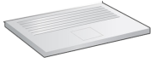
DHCP: example
connecting laptop needs its IP address, addr of first-hop router, addr of DNS server: use DHCP
DHCP
DHCP
UDP
IP
Eth
Phy
DHCP
DHCP
DHCP
DHCP
DHCP request encapsulated in UDP, encapsulated in IP, encapsulated in 802. 3 Ethernet
DHCP
DHCP
UDP
IP
Eth
Phy
168.1.1.1
DHCP
DHCP
DHCP
Ethernet frame broadcast (dest: FFFFFFFFFFFF) on LAN, received at router running DHCP server
DHCP
router with DHCP
server built into
router
Ethernet demuxed to IP demuxed, UDP demuxed to DHCP

Slide 143
DHCP: example
DHCP server formulates DHCP ACK containing client’s IP address, IP address of first-hop router for client, name & IP address of DNS server
DHCP
DHCP
UDP
IP
Eth
Phy
DHCP
DHCP
DHCP
DHCP
DHCP
UDP
IP
Eth
Phy
encapsulation of DHCP server, frame forwarded to client, demuxing up to DHCP at client
DHCP
DHCP
DHCP
router with DHCP
server built into
router
DHCP
client now knows its IP address, name and IP address of DNS server, IP address of its first-hop router

Slide 144
DHCP: Wireshark output (home LAN)
reply
Message type: Boot Reply (2)
Hardware type: Ethernet
Hardware address length: 6
Hops: 0
Transaction ID: 0x6b3a11b7
Seconds elapsed: 0
Bootp flags: 0x0000 (Unicast)
Client IP address: 192.168.1.101 (192.168.1.101)
Your (client) IP address: 0.0.0.0 (0.0.0.0)
Next server IP address: 192.168.1.1 (192.168.1.1)
Relay agent IP address: 0.0.0.0 (0.0.0.0)
Client MAC address: Wistron_23:68:8a (00:16:d3:23:68:8a)
Server host name not given
Boot file name not given
Magic cookie: (OK)
Option: (t=53,l=1) DHCP Message Type = DHCP ACK
Option: (t=54,l=4) Server Identifier = 192.168.1.1
Option: (t=1,l=4) Subnet Mask = 255.255.255.0
Option: (t=3,l=4) Router = 192.168.1.1
Option: (6) Domain Name Server
Length: 12; Value: 445747E2445749F244574092;
IP Address: 68.87.71.226;
IP Address: 68.87.73.242;
IP Address: 68.87.64.146
Option: (t=15,l=20) Domain Name = "hsd1.ma.comcast.net."
Message type: Boot Request (1)
Hardware type: Ethernet
Hardware address length: 6
Hops: 0
Transaction ID: 0x6b3a11b7
Seconds elapsed: 0
Bootp flags: 0x0000 (Unicast)
Client IP address: 0.0.0.0 (0.0.0.0)
Your (client) IP address: 0.0.0.0 (0.0.0.0)
Next server IP address: 0.0.0.0 (0.0.0.0)
Relay agent IP address: 0.0.0.0 (0.0.0.0)
Client MAC address: Wistron_23:68:8a (00:16:d3:23:68:8a)
Server host name not given
Boot file name not given
Magic cookie: (OK)
Option: (t=53,l=1) DHCP Message Type = DHCP Request
Option: (61) Client identifier
Length: 7; Value: 010016D323688A;
Hardware type: Ethernet
Client MAC address: Wistron_23:68:8a (00:16:d3:23:68:8a)
Option: (t=50,l=4) Requested IP Address = 192.168.1.101
Option: (t=12,l=5) Host Name = "nomad"
Option: (55) Parameter Request List
Length: 11; Value: 010F03062C2E2F1F21F92B
1 = Subnet Mask; 15 = Domain Name
3 = Router; 6 = Domain Name Server
44 = NetBIOS over TCP/IP Name Server
……
request

Slide 145
第4章 网络层: 数据平面
4.1 网络层概述
转发和路由选择: 数据平面和控制平面
网络服务模型
4.2 路由器工作原理
输入端口处理和基于目的地转发
交换
输出端口处理
何处出现排队
分组调度
4.4 网际协议: IPv4、寻址、IPv6及其它
IPv4 数据报格式
IPv4 数据报分片
IPv4 编址
网络地址转换
IPv6
4.5 通用转发和SDN
匹配
动作
匹配加动作操作中的OpenFlow例子
4.8 小结

Slide 146
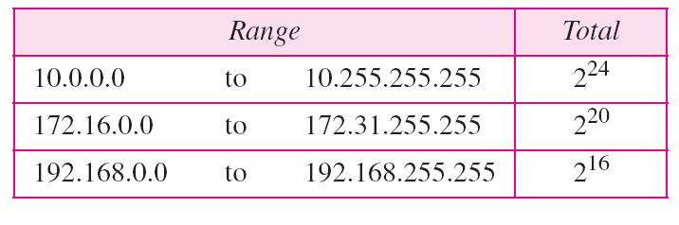
网络地址转换
为了将家庭或企业内部使用的地址从用于互联网的地址分开[separate]，互联网权威保留了三组地址作为私有地址，如下表所示。
表. 专用网络地址
Notes:
To separate the addresses used inside the home or business and the ones used for the Internet, the Internet authorities have reserved three sets of addresses as private addresses, shown in the following the table.

Slide 147
网络地址转换
NAT (Network Address Translation)
互联网的
其他部分
本地网络
(例如., 家庭网络)
10.0.0/24
10.0.0.1
10.0.0.4
10.0.0.2
138.76.29.7
10.0.0.3
所有离开本地网络的报文都拥有同一个源IP地址: 138.76.29.7,以及不同的源端口号
本网络中的数据报有着类似
10.0.0/24的源或目的IP地址
Notes:
Given our discussion about Internet addresses and the IPv4 datagram format, we’re now well aware that every IP-capable device needs an IP address.
With the proliferation of small office, home office (SOHO) subnets, this would seem to imply that whenever a SOHO wants to install a LAN to connect multiple machines, a range of addresses would need to be allocated by the ISP to cover all of the SOHO’s IP devices (including phones, tablets, gaming devices, IP TVs, printers and more).
If the subnet grew bigger, a larger block of addresses would have to be allocated.
But what if the ISP had already allocated the contiguous portions of the SOHO network’s current address range?
And what typical homeowner wants (or should need) to know how to manage IP addresses in the first place?
Fortunately, there is a simpler approach to address allocation that has found increasingly widespread use in such scenarios: network address translation (NAT) [RFC 2663; RFC 3022; Huston 2004, Zhang 2007; Cisco NAT 2016].
Figure 4.25 shows the operation of a NAT-enabled router.
The NAT-enabled router, residing in the home, has an interface that is part of the home network on the right of Figure 4.25.
Addressing within the home network is exactly as we have seen above — all four interfaces in the home network have the same subnet address of 10.0.0/24.
The address space 10.0.0.0/8 is one of three portions of the IP address space that is reserved in [RFC 1918] for a private network or a realm with private addresses, such as the home network in Figure 4.25.
A realm with private addresses refers to a network whose addresses only have meaning to devices within that network.
To see why this is important, consider the fact that there are hundreds of thousands of home networks, many using the same address space, 10.0.0.0/24.
Devices within a given home network can send packets to each other using 10.0.0.0/24 addressing.
However, packets forwarded beyond the home network into the larger global Internet clearly cannot use these addresses (as either a source or a destination address) because there are hundreds of thousands of networks using this block of addresses.
That is, the 10.0.0.0/24 addresses can only have meaning within the given home network.
But if private addresses only have meaning within a given network, how is addressing handled when packets are sent to or received from the global Internet, where addresses are necessarily unique?
The answer lies in understanding NAT.
The NAT-enabled router does not look like a router to the outside world.
Instead the NAT router behaves to the outside world as a single device with a single IP address.
In Figure 4.25, all traffic leaving the home router for the larger Internet has a source IP address of 138.76.29.7, and all traffic entering the home router must have a destination address of 138.76.29.7.
In essence, the NAT-enabled router is hiding the details of the home network from [防] the outside world.
(As an aside, you might wonder where the home network computers get their addresses and where the router gets its single IP address.
Often, the answer is the same — DHCP!
The router gets its address from the ISP’s DHCP server, and the router runs a DHCP server to provide addresses to computers within the NAT-DHCP-router controlled home network’s address space.)
If all datagrams arriving at the NAT router from the WAN have the same destination IP address (specifically, that of the WAN-side interface of the NAT router), then how does the router know the internal host to which it should forward a given datagram?
The trick is to use a NAT translation table at the NAT router, and to include port numbers as well as IP addresses in the table entries.

Slide 148
网络地址转换
动机: 本地网络只要使用一个IP地址就可以和外部网络相连 :
不需要从 ISP处获得大批IP地址: 所有设备可以使用同一个 IP地址
可以在不通知外部网络的情况下改变内网主机的IP地址
即使改变了ISP也无须改变内网主机的IP地址
内网主机对外网主机而言是不可见的、不可寻址的。
(这也算是一项安全措施).

Slide 149
网络地址转换
实现
发送数据报: 将每个外出报文的源IP地址、端口号替换为NAT IP地址以及新的端口号
. . . 远程客户机/服务器将以NAT IP地址以及新的端口号做为目的地址进行响应。
记住每一个地址转换对 (在 NAT 转换表中) ，即
源IP地址、端口号 → NAT IP地址、新的端口
接收数据报: 根据NAT转换表将每个进入报文的NAT IP地址和端口号替换为相应的源IP地址以及端口号。

Slide 150
网络地址转换
NAT 转换表
WAN 端 LAN 端
1: 主机 10.0.0.1
发送数据报到主机
128.119.40, 80
2: NAT路由器将
数据报的源地址
10.0.0.1, 3345
转换成138.76.29.7,
5001,同时更新
NAT转换表
138.76.29.7, 5001 10.0.0.1, 3345
…… ……
S: 10.0.0.1, 3345
D: 128.119.40.186, 80
10.0.0.1
1
2
S: 138.76.29.7, 5001
D: 128.119.40.186, 80
10.0.0.4
10.0.0.2
138.76.29.7
S: 128.119.40.186, 80
D: 10.0.0.1, 3345
4
S: 128.119.40.186, 80
D: 138.76.29.7, 5001
3
10.0.0.3
4: NAT路由器将
数据报的目的地址138.76.29.7, 5001
转换成 10.0.0.1, 3345
3: 响应报文到达 目的地址:
138.76.29.7, 5001
Notes:
Consider the example in Figure 4.25.
Suppose a user sitting in a home network behind host 10.0.0.1 requests a Web page on some Web server (port 80) with IP address 128.119.40.186.
The host 10.0.0.1 assigns the (arbitrary) source port number 3345 and sends the datagram into the LAN.
The NAT router receives the datagram, generates a new source port number 5001 for the datagram, replaces the source IP address with its WAN-side IP address 138.76.29.7, and replaces the original source port number 3345 with the new source port number 5001.
When generating a new source port number, the NAT router can select any source port number that is not currently in the NAT translation table.
(Note that because a port number field is 16 bits long, the NAT protocol can support over 60,000 simultaneous connections with a single WAN-side IP address for the router!)
NAT in the router also adds an entry to its NAT translation table.
The Web server, blissfully unaware that the arriving datagram containing the HTTP request has been manipulated by the NAT router, responds with a datagram whose destination address is the IP address of the NAT router, and whose destination port number is 5001.
When this datagram arrives at the NAT router, the router indexes the NAT translation table using the destination (10.0.0.1) and destination port number (3345) for the browser in the home network.
The router then rewrites the datagram’s destination address and destination port number, and forwards the datagram into the home network.

Slide 151
网络地址转换
两类地址
本地地址
10/8
172.16/12
192.168/16
全球地址
三种地址转换方式
静态NAT：一个本地地址对应一个全球地址
动态NAT：一个全球地址对应多个本地地址
端口NAT：一个本地地址的端口对应到一个全球地址的端口

Slide 152
网络地址转换
NAT使用中的争议
端口号是用于进程编址的，而不是用于主机编址的
路由器仅应当处理高达第三层的分组
NAT协议违反了端到端原则，即主机彼此应相互直接对话，节点不应介入修改IP地址和端口号
应使用IPv6来解决IP地址短缺问题
NAT traversal: what if client wants to connect to server behind NAT?
Notes:
NAT has enjoyed widespread deployment in recent years.
But NAT is not without detractors.
First, one might argue that, port numbers are meant to be used for addressing processes, not for addressing hosts.
This violation can indeed cause problems for servers running on the home network, since, as we
have seen in Chapter 2, server processes wait for incoming requests at well-known port numbers and
peers in a P2P protocol need to accept incoming connections when acting as servers.
Technical solutions to these problems include NAT traversal tools [RFC 5389] and Universal Plug and Play
(UPnP), a protocol that allows a host to discover and configure a nearby NAT [UPnP Forum 2016].
More “philosophical” arguments have also been raised against NAT by architectural purists.
Here, the concern is that routers are meant to be layer 3 (i.e., network-layer) devices, and should process packets only up to the network layer.
NAT violates this principle that hosts should be talking directly with each other, without interfering nodes modifying IP addresses, much less port numbers.
But like it or not, NAT has become an important component of the Internet, as have other so-called middleboxes [Sekar 2011] that operate at the network layer but have functions that are quite different from routers.
Middleboxes do not perform traditional datagram forwarding, but instead perform functions such as NAT, load balancing of traffic flows, traffic firewalling (see accompanying sidebar), and more.
The generalized forwarding paradigm that we’ll study shortly in Section 4.4 allows a number of these middlebox functions, as well as traditional router forwarding, to be accomplished in a common, integrated manner.

Slide 153
网络地址转换
NAT转换中存在的一个问题
客户端希望与10.0.0.1这台服务器通信
解决方案1
采用端口NAT，在路由器中静态的为服务器配置一条记录
如(123.76.29.7, 80) 总是指向(10.0.0.1, 80)
10.0.0.1
?
客户端
10.0.0.4
138.76.29.7
NAT
路由器
Notes:
Yet another major problem with NAT is that it interferes with P2P applications, including P2P file-sharing applications and P2P Voice-over-IP applications.
Recall from Chapter 2 that in a P2P application, any participating Peer A should be able to initiate a TCP connection to any other participating Peer B.
The essence of the problem is that if Peer B is behind a NAT, it cannot act as a server and accept TCP connections.
As we’ll see in the homework problems, this NAT problem can be circumvented if Peer A is not behind a NAT.
In this case, Peer A can first contact Peer B through an intermediate Peer C, which is not behind a NAT and to which B has established an ongoing TCP connection.
Peer A can then ask Peer B, via Peer C, to initiate a TCP connection directly back to Peer A.
Once the direct P2P TCP connection is established between Peers A and B, the two peers can exchange messages or
files.
This hack, called connection reversal, is actually used by many P2P applications for NAT traversal.
If both Peer A and Peer B are behind their own NATs, the situation is a bit trickier but can be handled using application relays, as we saw with Skype relays in Chapter 2.
NAT traversal is increasingly provided by Universal Plug and Play (UPnP), which is a protocol that allows a host to discover and configure a nearby NAT [UPnP Forum 2012].
UPnP requires that both the host and the NAT be UPnP compatible.
With UPnP, an application running in a host can request a NAT mapping between its (private IP address, private port number) and the (public IP address, public port number) for some requested public port number.
If the NAT accepts the request and creates the mapping, then nodes from the outside can initiate TCP connections to
(public IP address, public port number).
Furthermore, UPnP lets the application know the value of (public IP address, public port number), so that the application can advertise it to the outside world.
As an example, suppose your host, behind a UPnP-enabled NAT, has private address 10.0.0.1 and is running BitTorrent on port 3345.
Also suppose that the public IP address of the NAT is 138.76.29.7.
Your BitTorrent application naturally wants to be able to accept connections from other hosts, so that it can trade chunks with them.
To this end, the BitTorrent application in your host asks the NAT to create a “hole” that maps (10.0.0.1, 3345) to (138.76.29.7, 5001).
(The public port number 5001 is chosen by the application.)
The BitTorrent application in your host could also advertise to its tracker that it is available at (138.76.29.7, 5001).
In this manner, an external host running BitTorrent can contact the tracker and learn that your BitTorrent application is running at (138.76.29.7, 5001).
The external host can send a TCP SYN packet to (138.76.29.7, 5001).
When the NAT receives the packet to (10.0.0.1, 3345) and forward the packet through the NAT.
In summary, UPnP allows external hosts to initiate communication sessions to NATed hosts, using either TCP or UDP.
NATs have long been a nemesis for P2P applications; UPnP, providing an effective and robust NAT traversal solution, may be their savior.
Our discussion of NAT and UPnP here has been necessarily brief.
For more detailed discussions of NAT see [Huston 2004, Cisco NAT 2012].

Slide 154
网络地址转换
解决方案2—— 通用即插即用UPnP
内部主机通过IGD协议
了解公共IP地址
向路由器注册/移除映射记录
(内部IP地址，内部端口号) →
(公共IP地址，公共端口号)
内部主机通过某种渠道向外部应用程序公开(公共IP地址，公共端口号)
适用于P2P应用
10.0.0.1
IGD
NAT
路由器
Notes:
Internet Gateway Device，缩写IGD

Slide 155



网络地址转换
解决方案3 —中继（用于Skype）
2. 客户端与中继建立了连接
1. 10.0.0.1通过NAT与中继建立了连接
10.0.0.1
客户端
3. 建立中继
138.76.29.7
NAT
路由器

Slide 156
第4章 网络层: 数据平面
4.1 网络层概述
转发和路由选择: 数据平面和控制平面
网络服务模型
4.2 路由器工作原理
输入端口处理和基于目的地转发
交换
输出端口处理
何处出现排队
分组调度
4.4 网际协议: IPv4、寻址、IPv6及其它
IPv4 数据报格式
IPv4 数据报分片
IPv4 编址
网络地址转换
IPv6
4.5 通用转发和SDN
匹配
动作
匹配加动作操作中的OpenFlow例子
4.8 小结

Slide 157
第4章 网络层: 数据平面
4.1 网络层概述
转发和路由选择: 数据平面和控制平面
网络服务模型
4.2 路由器工作原理
输入端口处理和基于目的地转发
交换
输出端口处理
何处出现排队
分组调度
4.4 网际协议: IPv4、寻址、IPv6及其它
IPv4 数据报格式
IPv4 数据报分片
IPv4 编址
网络地址转换
IPv6
4.5 通用转发和SDN
匹配
动作
匹配加动作操作中的OpenFlow例子
4.8 小结

Slide 158
IPv6: 动机
首要动机: 32位地址空间即将被完全分配。
额外的动机:
首部格式有助于加速处理/转发
首部改变以促进服务质量 QoS(Quality of Service )
IPv6 datagram format:
fixed-length 40 byte header
no fragmentation allowed
IPv6 is the next generation Internet ?
Notes:
In the early 1990s, the Internet Engineering Task Force began an effort to develop a successor to the IPv4 protocol.
A prime motivation for this effort was the realization that the 32-bit IP address space was beginning to be used up, with new subnets and IP nodes being attached to the Internet (and being allocated unique IP addresses) at a breathtaking rate.
To respond to this need for a large IP address space, a new IP protocol, IPv6, was developed.
The designers of IPv6 also took this opportunity to tweak and augment other aspects of IPv4, based on the accumulated operational experience with IPv4.
The point in time when IPv4 addresses would be completely allocated (and hence no new networks could attach to the Internet) was the subject of considerable debate.
The estimates of the two leaders of the IETF’s Address Lifetime Expectations working group were that addresses would become exhausted in 2008 and 2018, respectively [Solensky 1996].
In February 2011, IANA allocated out the last remaining pool of unassigned IPv4 addresses to a regional registry.
While these registries still have available IPv4 addresses within their pool, once these addresses are exhausted, there are no more available address blocks that can be allocated from a central pool [Huston 2011a].
A recent survey of IPv4 address-space exhaustion, and the steps taken to prolong the life of the address space is [Richter 2015].
Although the mid-1990s estimates of IPv4 address depletion suggested that a considerable amount of time might be left until the IPv4 address space was exhausted, it was realized that considerable time would be needed to deploy a new technology on such an extensive scale, and so the process to develop IP version 6 (IPv6) [RFC 2460] was begun [RFC 1752].
(An often-asked question is what happened to IPv5?
It was initially envisioned that the ST-2 protocol would become IPv5, but ST-2 was later dropped.)
An excellent source of information about IPv6 is [Huitema 1998].

Slide 159
1. IPv6数据报格式
版本 | 流量类型 | 流标签
有效载荷长度 |  |  | 下一个首部 | 跳限制
源地址（128比特）
目的地址（128比特）
数据
IPv6数据报格式
无检查和，中间结点无需计算
中间结点不再负责分片和重组，由端结点负责
首部长度固定，加速中间结点转发速度
Notes:
IPv6 Datagram Format
The format of the IPv6 datagram is shown in Figure 4.26.
The most important changes introduced in IPv6 are evident in the datagram format:
• Expanded addressing capabilities.
IPv6 increases the size of the IP address from 32 to 128 bits.
This ensures that the world won’t run out of IP addresses.
Now, every grain of sand on the planet can be IP-addressable.
In addition to unicast and multicast addresses, IPv6 has introduced a new type of address, called an anycast address, which allows a datagram to be delivered to any one of a group of hosts.
(This feature could be used, for example, to send an HTTP GET to the nearest of a number of mirror sites that contain a given document.)
• A streamlined 40-byte header.
As discussed below, a number of IPv4 fields have been dropped or made optional.
The resulting 40-byte fixed-length header allows for faster processing of the IP datagram.
A new encoding of options allows for more flexible options processing.
• Flow labeling.
IPv6 has an elusive definition of a flow.
RFC 2460 states that this allows “labeling of packets belonging to particular flows for which the sender requests special handling, such as a non-default quality of service or real-time service.”
For example, audio and video transmission might likely be treated as a flow.
On the other hand, the more traditional applications, such as file transfer and e-mail, might not be treated as flows.
It is possible that the traffic carried by a high-priority user (for example, someone paying for better service for their traffic) might also be treated as a flow.
What is clear, however, is that the designers of IPv6 foresaw the eventual need to be able to differentiate among the flows, even if the exact meaning of a flow has not yet been determined.
As noted above, a comparison of Figure 4.26 with Figure 4.16 reveals the simpler, more streamlined structure of the IPv6 datagram.
The following fields are defined in IPv6:
• Version.
This 4-bit field identifies the IP version number.
Not surprisingly, IPv6 carries a value of 6 in this field.
Note that putting a 4 in this field does not create a valid IPv4 datagram.
(If it did, life would be a lot simpler — see the discussion below regarding the transition from IPv4 to IPv6.)
• Traffic class.
The 8-bit traffic class field, like the TOS field in IPv4, can be used to give priority to certain datagrams within a flow, or it can be used to give priority to datagrams from certain applications (for example, voice-over-IP) over datagrams from other applications (for example, SMTP e-mail).
• Flow label.
As discussed above, this 20-bit field is used to identify a flow of datagrams.
• Payload length.
This 16-bit value is treated as an unsigned integer giving the number of bytes in the IPv6 datagram following the fixed-length, 40-byte datagram header.
• Next header.
This field identifies the protocol to which the contents (data field) of this datagram will be delivered (for example, to TCP or UDP).
The field uses the same values as the protocol field in the IPv4 header.
• Hop limit.
The contents of this field are decremented by one by each router that forwards the datagram.
If the hop limit count reaches zero, the datagram is discarded.
• Source and destination addresses.
The various formats of the IPv6 128-bit address are described in RFC 4291.
• Data.
This is the payload portion of the IPv6 datagram.
When the datagram reaches its destination, the payload will be removed from the IP datagram and passed on to the protocol specified in the next header field.
The discussion above identified the purpose of the fields that are included in the IPv6 datagram.
Comparing the IPv6 datagram format in Figure 4.26 with the IPv4 datagram format that we saw in Figure 4.16, we notice that several fields appearing in the IPv4 datagram are no longer present in the IPv6 datagram:
• Fragmentation/Reassembly.
IPv6 does not allow for fragmentation and reassembly at intermediate routers; these operations can be performed only by the source and destination.
If an IPv6 datagram received by a router is too large to be forwarded over the outgoing link, the router simply drops the datagram and sends a “Packet Too Big” ICMP error message (see Section 5.6) back to the sender.
The sender can then resend the data, using a smaller IP datagram size.
Fragmentation and reassembly is a time-consuming operation; removing this functionality from the routers and placing it squarely in the end systems considerably speeds up IP forwarding within the network.
• Header checksum.
Because the transport-layer (for example, TCP and UDP) and link-layer (for example, Ethernet) protocols in the Internet layers perform checksumming, the designers of IP probably felt that this functionality was sufficiently redundant in the network layer that it could be removed.
Once again, fast processing of IP packets was a central concern.
Recall from our discussion of IPv4 in Section 4.3.1 that since the IPv4 header contains a TTL field (similar to the hop limit field in IPv6), the IPv4 header checksum needed to be recomputed at every router.
As with fragmentation and reassembly, this too was a costly operation in IPv4.
• Options.
An options field is no longer a part of the standard IP header.
However, it has not gone away.
Instead, the options field is one of the possible next headers pointed to from within the IPv6 header.
That is, just as TCP or UDP protocol headers can be the next header within an IP packet, so too can an options field.
The removal of the options field results in a fixed-length, 40-byte IP header.

Slide 160
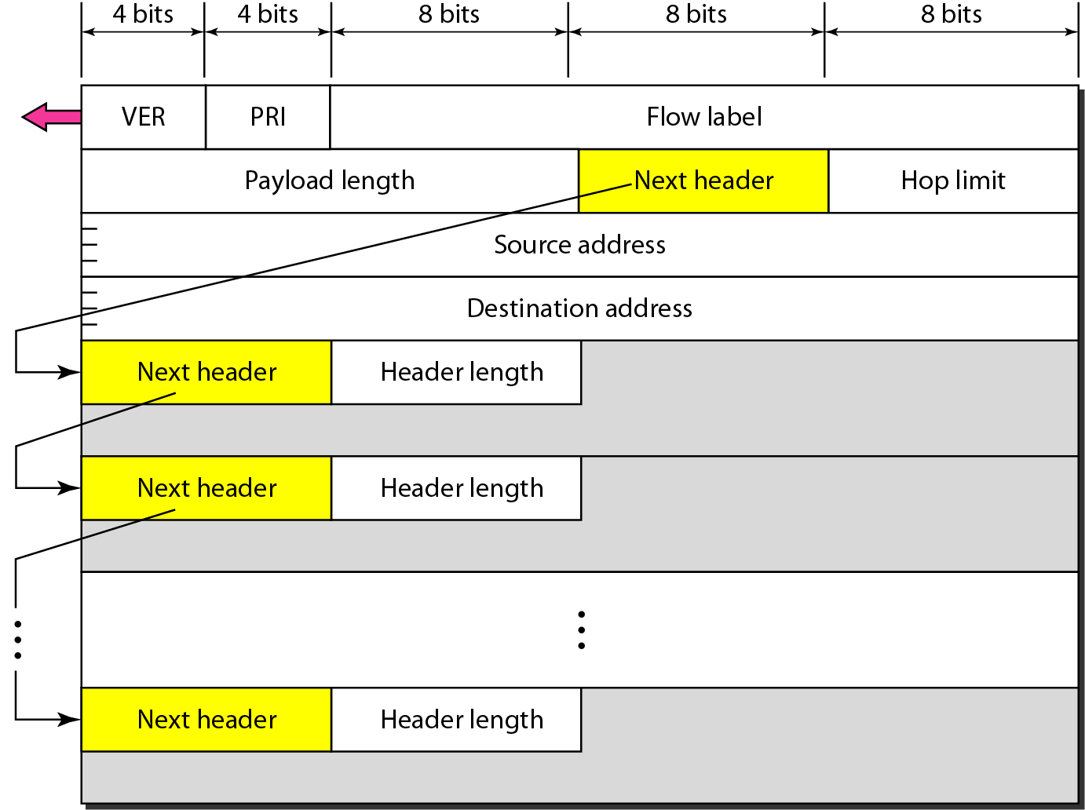
IPv6数据报格式
options field
options field
TCP/UDP

Slide 161
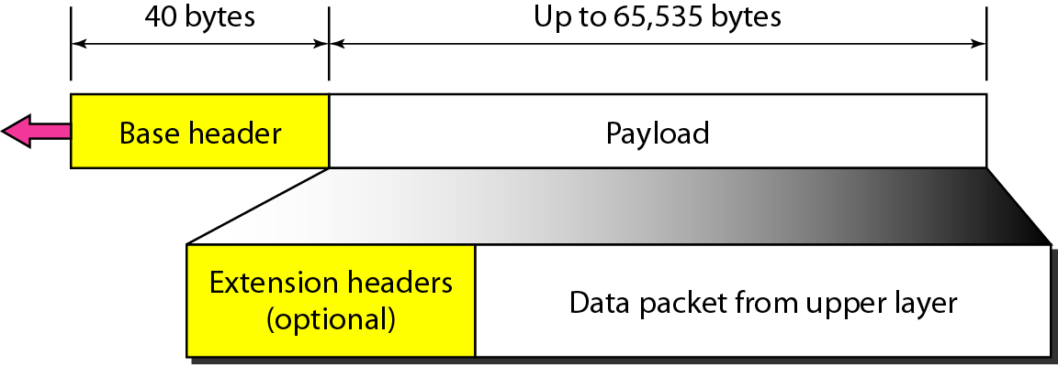
IPv6数据报首部和有效负载

Slide 162
Next header codes for IPv6

Slide 163
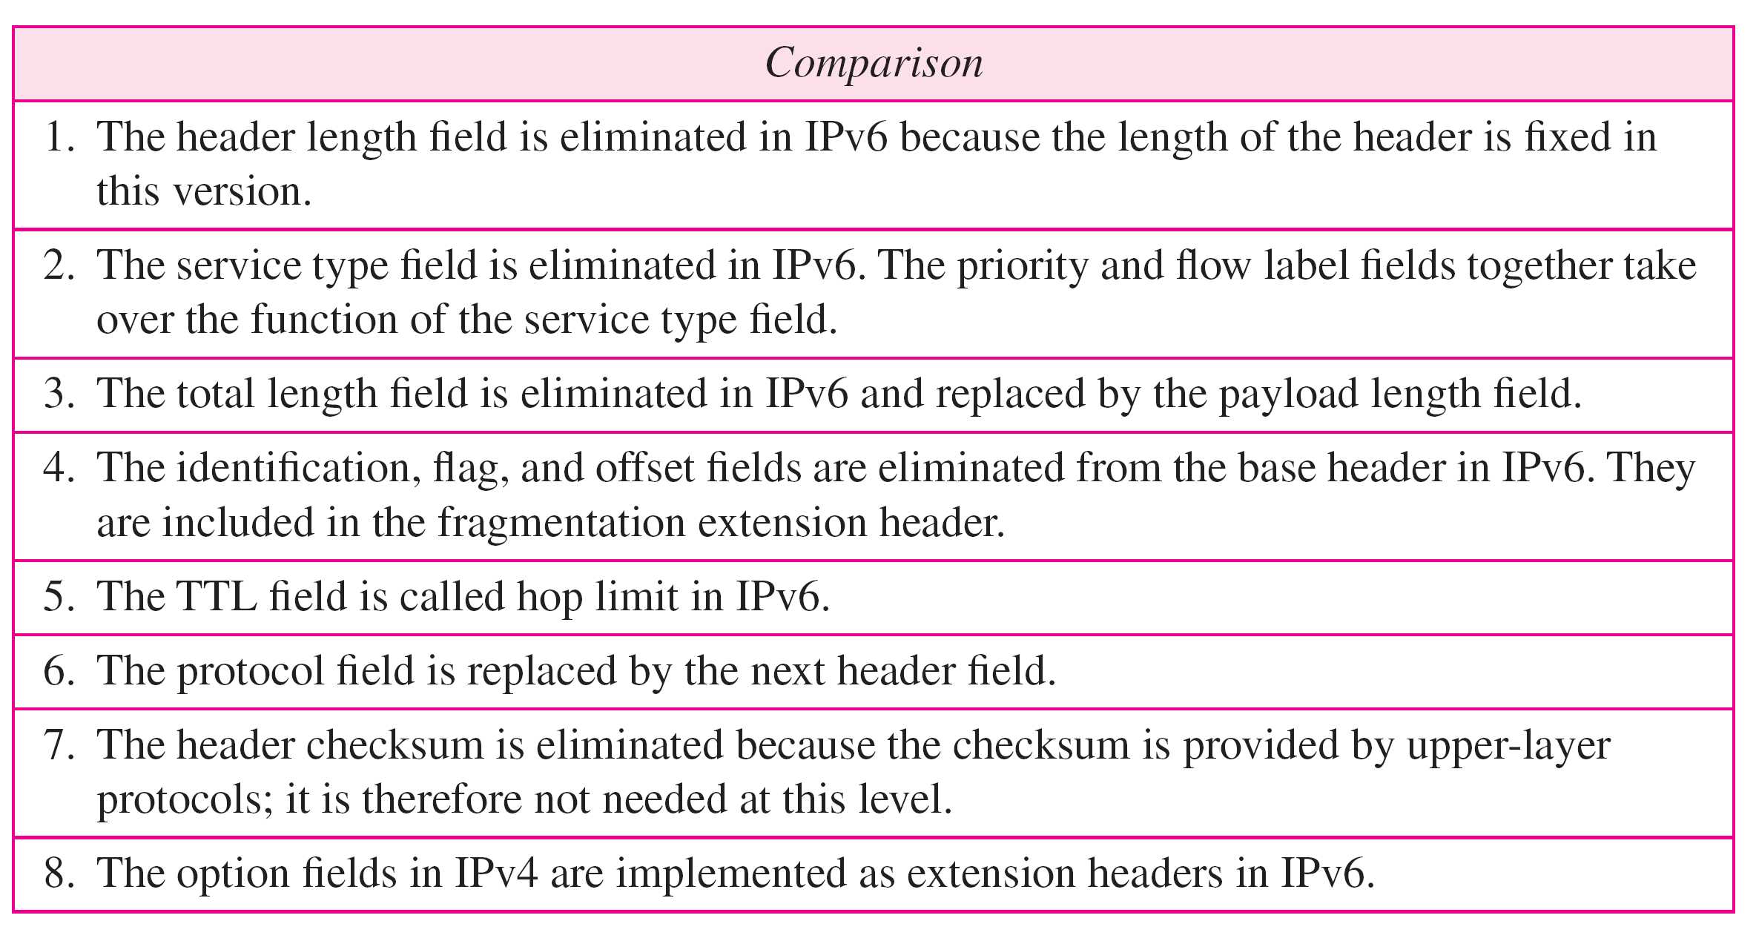
Comparison between IPv4 and IPv6 packet headers

Slide 164
2. IPv4到IPv6的迁移
设立标志日，统一迁移
双栈技术
新加入的设备支持IPv4/IPv6双协议栈
一段链路上，如果源和目标均支持IPv6，则使用IPv6进行通信
如果任一方不支持IPv6，则使用IPv4进行通信
可能会出现信息的丢失
隧道技术
Notes:
Now that we have seen the technical details of IPv6, let us consider a very practical matter:
How will the public Internet, which is based on IPv4, be transitioned to IPv6?
The problem is that while new IPv6-capable systems can be made backward-compatible, that is, can send, route, and receive IPv4 datagrams, already deployed IPv4-capable systems are not capable of handling IPv6 datagrams.
Several options possible [Huston 2011b, RFC 4213].
One option would be to declare a flag day — a given time and date when all Internet machines would be turned off and upgraded from IPv4 to IPv6.
The last major technology transition (from using NCP to using TCP for reliable transport service) occurred almost 35 years ago.
Even back then [RFC 801], when the Internet was tiny and still being administered by a small number of “wizards,” it was realized that such a flag day was not possible.
A flag day involving billions of devices is even more unthinkable today.
.

Slide 165
2. IPv4到IPv6的迁移
并非所有路由器都能同时升级
没有一个 “标志日”
混合使用IPv4和IPv6路由器的网络将如何运行?
隧道: IPv6数据报作为IPv4数据报的有效载荷，在IPv4路由器之间传输
IPv4 header fields
IPv6 header fields
IPv4 payload
IPv4 source, dest addr
IPv6 source dest addr
UDP/TCP payload
IPv6 datagram
IPv4 datagram
Notes:
The approach to IPv4-to-IPv6 transition that has been most widely adopted in practice involves
tunneling [RFC 4213]. The basic idea behind tunneling—a key concept with applications in many other
scenarios beyond IPv4-to-IPv6 transition, including wide use in the all-IP cellular networks that we’ll
cover in Chapter 7—is the following. Suppose two IPv6 nodes (in this example, B and E in Figure 4.27)
want to interoperate using IPv6 datagrams but are connected to each other by intervening IPv4 routers.
We refer to the intervening set of IPv4 routers between two IPv6 routers as a tunnel, as illustrated in
Figure 4.27. With tunneling, the IPv6 node on the sending side of the tunnel (in this example, B) takes
the entire IPv6 datagram and puts it in the data (payload) field of an IPv4 datagram. This IPv4 datagram
is then addressed to the IPv6 node on the receiving side of the tunnel (in this example, E) and sent to
the first node in the tunnel (in this example, C). The intervening IPv4 routers in the tunnel route this IPv4
datagram among themselves, just as they would any other datagram, blissfully unaware that the IPv4
datagram itself contains a complete IPv6 datagram. The IPv6 node on the receiving side of the tunnel
eventually receives the IPv4 datagram (it is the destination of the IPv4 datagram!), determines that the
IPv4 datagram contains an IPv6 datagram (by observing that the protocol number field in the IPv4
datagram is 41 [RFC 4213], indicating that the IPv4 payload is a IPv6 datagram), extracts the IPv6
datagram, and then routes the IPv6 datagram exactly as it would if it had received the IPv6 datagram
from a directly connected IPv6 neighbor.

Slide 166
建隧道
A
B
IPv4 tunnel
connecting IPv6 routers
E
F
logical view:
IPv6
IPv6
IPv6
IPv6
A
B
C
D
E
F
physical view:
IPv6
IPv6
IPv4
IPv4
IPv6
IPv6
Notes:
The approach to IPv4-to-IPv6 transition that has been most widely adopted in practice involves tunneling [RFC 4213].
The basic idea behind tunneling — a key concept with applications in many other scenarios beyond IPv4-to-IPv6 transition, including wide use in the all-IP cellular networks that we’ll cover in Chapter 7 — is the following.
Suppose two IPv6 nodes (in this example, B and E in Figure 4.27) want to interoperate using IPv6 datagrams but are connected to each other by intervening IPv4 routers.
We refer to the intervening set of IPv4 routers between two IPv6 routers as a tunnel, as illustrated in Figure 4.27.
With tunneling, the IPv6 node on the sending side of the tunnel (in this example, B) takes the entire IPv6 datagram and puts it in the data (payload) field of an IPv4 datagram.
This IPv4 datagram is then addressed to the IPv6 node on the receiving side of the tunnel (in this example, E) and sent to the first node in the tunnel (in this example, C).
The intervening IPv4 routers in the tunnel route this IPv4 datagram among themselves, just as they would [route] any other datagram, blissfully unaware that the IPv4 datagram itself contains a complete IPv6 datagram.
The IPv6 node on the receiving side of the tunnel eventually receives the IPv4 datagram (it is the destination of the IPv4 datagram!), determines that the IPv4 datagram contains an IPv6 datagram (by observing that the protocol number field in the IPv4 datagram is 41 [RFC 4213], indicating that the IPv4 payload is a IPv6 datagram), extracts the IPv6 datagram, and then routes the IPv6 datagram exactly as it would if it had received the IPv6 datagram from a directly connected IPv6 neighbor.

Slide 167
建隧道
A
B
IPv4 tunnel
connecting IPv6 routers
E
F
logical view:
IPv6
IPv6
IPv6
IPv6
A
B
C
D
E
F
physical view:
IPv6
IPv6
IPv4
IPv4
IPv6
IPv6
flow: X
src: A
dest: F
data
src:B
dest: E
src:B
dest: E
flow: X
src: A
dest: F
data
Flow: X
Src: A
Dest: F
data
Flow: X
Src: A
Dest: F
data
A-to-B:
IPv6
B-to-C:
IPv6 inside
IPv4
B-to-C:
IPv6 inside
IPv4
E-to-F:
IPv6
Notes:
The approach to IPv4-to-IPv6 transition that has been most widely adopted in practice involves tunneling [RFC 4213].
The basic idea behind tunneling — a key concept with applications in many other scenarios beyond IPv4-to-IPv6 transition, including wide use in the all-IP cellular networks that we’ll cover in Chapter 7 — is the following.
Suppose two IPv6 nodes (in this example, B and E in Figure 4.27) want to interoperate using IPv6 datagrams but are connected to each other by intervening IPv4 routers.
We refer to the intervening set of IPv4 routers between two IPv6 routers as a tunnel, as illustrated in Figure 4.27.
With tunneling, the IPv6 node on the sending side of the tunnel (in this example, B) takes the entire IPv6 datagram and puts it in the data (payload) field of an IPv4 datagram.
This IPv4 datagram is then addressed to the IPv6 node on the receiving side of the tunnel (in this example, E) and sent to the first node in the tunnel (in this example, C).
The intervening IPv4 routers in the tunnel route this IPv4 datagram among themselves, just as they would [route] any other datagram, blissfully unaware that the IPv4 datagram itself contains a complete IPv6 datagram.
The IPv6 node on the receiving side of the tunnel eventually receives the IPv4 datagram (it is the destination of the IPv4 datagram!), determines that the IPv4 datagram contains an IPv6 datagram (by observing that the protocol number field in the IPv4 datagram is 41 [RFC 4213], indicating that the IPv4 payload is a IPv6 datagram), extracts the IPv6 datagram, and then routes the IPv6 datagram exactly as it would if it had received the IPv6 datagram from a directly connected IPv6 neighbor.

Slide 168
双协议栈
IPv6/IPv4
双协议栈
IPv6/IPv4
IPv6
IPv4 网络
IPv6
A
B
C
D
E
F
双协议栈
IPv6/IPv4
双协议栈
IPv6/IPv4
IPv6
IPv4 网络
IPv6
A
B
隧道
E
F
IPv4
网络
流标号：X
源地址：A
目的地址：F
……
数据
源地址：B
目的地址：E
源地址：B
目的地址：E
流标号：X
源地址：A
目的地址：F
……
数据
…
IPv6
数据报
IPv6
数据报
IPv6 数据报
IPv6 数据报
IPv4 数据报
IPv4 数据报

Slide 169
IPv6: 采用
Google: 8% of clients access services via IPv6
NIST: 1/3 of all US government domains are IPv6 capable
Long (long!) time for deployment, use
20 years and counting!
think of application-level changes in last 20 years: WWW, Facebook, streaming media, Skype, …
Why?
Notes:
We end this section by noting that while the adoption of IPv6 was initially slow to take off [Lawton 2001; Huston 2008b], momentum has been building recently.
NIST [NIST IPv6 2015] reports that more than a third of US government second-level domains are IPv6-enabled.
On the client side, Google reports that only about 8 percent of the clients accessing Google services do so via IPv6 [Google IPv6 2015].
But other recent measurements [Czyz 2014] indicate that IPv6 adoption is accelerating.
The proliferation of devices such as IP-enabled phones and other portable devices provides an additional push for more widespread deployment of IPv6.
Europe’s Third Generation Partnership Program [3GPP 2016] has specified IPv6 as the standard addressing scheme for mobile multimedia.
One important lesson that we can learn from the IPv6 experience is that it is enormously difficult to change network-layer protocols.
Since the early 1990s, numerous new network-layer protocols have been trumpeted as the next major revolution for the Internet, but most of these protocols have had limited penetration to date.
These protocols include IPv6, multicast protocols, and resource reservation protocols; a discussion of these latter two protocols can be found in the online supplement to this text.
Indeed, introducing new protocols into the network layer is like replacing the foundation of a house — it is difficult to do without tearing the whole house down or at least temporarily relocating the house’s residents.
On the other hand, the Internet has witnessed rapid deployment of new protocols at the application layer.
The classic examples, of course, are the Web, instant messaging, streaming media, distributed games, and various forms of social media.
Introducing new application-layer protocols is like adding a new layer of paint to a house — it is relatively easy to do, and if you choose an attractive color, others in the neighborhood will copy you.
In summary, in the future we can expect to see changes in the Internet’s network layer, but these changes will likely occur on a time scale that is much slower than the changes that will occur at the application layer.

Slide 170
第4章 网络层: 数据平面
4.1 网络层概述
转发和路由选择: 数据平面和控制平面
网络服务模型
4.2 路由器工作原理
输入端口处理和基于目的地转发
交换
输出端口处理
何处出现排队
分组调度
4.4 网际协议: IPv4、寻址、IPv6及其它
IPv4 数据报格式
IPv4 数据报分片
IPv4 编址
网络地址转换
IPv6
4.5 通用转发和SDN
匹配
动作
匹配加动作操作中的OpenFlow例子
4.8 小结

Slide 171
通用转发和SDN
通用转发：每台分组交换机包含一张匹配加动作表，该表是由远程控制器计算和分发的。
logically-centralized routing controller
control plane
data plane
local flow table
headers counters actions
1
0100 1101
3
2
values in arriving
packet’s header
Notes:
In Section 4.2.1, we noted that an Internet router’s forwarding decision has traditionally been based solely on a packet’s destination address.
In the previous section, however, we’ve also seen that there has been a proliferation of middleboxes that perform many layer-3 functions.
NAT boxes rewrite header IP addresses and port numbers; firewalls block traffic based on header-field values or redirect packets for additional processing, such as deep packet inspection (DPI).
Load-balancers forward packets requesting a given service (e.g., an HTTP request) to one of a set of servers that provide that service.
[RFC 3234] lists a number of common middlebox functions.
This proliferation of middleboxes, layer-2 switches, and layer-3 routers [Qazi 2013] — each with its own specialized hardware, software and management interfaces — has undoubtedly resulted in costly headaches for many network operators.
However, recent advances in software-defined networking have promised, and are now delivering, a unified approach towards providing many of these network-layer functions, and certain link-layer functions as well, in a modern, elegant, and integrated manner.
Recall that Section 4.2.1 characterized destination-based forwarding as the two steps of looking up a destination IP address (“match”), then sending the packet into the switching fabric to the specified output port (“action”).
Let’s now consider a significantly more general “match-plus-action” paradigm, where the “match” can be made over multiple header fields associated with different protocols at different layers in the protocol stack.
The “action” can include forwarding the packet to one or more output ports (as in destination-based forwarding), load balancing packets across multiple outgoing interfaces that lead to a service (as in load balancing), rewriting header values (as in NAT), purposefully blocking / dropping a packet (as in a firewall), sending a packet to a special server for further processing and action (as in DPI), and more.
In generalized forwarding, a match-plus-action table generalizes the notion of the destination-based forwarding table that we encountered in Section 4.2.1.
Because forwarding decisions may be made using network-layer and/or link-layer source and destination addresses, the forwarding devices shown in Figure 4.28 are more accurately described as “packet switches” rather than layer 3 “routers” or layer 2 “switches.”
Thus, in the remainder of this section, and in Section 5.5, we’ll refer to these devices as packet switches, adopting the terminology that is gaining widespread adoption in SDN literature.
Figure 4.28 shows a match-plus-action table in each packet switch, with the table being computed, installed, and updated by a remote controller.
We note that while it is possible for the control components at the individual packet switch to interact with each other (e.g., in a manner similar to that in Figure 4.2), in practice generalized match-plus-action capabilities are implemented via a remote controller that computes, installs, and updates these tables.
You might take a minute to compare Figures 4.2, 4.3 and 4.28 — what similarities and differences do you notice between destination-based forwarding shown in Figure 4.2 and 4.3, and generalized forwarding shown in Figure 4.28?

Slide 172
SDN架构：控制与转发分离
网络资源统一管理
基于API的应用开发
SDN控制
应用程序
云管理平台
SDN应用
开放的REST API
网络设备私有接口
北向接口
控制层
网络操作系统
拓扑和设备管理
流表控制和下发
SDN控制器
南向接口
OpenFlow协议
转发层
网络设备
网络设备
网络设备
多级流表处理
高性能数据转发
Notes:
Our following discussion of generalized forwarding will be based on OpenFlow [McKeown 2008, OpenFlow 2009, Casado 2014, Tourrilhes 2014] — a highly visible and successful standard that has pioneered the notion of the match-plus-action forwarding abstraction and controllers, as well as the SDN revolution more generally [Feamster 2013].
We’ll primarily consider OpenFlow 1.0, which introduced key SDN abstractions and functionality in a particularly clear and concise manner.
Later versions of OpenFlow introduced additional capabilities as a result of experience gained through implementation and use; current and earlier versions of the OpenFlow standard can be found at [ONF 2016].

Slide 173
OpenFlow 数据平面抽象
流: 由首部字段定义
通用转发: 简单分组处理规则
模式: 匹配分组首部字段中的值
动作: 丢弃、转发、修改匹配的分组，或者发送匹配分组到控制器。
优先级: disambiguate overlapping patterns
计数器: #bytes and #packets
分组交换机中的流表(由控制器计算和分发)定义了分组交换机的匹配 + 动作规则
Notes:
Each entry in the match-plus-action forwarding table, known as a flow table in OpenFlow, includes:
A set of header field values to which an incoming packet will be matched.
As in the case of destination-based forwarding, hardware-based matching is most rapidly performed in TCAM memory, with more than a million destination address entries being possible [Bosshart 2013].
A packet that matches no flow table entry can be dropped or sent to the remote controller for more processing.
In practice, a flow table may be implemented by multiple flow tables for performance or cost reasons [Bosshart 2013], but we’ll focus here on the abstraction of a single flow table.
A set of counters that are updated as packets are matched to flow table entries.
These counters might include the number of packets that have been matched by that table entry, and the time since the table entry was last updated.
A set of actions to be taken when a packet matches a flow table entry.
These actions might be to forward the packet to a given output port, to drop the packet, makes copies of the packet and sent them to multiple output ports, and/or to rewrite selected header fields.

Slide 174
OpenFlow 数据平面抽象
流: 由首部字段定义
通用转发: 简单分组处理规则
模式: 匹配分组首部字段中的值
动作: 丢弃、转发、修改匹配的分组，或者发送匹配分组到控制器。
优先级: disambiguate overlapping patterns
计数器: #bytes and #packets
src=1.2.*.*, dest=3.4.5.* → drop
src = *.*.*.*, dest=3.4.*.* → forward (2)
3. src=10.1.2.3, dest=*.*.*.* → send to controller
* : wildcard
Notes:
We’ll explore matching and actions in more detail in Sections 4.4.1 and 4.4.2, respectively.
We’ll then study how the network-wide collection of per-packet switch matching rules can be used to implement a wide range of functions including routing, layer-2 switching, firewalling, load-balancing, virtual networks, and more in Section 4.4.3.
In closing, we note that the flow table is essentially an API, the abstraction through which an individual packet switch’s behavior can be programmed; we’ll see in Section 4.4.3 that network-wide behaviors can similarly be programmed by appropriately programming / configuring these tables in a collection of network packet switches [Casado 2014].

Slide 175
第4章 网络层: 数据平面
4.1 网络层概述
转发和路由选择: 数据平面和控制平面
网络服务模型
4.2 路由器工作原理
输入端口处理和基于目的地转发
交换
输出端口处理
何处出现排队
分组调度
4.4 网际协议: IPv4、寻址、IPv6及其它
IPv4 数据报格式
IPv4 数据报分片
IPv4 编址
网络地址转换
IPv6
4.5 通用转发和SDN
匹配
动作
匹配加动作操作中的OpenFlow例子
4.8 小结

Slide 176
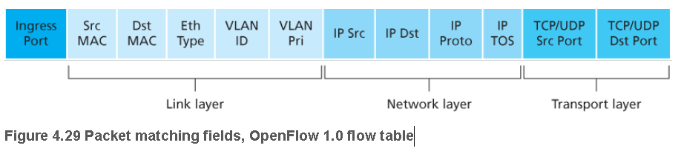
匹配
Notes:
Figure 4.29 shows the eleven packet-header fields and the incoming port ID that can be matched in an OpenFlow 1.0 match-plus-action rule.
Recall from Section 1.5.2 that a link-layer (layer 2) frame arriving to a packet switch will contain a network-layer (layer 3) datagram as its payload, which in turn will typically contain a transport-layer (layer 4) segment.
The first observation we make is that OpenFlow’s match abstraction allows for a match to be made on selected fields from three layers of protocol headers (thus rather brazenly defying the layering principle we studied in Section 1.5).
Since we’ve not yet covered the link layer, suffice it to say that the source and destination MAC addresses shown in Figure 4.29 are the link-layer addresses associated with the frame’s sending and receiving interfaces; by forwarding on the basis of Ethernet addresses rather than IP addresses, we can see that an OpenFlow-enabled device can equally perform as a router (layer-3 device) forwarding datagrams as well as a switch (layer-2 device) forwarding frames.
The Ethernet type field corresponds to the upper layer protocol (e.g., IP) to which the frame’s payload will be demultiplexed, and the VLAN fields are concerned with so-called virtual local area networks that we’ll study in Chapter 6.
The set of twelve values that can be matched in the OpenFlow 1.0 specification has grown to 41 values in more recent OpenFlow specifications [Bosshart 2014].
The ingress port refers to the input port at the packet switch on which a packet is received.
The packet’s IP source address, IP destination address, IP protocol field, and IP type of service fields were discussed earlier in Section 4.3.1.
The transport-layer source and destination port number fields can also be matched.
Flow table entries may also have wildcards.
For example, an IP address of 128.119.*.* in a flow table will match the corresponding address field of any datagram that has 128.119 as the first 16 bits of its address.
Each flow table entry also has an associated priority.
If a packet matches multiple flow table entries, the selected match and corresponding action will be that of the highest priority entry with which the packet matches.
Lastly, we observe that not all fields in an IP header can be matched.
For example OpenFlow does not allow matching on the basis of TTL field or datagram length field.
Why are some fields allowed for matching, while others are not?
Undoubtedly, the answer has to do with the tradeoff between functionality and complexity.
The “art” in choosing an abstraction is to provide for enough functionality to accomplish a task (in this case to implement, configure, and manage a wide range of network-layer functions that had previously been implemented through an assortment of network-layer devices), without overburdening the abstraction with so much detail and generality that it becomes bloated and unusable.
Butler Lampson has famously noted [Lampson 1983]:
Do one thing at a time, and do it well.
An interface should capture the minimum essentials of an abstraction.
Don’t generalize; generalizations are generally wrong.
Given OpenFlow’s success, one can surmise that its designers indeed chose their abstraction well.
Additional details of OpenFlow matching can be found in [OpenFlow 2009, ONF 2016].

Slide 177
OpenFlow流表条目
头域规则
Action
Stats
报文和字节计数
转发至零个到多个端口(虚拟或物理端口)
封装并转发至控制器
丢弃分组
转发至正常的处理流水线
域修改
Switch
Port
VLAN
ID
MAC
src
MAC
dst
Eth
type
IP
Src
IP
Dst
IP
Prot
TCP
sport
TCP
dport
链路层
网络层
传输层
Notes:
177

Slide 178
例子
基于目的地转发:
Switch
Port
MAC
src
MAC
dst
Eth
type
VLAN
ID
IP
Src
IP
Dst
IP
Prot
TCP
sport
TCP
dport
Action
*
*
*
*
*
*
51.6.0.8
*
*
*
port6
IP datagrams destined to IP address 51.6.0.8 should be forwarded to router output port 6
防火墙:
Switch
Port
MAC
src
MAC
dst
Eth
type
VLAN
ID
IP
Src
IP
Dst
IP
Prot
TCP
sport
TCP
dport
Forward
*
*
*
*
*
*
*
*
*
22
drop
do not forward (block) all datagrams destined to TCP port 22
Switch
Port
MAC
src
MAC
dst
Eth
type
VLAN
ID
IP
Src
IP
Dst
IP
Prot
TCP
sport
TCP
dport
Forward
*
*
*
*
*
128.119.1.1
*
*
*
*
drop
do not forward (block) all datagrams sent by host 128.119.1.1

Slide 179
例子
基于目的地第2层(交换机)转发:
Switch
Port
MAC
src
MAC
dst
Eth
type
VLAN
ID
IP
Src
IP
Dst
IP
Prot
TCP
sport
TCP
dport
Action
*
22:A7:23:
11:E1:02
*
*
*
*
*
*
*
*
port 6
layer 2 frames from MAC address 22:A7:23:11:E1:02 should be forwarded to output port 6

Slide 180
OpenFlow抽象
匹配+动作：统一不同类型设备
路由器
匹配：最长目的IP地址前缀
动作：通过某链路端口转发
交换机
匹配: 目的MAC地址
动作: 转发或者洪泛
防火墙
匹配：IP地址和UDP/TCP端口
号
动作：允许或者拒绝
NAT
匹配：IP地址和UDP/TCP端口号
动作：重写地址和端口
Notes:
As shown in Figure 4.28, each flow table entry has a list of zero or more actions that determine the processing that is to be applied to a packet that matches a flow table entry.
If there are multiple actions, they are performed in the order specified in the list.
Among the most important possible actions are:
Forwarding.
An incoming packet may be forwarded to a particular physical output port, broadcast over all ports (except the port on which it arrived) or multicast over a selected set of ports.
The packet may be encapsulated and sent to the remote controller for this device.
That controller then may (or may not) take some action on that packet, including installing new flow table entries, and may return the packet to the device for forwarding under the updated set of flow table rules.
Dropping.
A flow table entry with no action indicates that a matched packet should be dropped.
Modify-field.
The values in ten packet header fields (all layer 2, 3, and 4 fields shown in Figure 4.29 except the IP Protocol field) may be re-written before the packet is forwarded to the chosen output port.

Slide 181
第4章 网络层: 数据平面
4.1 网络层概述
转发和路由选择: 数据平面和控制平面
网络服务模型
4.2 路由器工作原理
输入端口处理和基于目的地转发
交换
输出端口处理
何处出现排队
分组调度
4.4 网际协议: IPv4、寻址、IPv6及其它
IPv4 数据报格式
IPv4 数据报分片
IPv4 编址
网络地址转换
IPv6
4.5 通用转发和SDN
匹配
动作
匹配加动作操作中的OpenFlow例子
4.8 小结

Slide 182


第一个例子：简单转发
匹配
动作
IP Src = 10.3.*.*
IP Dst = 10.2.*.*
Host h6
10.3.0.6
简单转发: 来自主机h5和h6的数据报应该通过s1发送到h3或h4，然后从s1那里发送到s2
forward(3)
1
s3
controller
2
3
4
Host h5
10.3.0.5
1
s1
s2
1
2
Host h4
10.2.0.4
4
2
4
Host h1
10.1.0.1
3
3
Host h2
10.1.0.2
匹配
动作
匹配
动作
Host h3
10.2.0.3
ingress port = 2
IP Dst = 10.2.0.3
ingress port = 2
IP Dst = 10.2.0.4
forward(3)
ingress port = 1
IP Src = 10.3.*.*
IP Dst = 10.2.*.*
forward(4)
forward(4)
Notes:
Having now considered both the match and action components of generalized forwarding, let’s put these ideas together in the context of the sample network shown in Figure 4.30.
The network has 6 hosts (h1, h2, h3, h4, h5 and h6) and three packet switches (s1, s2 and s3), each with four local interfaces (numbered 1 through 4).
We’ll consider a number of network-wide behaviors that we’d like to implement, and the flow table entries in s1, s2 and s3 needed to implement these behaviors.
A First Example: Simple Forwarding
As a very simple example, suppose that the desired forwarding behavior is that packets from h5 or h6 destined to h3 or h4 are to be forwarded from s3 to s1, and then from s1 to s2 (thus completely avoiding the use of the link between s3 and s2).
The flow table entry in s1 would be:
s1 Flow Table (Example 1)
Match Action
Ingress Port = 1 ; IP Src = 10.3.*.* ; IP Dst = 10.2.*.* Forward(4)
… …
Of course, we’ll also need a flow table entry in s3 so that datagrams sent from h5 or h6 are forwarded to s1 over outgoing interface 3:
s3 Flow Table (Example 1)
Match Action
IP Src = 10.3.*.* ; IP Dst = 10.2.*.* Forward(3)
… …
Lastly, we’ll also need a flow table entry in s2 to complete this first example, so that datagrams arriving from s1 are forwarded to their destination, either host h3 or h4:
s2 Flow Table (Example 1)
Match Action
Ingress port = 2 ; IP Dst = 10.2.0.3 Forward(3)
Ingress port = 2 ; IP Dst = 10.2.0.4 Forward(4)

Slide 183
第二个例子：负载均衡
Host h6
10.3.0.6
负载均衡： 作为第二个示例，我们考虑一个负载均衡场景，其中来自h3发往到10.1.*.*的数据报经过s2和s1之间的直接链路转发，而与此同时来自h4发往10.1.*.*的数据报经过s2和s3 (然后从s3到s1)之间的链路转发。
1
s3
controller
2
3
4
Host h5
10.3.0.5
1
s1
s2
1
2
Host h4
10.2.0.4
Host h1
10.1.0.1
4
2
4
3
3
Host h2
10.1.0.2
匹配
动作
Host h3
10.2.0.3
ingress port = 3
IP Dst = 10.1.*.*
ingress port = 4
IP Dst = 10.1.*.*
forward (2)
forward (1)
Notes:
A Second Example: Load Balancing
As a second example, let’s consider a load-balancing scenario, where datagrams from h3 destined to 10.1.*.* are to be forwarded over the direct link between s2 and s1, while datagrams from h4 destined to 10.1.*.* are to be forwarded over the link between s2 and s3 (and then from s3 to s1).
Note that this behavior couldn’t be achieved with IP’s destination-based forwarding.
In this case, the flow table in s2 would be:
s2 Flow Table (Example 2)
Match Action
Ingress port = 3; IP Dst = 10.1.*.* Forward (2)
Ingress port = 4; IP Dst = 10.1.*.* Forward (1)
… …
Flow table entries are also needed at s1 to forward the datagrams received from s2 to either h1 or h2; and flow table entries are needed at s3 to forward datagrams received on interface 4 from s2 over interface 3 towards s1.
See if you can figure out these flow table entries at s1 and s3.
A Third

Slide 184
第三个例子：充当防火墙
Host h6
10.3.0.6
充当防火墙: 作为第三个示例，我们考虑一个防火墙场景，其中s2仅希望(在它的任何接口上)接收来自与s3相连的主机所发送的流量。
1
s3
controller
2
3
4
Host h5
10.3.0.5
1
s1
s2
1
2
Host h4
10.2.0.4
Host h1
10.1.0.1
4
2
4
3
3
Host h2
10.1.0.2
匹配
动作
Host h3
10.2.0.3
IP Src = 10.3.*.*
IP Dst = 10.2.0.3
IP Src = 10.3.*.*
IP Dst = 10.2.0.4
forward (3)
forward (4)
Notes:
A Third Example: Firewalling
As a third example, let’s consider a firewall scenario in which s2 wants only to receive (on any of its interfaces) traffic sent from hosts attached to s3.
s2 Flow Table (Example 3)
Match Action
IP Src = 10.3.*.* IP Dst = 10.2.0.3 Forward (3)
IP Src = 10.3.*.* IP Dst = 10.2.0.4 Forward (4)
… …
If there were no other entries in s2’s flow table, then only traffic from 10.3.*.* would be forwarded to the hosts attached to s2.
Although we’ve only considered a few basic scenarios here, the versatility and advantages of generalized forwarding are hopefully apparent.
In homework problems, we’ll explore how flow tables can be used to create many different logical behaviors, including virtual networks — two or more logically separate networks (each with their own independent and distinct forwarding behavior) — that use the same physical set of packet switches and links.
In Section 5.5, we’ll return to flow tables when we study the SDN controllers that compute and distribute the flow tables, and the protocol used for communicating between a packet switch and its controller.

Slide 185
第4章 网络层: 数据平面
4.1 网络层概述
转发和路由选择: 数据平面和控制平面
网络服务模型
4.2 路由器工作原理
输入端口处理和基于目的地转发
交换
输出端口处理
何处出现排队
分组调度
4.4 网际协议: IPv4、寻址、IPv6及其它
IPv4 数据报格式
IPv4 数据报分片
IPv4 编址
网络地址转换
IPv6
4.5 通用转发和SDN
匹配
动作
匹配加动作操作中的OpenFlow例子
4.8 小结

Slide 186
4.8 小结
Question: 如何计算转发表(基于目的地的转发) 或流表(通用转
发)?
Answer: 通过控制平面(下一章)
Notes:
In this chapter we’ve covered the data plane functions of the network layer — the per-router functions that determine how packets arriving on one of a router’s input links are forwarded to one of that router’s output links.
We began by taking a detailed look at the internal operations of a router, studying input and output port functionality and destination-based forwarding, a router’s internal switching mechanism, packet queue management and more.
We covered both traditional IP forwarding (where forwarding is based on a datagram’s destination address) and generalized forwarding (where forwarding and other functions may be performed using values in several different fields in the datagram’s header) and seen the versatility of the latter approach.
We also studied the IPv4 and IPv6 protocols in detail, and Internet addressing, which we found to be much deeper, subtler, and more interesting than we might have expected.
With our newfound understanding of the network-layer’s data plane, we’re now ready to dive into the network layer’s control plane in Chapter 5!

Slide 187
第4章 网络层: 数据平面
4.1 网络层概述
转发和路由选择: 数据平面和控制平面
网络服务模型
4.2 路由器工作原理
输入端口处理和基于目的地转发
交换
输出端口处理
何处出现排队
分组调度
4.4 网际协议: IPv4、寻址、IPv6及其它
IPv4 数据报格式
IPv4 数据报分片
IPv4 编址
网络地址转换
IPv6
4.5 通用转发和SDN
匹配
动作
匹配加动作操作中的OpenFlow例子
4.8 小结

